Slide 1



TOC, Minor Construction or Open Bidding – Carefully Pick Your Poison
2023 Office of State Engineer Facility Directors Conference
October 25-27, 2023
Hickory Knob State Park

Slide 2
Applicable Laws – Contractor Licensing
SECTION 40-11-360. Exemptions from application of chapter; content of posters to be distributed to building permit offices.
(A) This chapter does not apply to:
(8) Public owners performing all or a portion of any work on a project themselves as long as the work performed falls within the limitations of a License Group 3 General Contractor or a License Group 4 Mechanical Contractor, as adjusted by an inflation factor reflecting the Department of Labor's Consumer Price Index.
Section 40-11-20. For purposes of this chapter: (22) "Public owner" means the State and any of its political subdivisions, which includes all counties, municipalities, school districts, public service, or special purpose districts.
Section 40-11-30. No entity or individual may practice as a contractor by performing or offering to perform contracting work for which the total cost of construction is greater than ten thousand dollars for general contracting or greater than ten thousand dollars for mechanical contracting without a license issued in accordance with this chapter.

Slide 3
Applicable Laws - Procurement
SECTION 11-35-20. Purpose and policies.
(1) This code must be construed and applied to promote underlying purposes and policies.
(2) The underlying purposes and policies of this code are:
a) to provide increased economy in state procurement activities and to maximize to the fullest extent practicable the purchasing values of funds while ensuring that procurements are the most advantageous to the State and in compliance with the provisions of the Ethics Government Accountability and Campaign Reform Act;
(b) to foster effective broad based competition for public procurement within the free enterprise system;
(f) to ensure the fair and equitable treatment of all persons who deal with the procurement system which will promote increased public confidence in the procedures followed in public procurement;
(g) to provide safeguards for the maintenance of a procurement system of quality and integrity with clearly defined rules for ethical behavior on the part of all persons engaged in the public procurement process;

Slide 4
Applicable Laws – Procurement Certification
SECTION 11-35-1210 Certification.
(1) Authority. In an amount up to fifty thousand dollars in actual or potential value, individual governmental bodies may make direct procurements not under term contracts. Subject to the following and subject to any ensuing regulations:
(a) the board may assign differential dollar limits below which individual governmental bodies may make direct procurements not under term contracts. The Division of Procurement Services shall review the respective governmental body's internal procurement operation, shall certify in writing that it is consistent with the provisions of this code and the ensuing regulations, and recommend to the board those dollar limits for the respective governmental body's procurement not under term contract;

Slide 5
Applicable Laws - Procurement, Competitive Sealed Bidding
SECTION 11-35-1520. Competitive sealed bidding.
(3) Notice. Adequate notice of the invitation for bids must be given at a reasonable time before the date set forth in it for the opening of bids. The notice must include publications in "South Carolina Business Opportunities".
(5) Bid Opening. Bids must be opened publicly in the presence of one or more witnesses, at the time and place designated in the invitation for bids and in the manner prescribed by regulation of the board. The amount of each bid, and other relevant information as may be specified by regulation, together with the name of each bidder, must be tabulated. The tabulation must be open to public inspection at that time.
(10) Award. Unless there is a compelling reason to reject bids as prescribed by regulation of the board, notice of an award or an intended award of a contract to the lowest responsive and responsible bidders whose bid meets the requirements set forth in the invitation for bids must be given by posting the notice on the date and at a location specified in the invitation for bids. For contracts with a total or potential value in excess of one hundred thousand dollars, notice of an intended award of a contract must be given by posting the notice for seven business days before entering into a contract and must be sent electronically to all bidders responding to the solicitation on the same day that the notice is posted in accordance with this section.

Slide 6
Applicable Laws - Procurement, Competitive Small Purchases
SECTION 11-35-1550. Small purchase procedures; when competitive bidding required.
(1) Authority. The following small purchase procedures may be utilized only in conducting procurements for governmental bodies that are up to the amounts specified herein, but not in excess of the authority granted pursuant to Section 11-35-1210. Procurement requirements must not be artificially divided by governmental bodies so as to constitute a small purchase pursuant to this section.

Slide 7
Applicable Laws - Procurement, Competitive Small Purchases
(2) Competition and Price Reasonableness.
(a) No Competition. Small purchases not exceeding ten thousand dollars may be accomplished without securing competitive quotations if the prices are considered reasonable. The purchasing office must annotate the purchase requisition: "Price is fair and reasonable" and sign. The purchases must be distributed equitably among qualified suppliers. When practical, a quotation must be solicited from other than the previous supplier before placing a repeat order. The administrative cost of verifying the reasonableness of the price of purchase "not in excess of" may more than offset potential savings in detecting instances of overpricing. Action to verify the reasonableness of the price need be taken only when the procurement officer of the governmental body suspects that the price may not be reasonable, comparison to previous price paid, or personal knowledge of the item involved.

Slide 8
Applicable Laws - Procurement, Competitive Small Purchases
(b) Three Written Quotes. Written request for written quotes from a minimum of three qualified sources of supply may be made and, unless adequate public notice is provided in the South Carolina Business Opportunities, documentation of at least three bona fide, responsive, and responsible quotes must be attached to the purchase requisition for a small purchase not in excess of twenty five thousand dollars, or for a small purchase of commercially available off the shelf products not in excess of one hundred thousand dollars, or for a small purchase of construction not in excess of one hundred thousand dollars. The award must be made to the lowest responsive and responsible sources. The request for quotes must include a purchase description. Requests must be distributed equitably among qualified supplies unless advertised as provided above.

Slide 9
Applicable Laws - Procurement, Bid Bonds
SECTION 11-35-3030. Bond and security.
(1) Bid Security.
(a) Requirement for Bid Security. Bid security is required for all competitive sealed bidding for construction contracts in a design bid build procurement in excess of one hundred thousand dollars and other contracts as may be prescribed by the State Engineer's Office. Bid security is a bond provided by a surety company meeting the criteria established by the regulations of the board or otherwise supplied in a form that may be established by regulation of the board.

Slide 10
Applicable Laws - Procurement, P&P Bonds
(2) Contract Performance Payment Bonds.
(a) When Required Amounts. Contracts for construction must require the following bonds or security:
(i) a performance bond satisfactory to the State, executed by a surety company meeting the criteria established by the board in regulations, or otherwise secured in a manner satisfactory to the State, in an amount equal to one hundred percent of the portion of the contract price that does not include the cost of operation, maintenance, and finance;
(ii) a payment bond satisfactory to the State, executed by a surety company meeting the criteria established by the board in regulations, or otherwise secured in a manner satisfactory to the State, for the protection of all persons supplying labor and material to the contractor or its subcontractors for the performance of the construction work provided for in the contract. The bond must be in an amount equal to one hundred percent of the portion of the contract price that does not include the cost of operation, maintenance, and finance;
(iii) in the case of a construction contract valued at fifty thousand dollars or less, the governmental body may waive the requirements of subitems (i) and (ii) above, if the governmental body has protected the State;

Slide 11
Applicable Laws - Procurement, Task Order Contracts
SECTION 11-35-3320. Task order contracts.
(A) The term "task order contract" means a contract that does not procure or specify a firm quantity of services, other than a minimum or maximum quantity, and that provides for the issuance of task orders for the performance of tasks during the period of the contract. Subject to the requirements of this section and other applicable law, a governmental body may enter into task order contracts to acquire construction services when the exact time or exact quantities of future tasks are not known at the time of contract award. In accordance with Section 11-35-4810, the State Engineer may award task order contracts on behalf of any governmental body and for use by any state public procurement unit authorized by the State Engineer.

Slide 12
Applicable Laws - Procurement, Task Order Contracts
(B) At any given time, a governmental body may enter into task order contracts with four businesses for each geographic area for each licensing classification and subclassification for construction. Licensing classification and subclassification has the meaning provided by Chapter 11, Title 40. Except as otherwise provided in this section, a task order contract for construction must be procured as provided in Section 11-35-1530, not including paragraph (4) (Request for Qualifications) or paragraph (8) (Negotiations). All evaluations must be conducted by a panel composed of at least three members. A governmental body shall invite the State Engineer or his designee to serve as one of the panel members. Except as provided by regulation, award must be made to the four responsible offerors whose proposals are determined in writing to be the most advantageous to the State, taking into consideration the evaluation factors set forth in the request for proposals. The contract file must contain the basis on which the awards will be made and must be sufficient to satisfy external audit. Procedures and requirements for the notification of intent to award the contracts must be the same as those provided in Section 11-35-1520(1) (Award). Section 11-35-3023 does not apply to contracts awarded pursuant to this section.

Slide 13
Applicable Laws - Procurement, Task Order Contracts
(C) Limitations on task order contracts.
(1) A task order contract awarded for geographic area may not be used to perform services at a different geographic area.
(2) A task order contract may not exceed five years, including extensions.
(3) Total expenditures pursuant to all task order contracts for construction resulting from a single solicitation may not exceed four million dollars.
(4) The total construction cost of a single project performed using multiple task orders or task orders in combination with other types of contracts may not exceed five hundred thousand dollars. Projects may not be divided artificially to avoid this limitation.
(5) A single project must not be performed using task order contracts for construction in combination with contracts awarded pursuant to Section 11- 35-1550. Standards for determining whether work constitutes a single project must be established in the Manual for Planning and Execution of State Permanent Improvements.

Slide 14
Applicable Laws - Procurement, Task Order Contracts
(D) Limitations on task orders.
(1) A task order must clearly specify all tasks to be performed or property to be delivered under the order so the full price for the performance of the work can be established when the order is placed. All task orders must be issued on a fixed price basis.
(2) A quote request for construction must be provided to all task order contractors. A task order for construction may not be issued unless the governmental body receives at least two responsive, bona fide, fixed price quotes. Any award must be issued to the contractor submitting the lowest responsive quote.
(3) All task orders must be issued within the period of the contract and must be within the scope and maximum value of the contract.
(4) A task order for construction may not be less than ninety thousand dollars and may not exceed three hundred fifty thousand dollars. Work may not be aggregated or divided artificially in order to avoid these limits.

Slide 15
Applicable Laws - Procurement, Task Order Contracts
(E) Any solicitation for a task order contract must include the following:
(1) the period of the contract, including the number of options to extend the contract and the period for which the contract may be extended under each option, if any;
(2) the maximum dollar value of the services to be procured under the contract;
(3) the minimum and maximum dollar value of the services to be procured under a single task order;
(4) a description that reasonably describes the licensing classification and the general scope, nature, complexity, and purposes of the services to be procured under the contract in a manner that will enable a prospective offeror to decide whether to submit an offer;
(5) the procedures that the governmental body will use for requesting fixed price quotes and for issuing orders, a restriction on communications between contractors regarding pending quote requests, and a requirement that all contractors must respond to all quote requests;
(6) the geographic area to which the task order contract applies. Ordinarily, a geographically contiguous area should not be subdivided; and
(7) the number of task order contracts to be awarded.

Slide 16
Applicable Laws - Procurement, Task Order Contracts
(F) Every award of a task order contract must be approved by the Office of the State Engineer and is subject to procedures or guidelines established in the Manual for Planning and Execution of State Permanent Improvements. A governmental body shall submit to the Office of the State Engineer any reports required by the Manual for Planning and Execution of State Permanent Improvements.
(G) Administrative review under Article 17 is not available for the award of an individual task order, except for a protest of the award of a task order on the ground that the order increases the scope, period, or maximum value of the task order contract under which the order is issued.

Slide 17
Applicable Laws - Procurement, Protest Rights
SECTION 11-35-4210. Right to protest; procedure; duty and authority to attempt to settle; administrative review; stay of procurement.
Right to Protest.
A prospective bidder, offeror, contractor, or subcontractor who is aggrieved in connection with a solicitation shall protest to the appropriate chief procurement officer in the manner stated in subsection (2) within fifteen days of the date of issuance of the Invitation For Bids Request for Proposals or other solicitation documents, whichever is applicable, or any amendment to it, if the amendment is at issue. An Invitation for Bids or Requests for Proposals or other solicitation document, not including an amendment to it, is considered to have been issued on the date required notice of the issuance is given in accordance with this code.
(d) The rights and remedies granted by subsection (1) and Section 11-35-4410(1)(b) are not available for contracts with an actual or potential value of up to fifty thousand dollars.

Slide 18
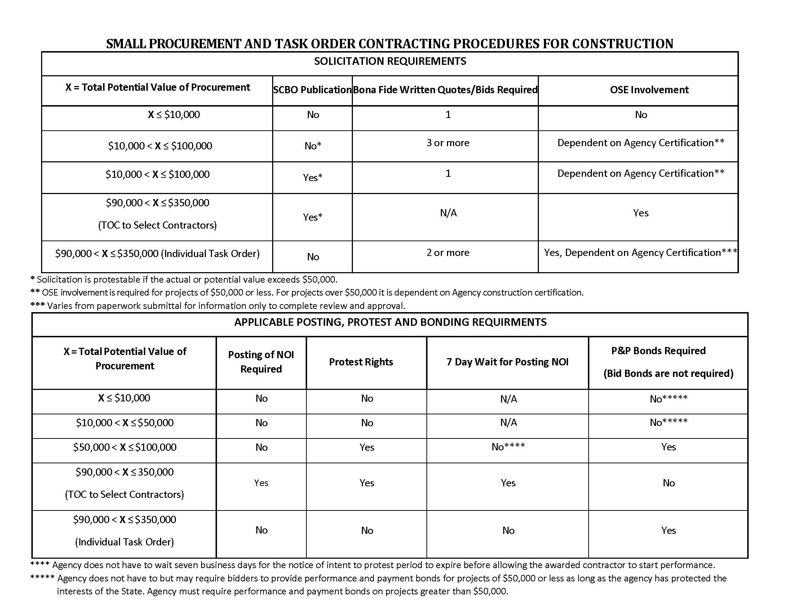

Slide 19
Contractor License Group Limitations

Slide 20

So, Where Do We Start?
???
3 Quotes
TOC
SCBO
Open Bid
OSE

Slide 21
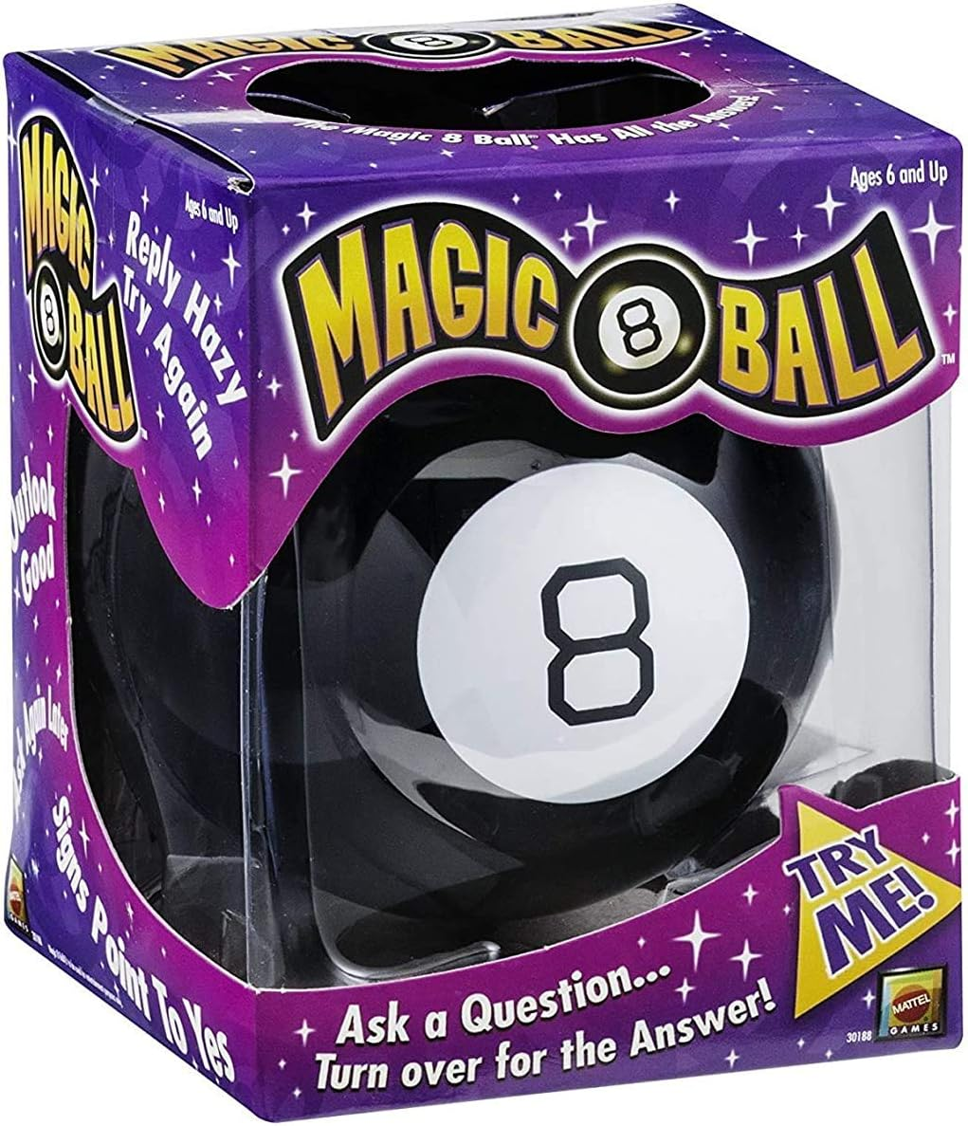
Or Maybe?

Slide 22
Project Planning
Do we have a cost estimate?
Is there a state term contract for this type of work?
Do we need to hire an A/E or can we prepare the procurement documents in house
Is a Contractor’s license required for this type of work?
How much of this type of work req.?

Slide 23
Do We Need to Hire an A/E?
Engineers
SECTION 40-22-280. Exceptions from application of chapter.
(B) If drawings and specifications are signed by the authors with the true title of their occupations, this chapter does not apply to the preparation of plans and specifications for:
(1) farm buildings not designed or used for human occupancy;
(2) buildings and structures less than three stories high and less than five thousand square feet in area, except that buildings and structures classified as assembly, educational, high hazard, institutional, or uses as defined by the International Code Series, as adopted by the State of South Carolina, regardless of size or area, are not exempt from the provisions of this chapter;
(4) alterations to a building to which this chapter does not apply, if the alterations do not result in a change which would otherwise place the building under the application of this chapter.
Architects Section 40-3-290 (C)(1), (2) & (4) read almost exactly the same.

Slide 24
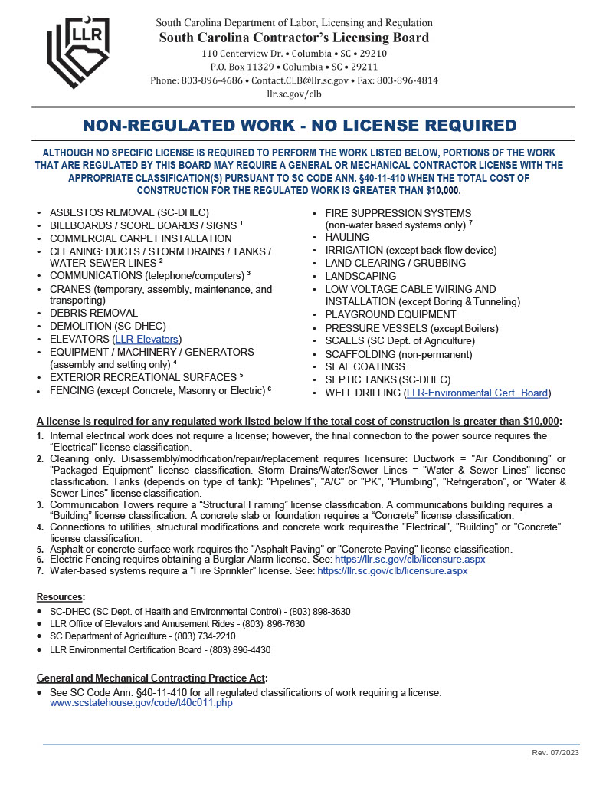
Contractor’s License Required ?

Slide 25
Purchases Under
$10,000
No contractor’s license required
Only one (1) quote required
No protest rights
Agency should distribute these purchases equitably among contractors (Great opportunity to use small and minority.)
Annotate the purchase requisition with the words “Price is fair and reasonable” and sign it.
No OSE involvement required

Slide 26
Purchases
< $50,000
Contractor’s License GC Group 1 or MC Group 1 (if <$35K) or Group 2
Three (3) quotes or one (1) bid (SCBO)
No protest rights
No P&P bonds required if interest of the State is protected
No posting of NOI required
Agency should distribute these purchases equitably among contractors (Great opportunity to use small and minority.)
Can use SE-311 and Minor Const. Project Manual, but not required
No OSE involvement required

Slide 27
Purchases
$0 < $100K
Contractor’s License GC Group 1 or MC Groups 2
Three (3) quotes or One (1) bid (SCBO)
Protest rights apply if over $50K
P&P bonds required if over $50K
Agency should distribute these purchases equitably among contractors
SE-311 and Minor Const. Project Manual
Create bid/quote tab & post SE-375, NOI, if over $50K
OSE involvement depends on certification

Slide 28
TOC – Two Part Process, Part One Contractor Selection
OSE involvement required
Competitive Sealed Proposals
Have to award four (4) contracts (by geographical area) for each license cat.
Three (3) year term with two (2) automatic one (1) year extensions
SCBO ad required
Protest rights apply

Slide 29
TOC – Task Orders, Delivery Orders
Limitations
Sum of all Task Order issued under a single TOC may not exceed $4,000,000.
The minimum amount is $90,000
The maximum amount is $350,000
Total cost of a single construction project performed using multiple TO or TO in combination with other contracts (not small) may not exceed $500,000.
Projects may not be divided artificially to avoid these limits.

Slide 30
TOC – Task Orders, Part Two Delivery Orders
$90K-$350K
OSE must review quote documents if not within agency certification
Must solicit quotes from all four (4) contractors
Must receive two (2) bona fide quotes
P&P bonds required
No protest rights

Slide 31

Open Bidding
$100,000 - Infinity and Beyond

Slide 32
Test Your Understanding
You receive three bona fide quotes for a $75K project, you need to create a quote tab and post a NOI?
A. True
B. False

Slide 33
Test Your Understanding
You receive three quotes on a Task Order Delivery Order
1. $88,654
2. $97,234
3. $101,777
You can award the contract to the $97,234 quote?
A. True
B. False

Slide 34
Test Your Understanding
You receive three (3) bids on a project advertised in SCBO using a SE-311
1. $108,654
2. $107,234
3. $101,777
You can award the contract to the $101,777 bid?
A. True
B. False
C. Depends on the OSE PM

Slide 35

Questions?

Slide 36
Thank you

