Slide 1

Know Your A/E Contract
(AIA B101, SCOSE version)
2023 Facilities Directors Conference
Phil Gerald, PE
Deputy State Engineer
Office of State Engineer

Slide 2
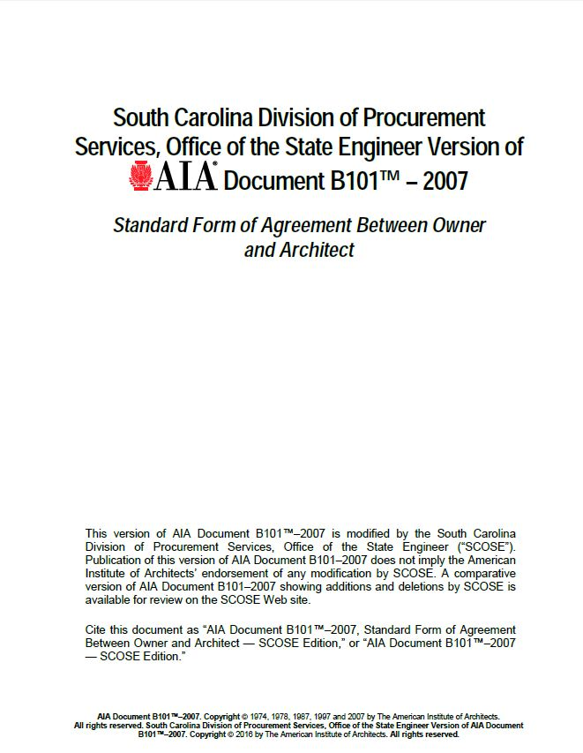
Agreement between the Owner and the Architect/Engineer
Agreement is tailored to fit all projects

Slide 3

Highlighters Ready!!?

Slide 4
Article 1, Initial Information
§1.1 Agreement is based on Initial Information
  .1 Physical Characteristics
  .2 Owner’s anticipated scheduling information
  .3 Owner’s budget for the Cost of the Work (6.1)
  .4 Design & Construction milestones
  .6 Owner’s sustainable objective
  .1 AIA E204-2017, Sustainable Projects Exhibit

Slide 5
Article 1, Initial Information
§1.1 Agreement is based on Initial Information
  .7 Owner’s representative
  .9 Owner’s consultants/contractors
  .10 Architect’s representative (§2.3 change only with written consent of Owner)
  .11 Architect’s consultants (§2.3.1 change only with written consent of Owner)
  .1 Consultants for Basic Services
  .2 Consultants for Supplemental Services

Slide 6
Article 2, Architect’s Responsibilities
§2.1 provide professional services….A/E and its consultants are properly licensed
§2.5 Insurance Coverages
  .1 Commercial General Liability ($1mil/occur)
  .2 Automobile Liability ($1mil/accident)
  .4 Worker’s Compensation (per statutory limits)
  .5 Employers Liability ($1mil/accident)

Slide 7
Article 2, Architect’s Responsibilities
§2.5 Insurance Coverages (cont’d)
  .6 Professional Liability (correct amount?)
  .8 Architect consultants are required to comply, unless…

Slide 8
Article 3, Architect’s Basic Services
§3.1 …include customary civil, structural, mechanical, fire protection, and electrical…
  .1 Architect is responsible to coordinate all services by its employees and consultants
  .3 Within 15 days of Agreement execution, submit performance schedule
  .5 Architect shall contact governmental authorities
  .6 filing documents for government approvals

Slide 9
Article 3, Architect’s Basic Services
§3.1 (cont’d)
  .7 comply with the requirements of Chapter 5 in the Manual
  .9 shall prepare and distribute…
  .10 work to be divided into two Phases?
  .11 “reasonable time” or “reasonable promptness” is understood to mean no more than 10 days

Slide 10
Article 3, Architect’s Basic Services
§3.2 Schematic Design Phase
  .2 evaluate owner’s program, schedule, budget, etc. and notify
  .5 based on Owner’s approval, prepare Schematic Design
  .6 estimate the Cost of the Work

Slide 11

Are you awake?

Slide 12
Article 3, Architect’s Basic Services
§3.3 Design Development Phase
  .1 based on Owner’s approval of the Schematic, OSE comments, adjustments, and Cost, prepare Design Development
  .2 update the estimate of the Cost of the Work

Slide 13
Article 3, Architect’s Basic Services
§3.4 Construction Documents Phase
  .1 based on Owner’s approval of the Design Development, OSE comments, adjustments, and Cost, prepare Design Development
  .3 compile a Project Manual
  .4 update the estimate of the Cost of the Work
  .7 specifications to permit maximum practicable competition. The use of a brand name is for the purpose….

Slide 14
Article 3, Architect’s Basic Services
§3.5 Procurement Phase
  .1 a list of prospective bidders
  .2.1 OSE and Owner get the same Bid Documents a contractors
  .2.2 assist in Bidding
  .2.3 consider substitutions, prepare and distribute addenda

Slide 15
Article 3, Architect’s Basic Services
§3.6 Construction Phase
  .1.2 act on the behalf of the Owner only to…
  .1.3 services begin with award, and end 21 days after issuing final certificate of payment
  .2.1 visit the site
  (1) familiar with progress and quality
  (2) inform and guard Owner
  (3) work will be in accordance with documents
  (4) at least once a month

Slide 16
Article 3, Architect’s Basic Services
§3.6 (cont’d)
  .2.1.1 visits by Architect and consultants
  .3.1 represent to Owner that amounts due based on evaluation
  .4.1 review & respond to submittals with reasonable promptness
  .4.4 review & respond to RFI’s with reasonable promptness

Slide 17
Article 3, Architect’s Basic Services
§3.6 (cont’d)
  .5.1 minor changes in the Work and prepare Change Orders and Change directives
  .6.1 Substantial Completion (1) & final completion (1)
  .6.5 inspect project after 10th month and prepare a report

Slide 18
Article 4, Supplemental & Additional Services
§4.1 Supplemental
  Table: determine if services are required and which party is responsible
  §4.2 Additional
  A/E may provide after execution of the Agreement
  .3 # of site visits, # of Substantial, # of Final
  .4 services more than 60 days after Substantial

Slide 19
Article 5, Owner’s Responsibility
§5.2 Establish Budget
  Cost of the Work
  Other costs
  Contingencies
  .1 review documents and written approval

Slide 20
Article 5, Owner’s Responsibility
§5.4 furnish surveys
§5.5 furnish geotechnical
§5.12 include architect in all communications with contractor
§5.16 “reasonable time” or “reasonable promptness” is understood to mean no more than 10 days

Slide 21

Wake up, I’m almost finished!

Slide 22
Article 6, Cost of the Work
§6.1 total cost to construct… does not include…
§6.3 A/E may recommend alternatives to meet Owner’s budget
§6.6 Lowest bid exceeds budget
.1 increase budget and award (*)
.2 cancel invitation and rebid (90 days?) (*)
.4 cancel Bid, revise and rebid
.5 negotiate per SC Code §11-35-3020(d) (*)

Slide 23
Article 8, Claims and Disputes
§8.1.1 all disputes, claims, or controversies resolved by Chief Procurement Officer (Title 11, Chapter 35, Article 17)
§8.2.2 parties endeavor to resolve… or Mediation
§8.5 despite resolution, A/E to proceed with performance of services

Slide 24
Article 9, Termination or Suspension
§9.1 Owner fails to pay – suspension of service
§9.2 Owner suspends project – compensate for services prior to notice. If suspension exceeds 90 days – equitable adjust fees and schedule
§9.3 A/E terminate Agreement with 14 days
§9.4 Either party terminate Agreement with 21 days
§9.5 Owner terminate Agreement for convenience or cause with 21 days

Slide 25
Article 10, Miscellaneous
§10.3 Contract is not transferrable without…
§10.14 A/E’s records and documents
§10.15 Owner can audit books and records up to 3 years from final payment

Slide 26
Article 11, Compensation
§11.1 Basic services
§11.2 Supplemental services
§11.3 Additional Services
§11.4 Total Compensation for Phase I and II
§11.8 Reimbursables
.2 markup <10%
.3 transportation & subsistence

Slide 27
Article 11, Compensation
§11.10 Payments to Architect
.2.1 interest of 1%
.2.2 can’t withhold compensation to impose a penalty

Slide 28

B101 SCOSE Version

