Slide 1

Job Order Contracting (JOC)
2023 Facility Directors Conference
Phil Gerald, PE
Deputy State Engineer
Office of State Engineer

Slide 2
OH NO!!! Not another construction delivery method!!

Slide 3

Job Order Contracting - History
1982 – Harry Mellon (LtC, Army) creates JOC to simplify and expedite construction procurement process
1990 – Mellon founded Gordian
2014 – Gordian acquires RS Means (cost database)
2015 – Gordian acquires Sightlines (facilities intelligence solutions to improve planning
2017 – Gordian acquires 4Clicks (cost estimating & project management solutions)
2018 – Gordian acquires Fortive (connective workflows, real-time data and analytics)
2021 – Gordian acquires VFA and Kykloud (assessment and capital planning solutions)

Slide 4
Job Order Contracting
Annually (worldwide)
Complete >$3.2B of construction volume
Develop >165,000 construction project estimates
Collect and Analyze >1.65B gross sq. ft. of facilities data
Execute 30,000 construction projects

Slide 5
What type of Projects is JOC used?
New Construction
Repairs
Renovations
Replacement-in-kind
Maintenance
Emergency work
Alterations

Slide 6
Job Order Contracting - Definition
1. Indefinite delivery/indefinite quantity process (IDIQ)
2. Enables facility owners to complete a substantial number of individual projects with a single, competitively-awarded bid
3. Construction Tasks are based on preset costs in a Unit Price Book (UPB)
4. Contractors bid an Adjustment Factor to be applied to a UPB, resulting in on-call, competitively bid and awarded contractors that are available to perform work at agreed upon prices

Slide 7
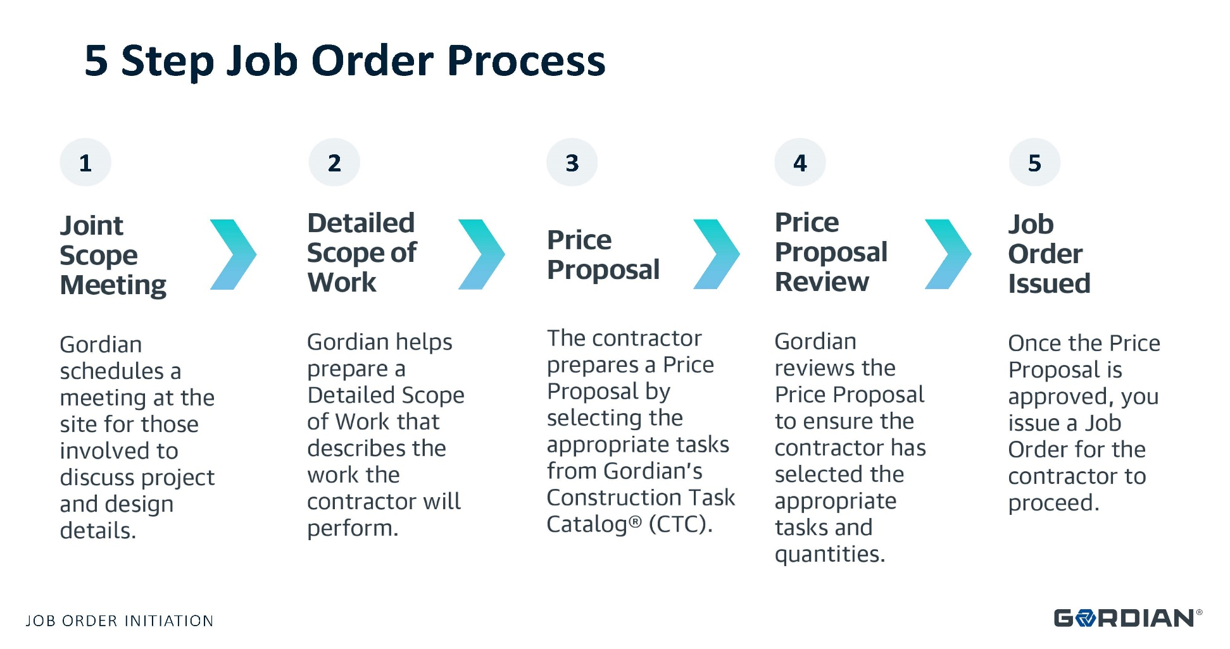
Job Order Contracting - Process

Slide 8
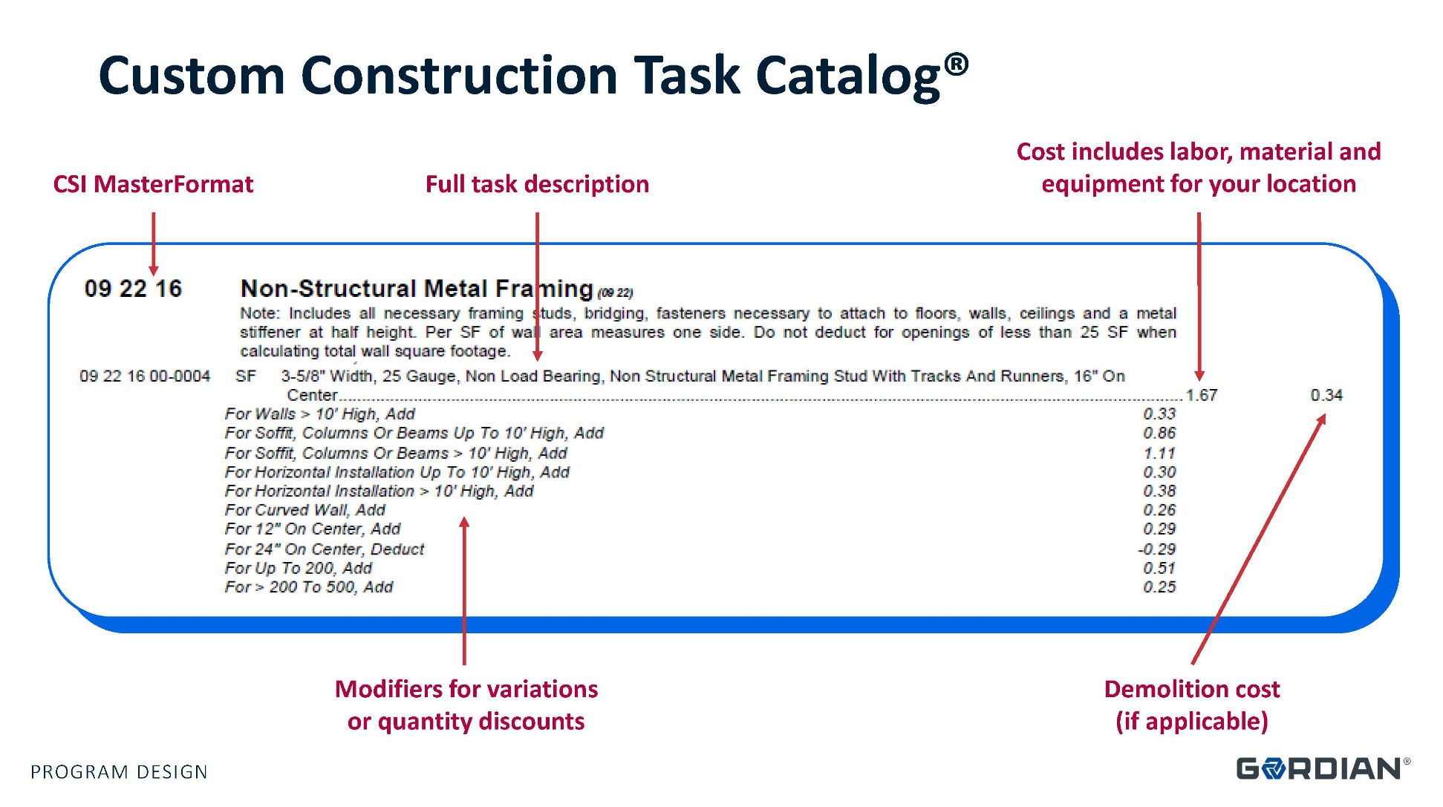
Job Order Contracting – Task Catalog

Slide 9
JOC – Bid Adjustment Factor
An Adjustment Factor is a multiplier applied to the construction tasks that may increase or decrease the prices listed in the UPB.
Contractors may bid multiple Adjustment Factors (normal working hours, other than normal working hours, etc.) that are applied to all Tasks in the UPB.
Adjustment Factors should include all direct and indirect costs not included in the preset prices, and the contractor’s overhead and profit.

Slide 10
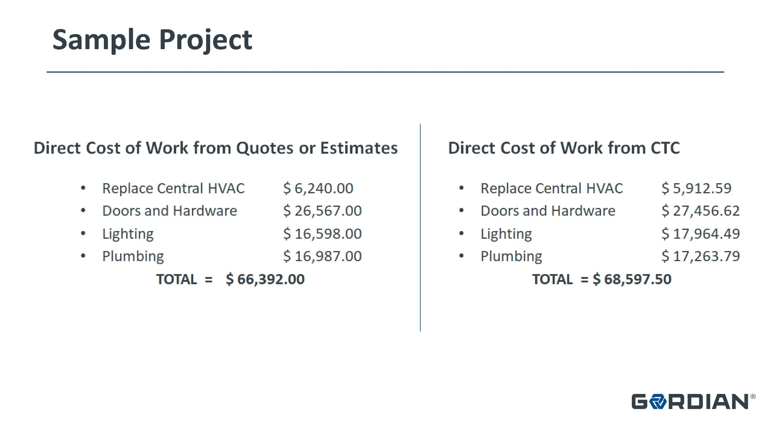
JOC – Determining the Factor

Slide 11
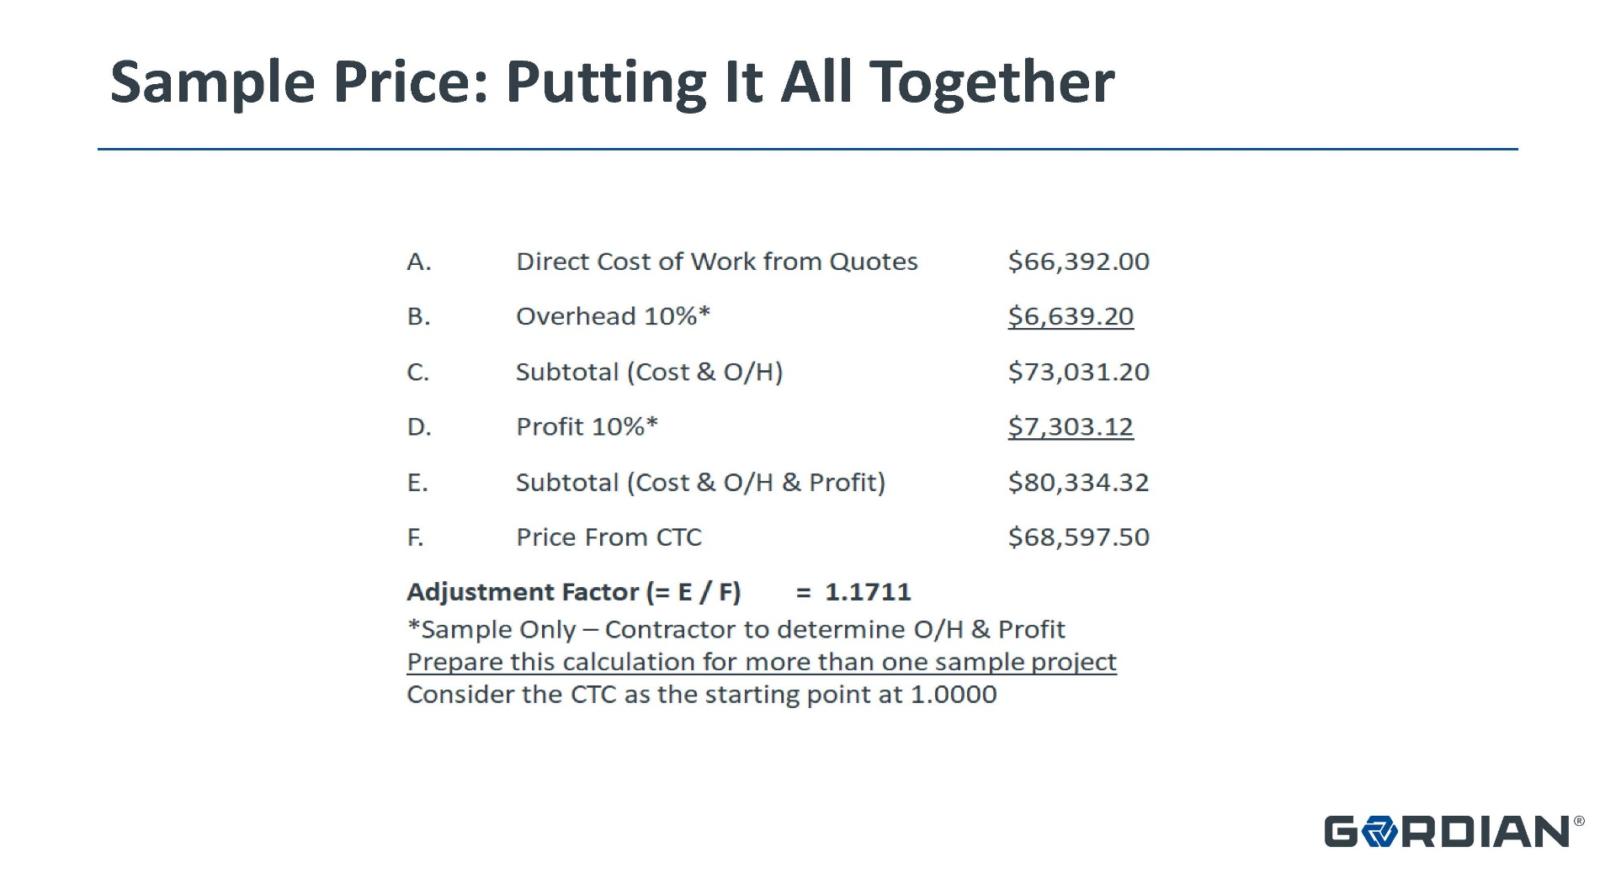
JOC – Determining the Factor (cont’d)

Slide 12
Job Order Contracting
How does Gordian make money?
  They offer three services:
  UPB usage fee per individual Job Order – 2.7%
  Item #1 plus review each Job Order for UPB compliance, project scope, and quantity verification – 3.7%
  Item #1 and 2 plus Gordian performs Construction Management – 5.75%
  Gordian fee is added to the adjustment factor

Slide 13
JOC – How did SC get here?
July 2022 – Proviso 117.167
  SFAA to create a pilot program for two years
  Two state agencies & four school districts
  Job Order Contracts with up to four businesses for each governmental unit (GU) for each licensing classification of sub-classification
  Individual Job Orders < $500,000
  Total Job Orders/contractor/GU < $4,000,000
  Contractors use an adjustment factor against a UPB

Slide 14
JOC – How did SC get here?
Pilot Program Governmental Units
  Univ of South Carolina
  Clemson University
  Horry County School District
  Charleston County School District
  Colleton County School District
  Lexington County 1 School Disitrict

Slide 15
JOC – How did SC get here?
Two Procurements:
  UPB provider
  Contractors
    General Contractor (min. BD3)
    Fire Sprinkler
    Specialty Roofing (min. SR3)
    Electrical (min. EL5)
    Plumbing (min. PB5)
    HVAC (min. HT5/AC5)

Slide 16
SC Job Order Contracting
UPB Provider
  UPB to be relevant to SC prices
  UPB to be electronic (accessible by GU and Contractors)
  UPB to contain materials, labor, and equipment
  UPB to be updated semi-annually
  The non-prepriced items not contained in the UPB cannot exceed 10% of construction cost

Slide 17
SC Job Order Contracting
Contractors
  33 firms requested bid packages (none from Fire Sprinkler)
  2 dropped out prior to bid
  1 failed to submit a bid (SCEIS)
  15 decided not to bid
  1 did not have competition (ineligible to bid)
  14 qualified firms submitted adjustment factors

Slide 18
SC Job Order Contracting
Contractors
  8 - General Contractors
  0 - Fire Sprinkler
  3 - Specialty Roofing (min. SR3)
  0 - Electrical (min. EL5)
  2 - Plumbing (min. PB5)
  3 - HVAC (min. HT5/AC5)

Slide 19
SC Job Order Contracting - Process
Owner provides construction documents to “a” Contractor for pricing
Contractor reviews documents, visits site, submits questions, etc.
Contractor utilizes UPB to create estimate
GU decides Gordian involvement (%)
Contractor submits estimate to GU

Slide 20
SC Job Order Contracting - Process
GU receives and/or issues:
  Payment & Performance Bonds
  Certificates of Insurance
  Notice to Proceed
  Building Permit
  Inspection Services
  Substantial Completion/Certificate of Occupancy
  Final Completion

Slide 21
SC Job Order Contracting
How is it working?
  Owners
  Contractors
  Gordian
Will it become law?
Questions?

