Slide 1
DESIGN-BUILD
When is it Best Used?
Facilities Directors Conference
Hickory Knob State Park
2017

Slide 2
DB Includes:
Design-Build-Operate-Maintain (DBOM)
Design-Build-Finance-Operate-Maintain (DBFOM)
Guaranteed Energy, Water, and Wastewater Savings Projects

Slide 3
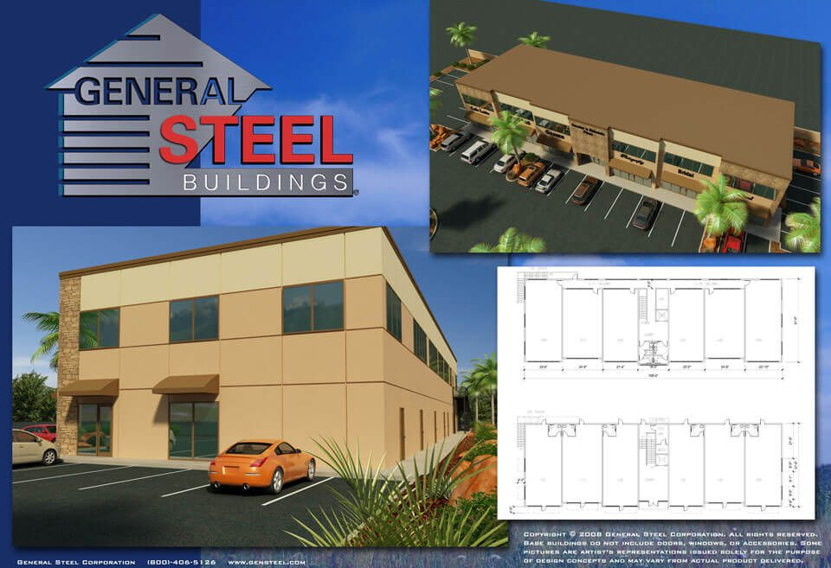
“IF YOU NEED A NEW BUILDING – CALL THE GENERAL”

Slide 4
So, what Exactly is DB and What are some Advantages and Disadvantages?

Slide 5
Definitions*
DB is a project delivery method where an Agency enters into a single contract for design and construction.
* See §§ 11-35-2910 (7) – (14)

Slide 6
Definitions
Design Requirements
Independent Peer Reviewer Services
Infrastructure Facility
Proposal Development Documents
Prequalification – RFQ
Short listing – RFP
  § 11-35-3024(2)(c)(ii) &
  Reg. 19-445.2145 K(1)(c)(ii)

Slide 7
Disadvantage
A single contract doesn’t have an A/E looking out for Agencies Interests

Slide 8
Advantage
With a single negotiated contract you don’t have to worry as much about not being able to complete the project within budget.

Slide 9
Disadvantage
There is no OSE DB Contract
Agency has to develop their own
Most use the EJCDC* D-520 & D-700
Must include the Clauses for Use in DB Contracts and other modifications to meet SC Laws
*Engineers Joint Contract Documents Committee

Slide 10
Advantage
Independent Peer Review Services (IPR)are required to verify the design

Slide 11
Selection Plan/RFP
Hiring an IPR, Can do One of Three Ways:
Include as part of the RFP for the DB to propose and contract with an IPR.
Hire an IPR independent of DB services
Ask OSE for Exception to Self Perform – Must have qualified personnel

Slide 12
Disadvantage
Two Part Capital Budgeting Process
Can’t do much except prepare until Phase 2 budget approval

Slide 13
Advantage
Two Part Capital Budgeting Process gives you time to prepare the:
Determination
Selection Plan
Design Requirements
Solicitation
RFQ/RFP

Slide 14
Design requirements/RFP
“Unless the Agency has the staff necessary to prepare the design requirements, it should hire a design firm to do so using one of the processes set forth in Chapter 4.”

Slide 15
Design requirements/RFP
If hiring an A/E is required to describe the Infrastructure Facility to be acquired, it may be too complicated to use DB.

Slide 16
Design requirements/RFP
“Providing the minimum design requirements necessary to describe the infrastructure facility an Agency requires will allow the offerors the maximum flexibility and creativity to meet the Agency’s needs within the budget constraints.”

Slide 17
Design Requirements
400 Bed (min.) Dormitory, suite style
One laundry room and one common room per floor
First floor to include a residence hall advisor apartment, security desk, lounge and meeting/study space.
Architectural design to meet campus standards, refer to campus design manual for this and other requirements
Budget is $X.X M
Completed by start of Fall Semester 2019
LEED Silver or Two Green Globes

Slide 18
Selection Committee
Min. 5 Voting Members for >$5 M
More is not better – It becomes more difficult to schedule meetings.
Technical Advisors are Very Important for DB to review technical portions of proposed development documents

Slide 19
Determination/Selection Plan
DB can be selected in 3 Ways:
  RFQ/RFP (Prequalification)
  RFP
  RFP w/Shortlisting
    Must specify # to be SL in RFP

Slide 20
Selection Plan/RFP
Paying Stipends
  Only paid to Prequalified or Shortlisted firms
  Conditions under which firms will be paid
  Do not have to pay stipends unless part of plan

Slide 21
Selection Plan/RFP
Proposal Development Documents
  Describe the Infrastructure Facility that the offeror is proposing to build for the contract price
  Can be drawings or descriptions – similar to Schematic Design Documents
  Don’t be swayed by fancy presentations, concentrate on the content

Slide 22
Discussions/negotiations
Must be conducted in Good Faith
Clarifications may be sought at any time
Other discussions/negotiations are ordinarily prior to final ranking
  Scope
  Cost
  Time
  BAFO
  Should be in writing/documented
  Should not be used to re-evaluate one proposal against another.
See RFP Discussions Handbook on OSE Website

Slide 23
Projects that Require Little Programming
Roads & Bridges
Parking Lot/Garage
Intramural Sports Fields
Agricultural Buildings
Mechanical Systems Replacement
Others ????

Slide 24
???

