Slide 1
Bid Opening Pitfalls (Instructions to Bidders SCOSE AIA A701)
2023 Facility Directors Conference
Hickory Knob State Park
Perry M. Derrick, PE
Project Manager
Office of State Engineer

Slide 2
Addenda
§3.4.3 Addenda will be issued at least (5) business days before the day of the Bid Opening…except…to cancel the Bid Opening or to postpone the Bid Opening
§3.4.4 Bidder to acknowledge receipt of all Addendums on the bid form

Slide 3
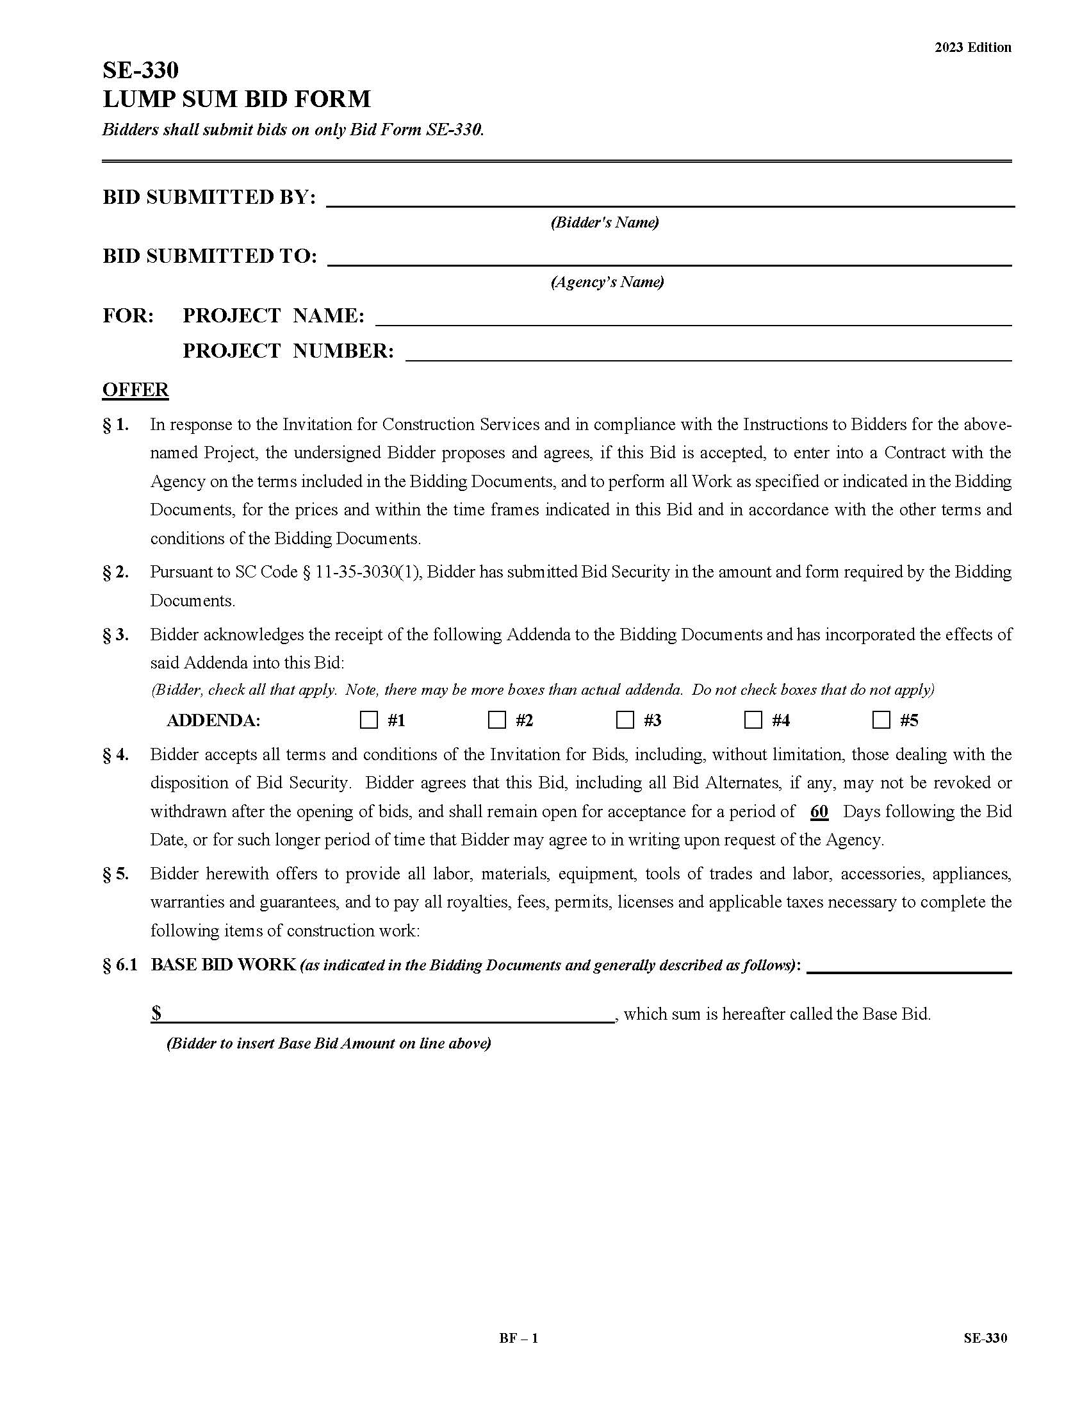

Slide 4
Alternates
§4.1.5 – All requested Alternates shall be bid. The failure to indicate a price for an Alternate shall render the Bid non-responsive.
$§$5.3.2 – The owner shall have the right to accept Alternates in any order or combination…

Slide 5
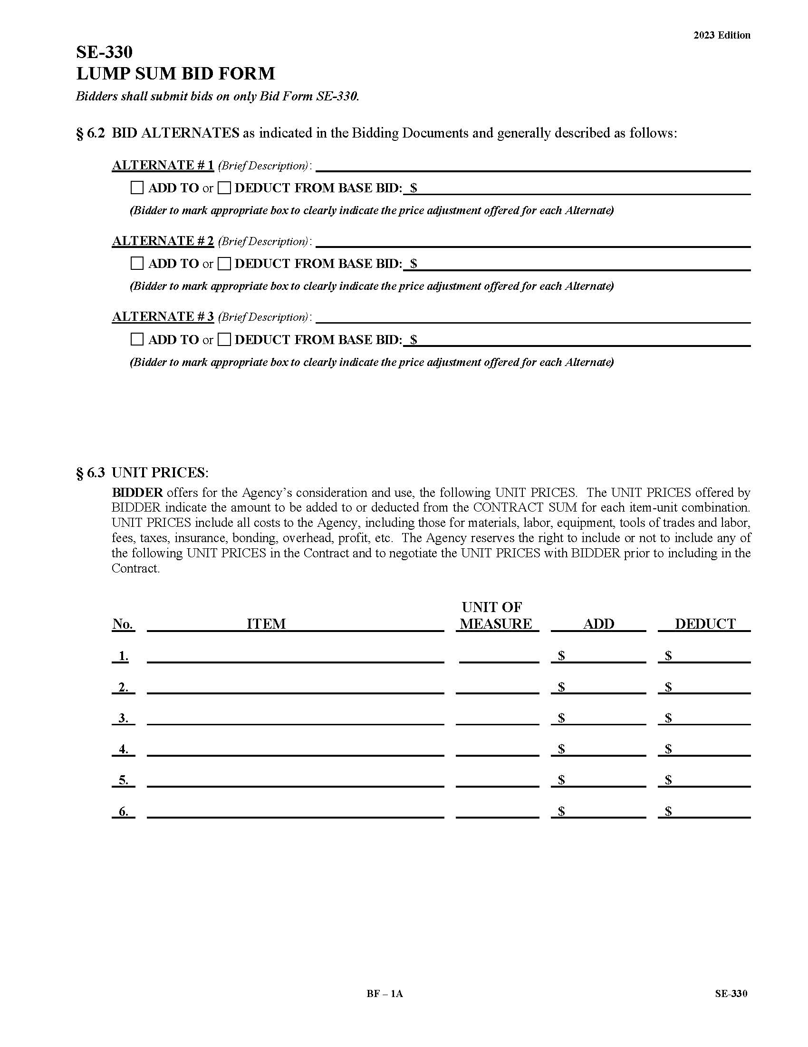

Slide 6
Subcontractor Listing
§4.1.6 – …the Bid Form sets forth a list of proposed subcontractors for which the Bidder is required to identify those subcontractors the Bidder will use to perform the work listed.
Failure to properly fill out Section 7 may result in rejection of Bidder’s bid as non-responsive.
$§$4.1.7 – Contractors and subcontractors listed in Section 7 of the Bid Form…must be licensed as required by law at the time of bidding.

Slide 7
Subcontractor Listing cont’d
OSE Manual – 5.18.2
5.18.2 A.
1. The Agency, in consultation with the project architect/engineer, must identify by license classification or subclassification the Subcontractors:
b. Whose subcontracts are expected to exceed three percent (3%) of the prime Contractor’s total base bid. Subcontractor listings for alternates are only required when the subcontracts are expected to exceed 3% of the total base bid, not 3% of the alternate.

Slide 8
Subcontractor Listing cont’d
OSE Manual – 5.18.2
5.18.2 A.
4. The Agency’s determination of which Subcontractors to list in the invitation for bids is not protestable.
5.A Bidder’s listing of Subcontractors in response to the Invitation for Bids is protestable.

Slide 9
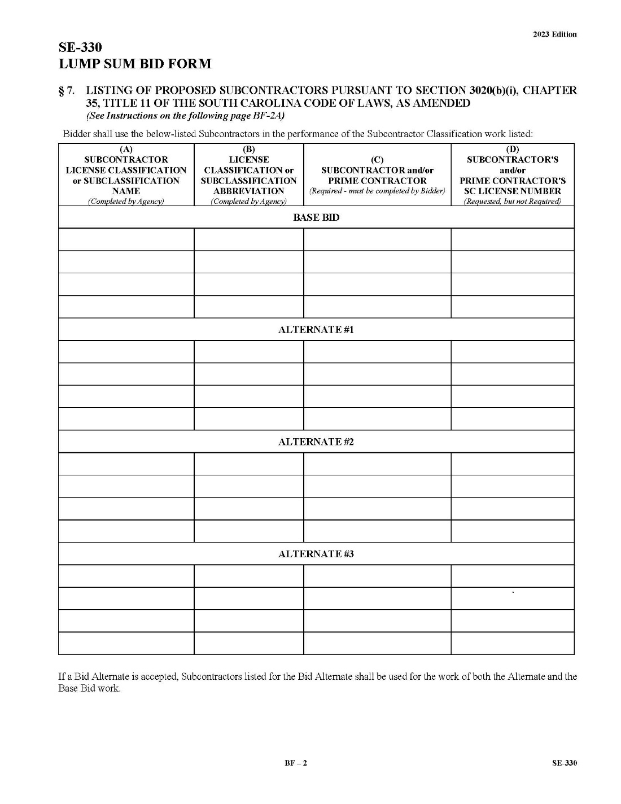
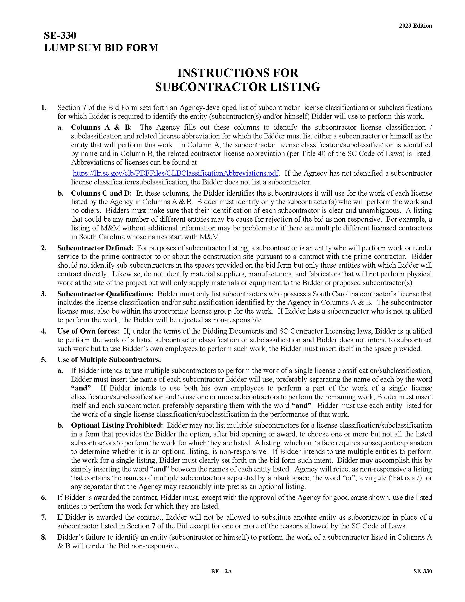

Slide 10
At Bid Opening
Bids to be opened publicly and read aloud
Announce
Bidder’s name
Amount of Base Bid
Acknowledge each Addendum
Amount of each Alternate
If bid bond is present
Name of each subcontractor listed in the subcontractor listing
Place and proposed time of Intent to Award Posting

Slide 11
At Bid Opening cont’d
“Thank you for submitting a bid.”
The end….no announcing the low bidder, no conversations with the prospective low bidder or other bidders.

Slide 12
Some Reasons for a Bid Rejection
§ 5.2.2
Bidder was not present at a mandatory pre-bid
Bidder did not deliver the Bid on time
Bidder did not comply with Bid Security requirements
Listing an invalid electronic Bid Bond
Failure to Bid an Alternate (unless expressly allowed by law)
Failure to list subcontractor(s)
Bidder qualifies his bid – includes modifying the bid or project scope requirements
Faxing a bid
Failure to include an executed Power-of-Attorney

Slide 13
Some Minor Informalities (Not Reasons for a Bid Rejection)
OSE Manual § 6.10.2
Failure to write “Sealed Bid Enclosed” on the outside of the bid envelope
Failure to seal the bid envelope
Failure to indicate for an alternate “ADD” or “DEDUCT”, but only when the adjustment to the bid is obvious
Failure to include unit prices on the bid when requested
Bidder provided additional listings of subcontractors beyond those requested
Failure to sign the bid, provided other material indicting the Bidder’s intent to be bound by the unsigned document

Slide 14
After Bid Opening
Owner to make a determination of Bidder’s responsibility before award a contract
Determine if the Bidder and listed subcontractor(s) are properly licensed with SC Labor, Licensing and Regulation
Verify Credit Rating of surety company (‘A’ rating or better)
Verify surety company is licensed to do business in SC
Bid Bond is provided on AIA Document A310 or provides the same protection to the owner

Slide 15
After Bid Opening cont’d
Verify if the Bidder has been disbarred in SC (at the present time, no building contractor is disbarred in SC)
Send the OSE project manager Bid Tabulation, Apparent low Bid, Bid Bond, Power of Attorney, Bidder’s and subcontractors’ licenses and Request for Concurrence in Posting Notice of Intent to Award (SE-360)

Slide 16
After Bid Opening cont’d
After the OSE Project Manager approves the SE-360…
Send each Bidder a copy of the Bid Tabulation along with the signed Notice of Intent to Award (SE-370) within (10) days of the Bid Opening
Post the SE-370 in the location specified at the Bid Opening

Slide 17
Bid Example #1

Slide 18
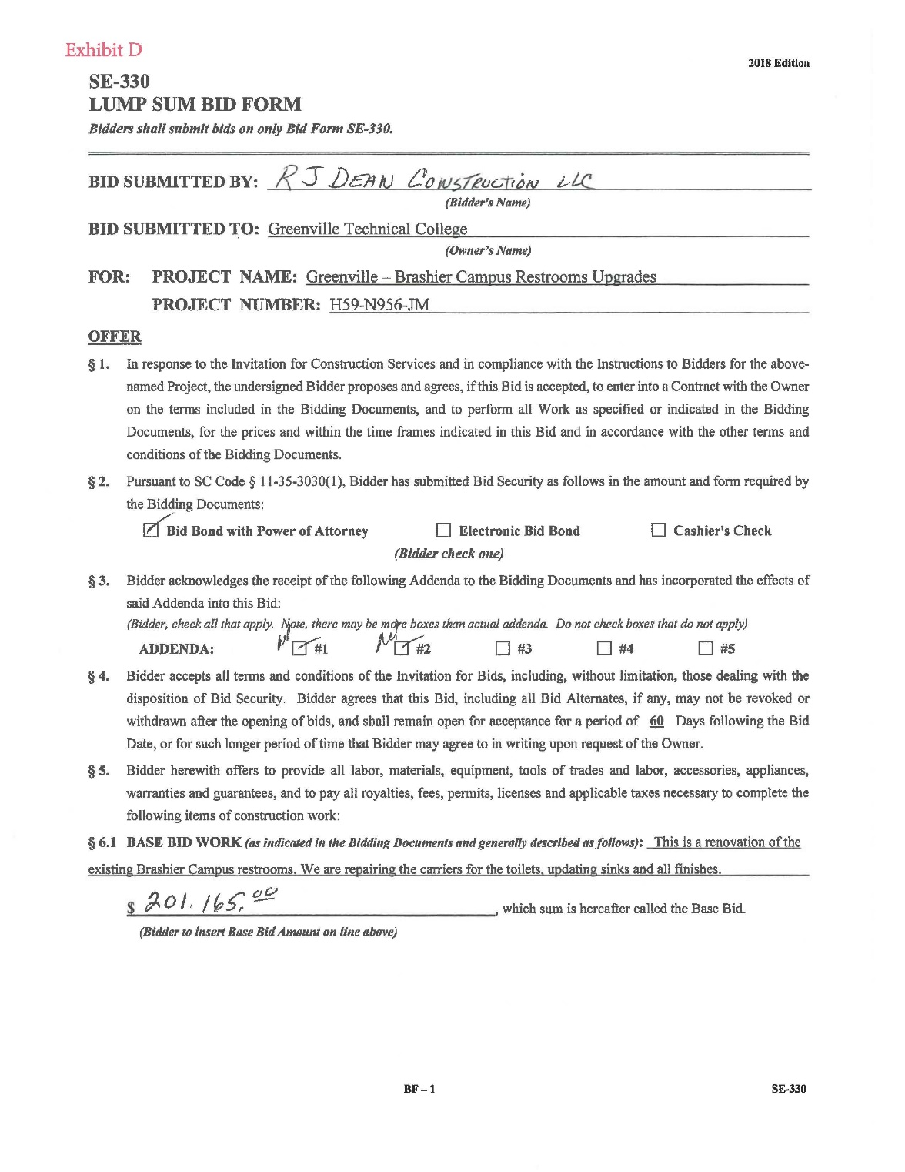
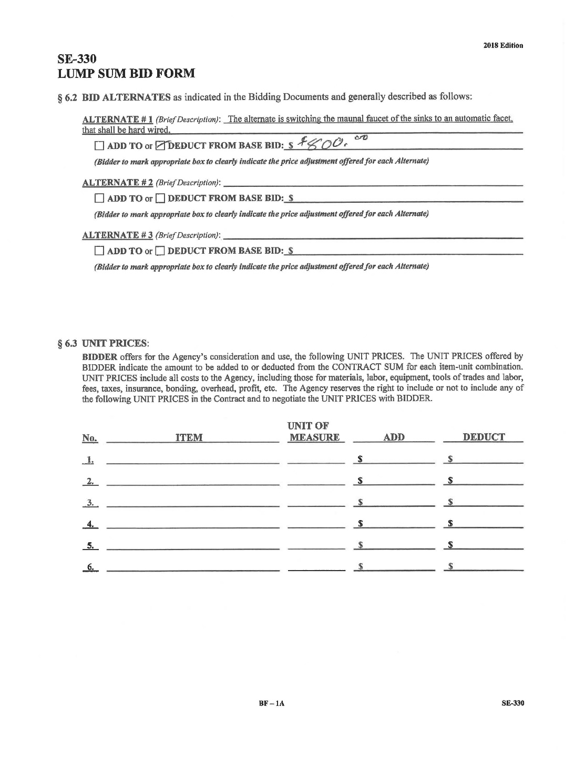

Slide 19
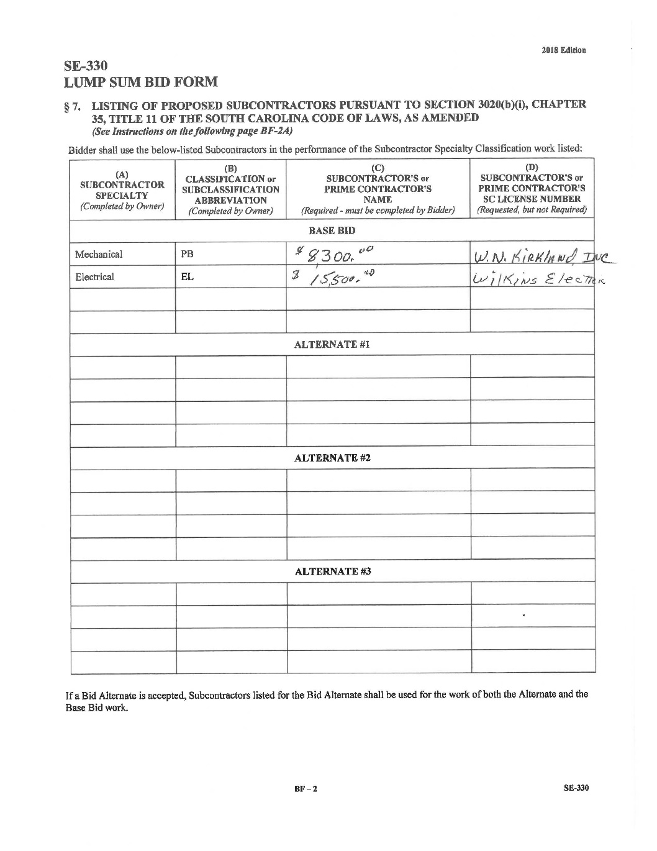
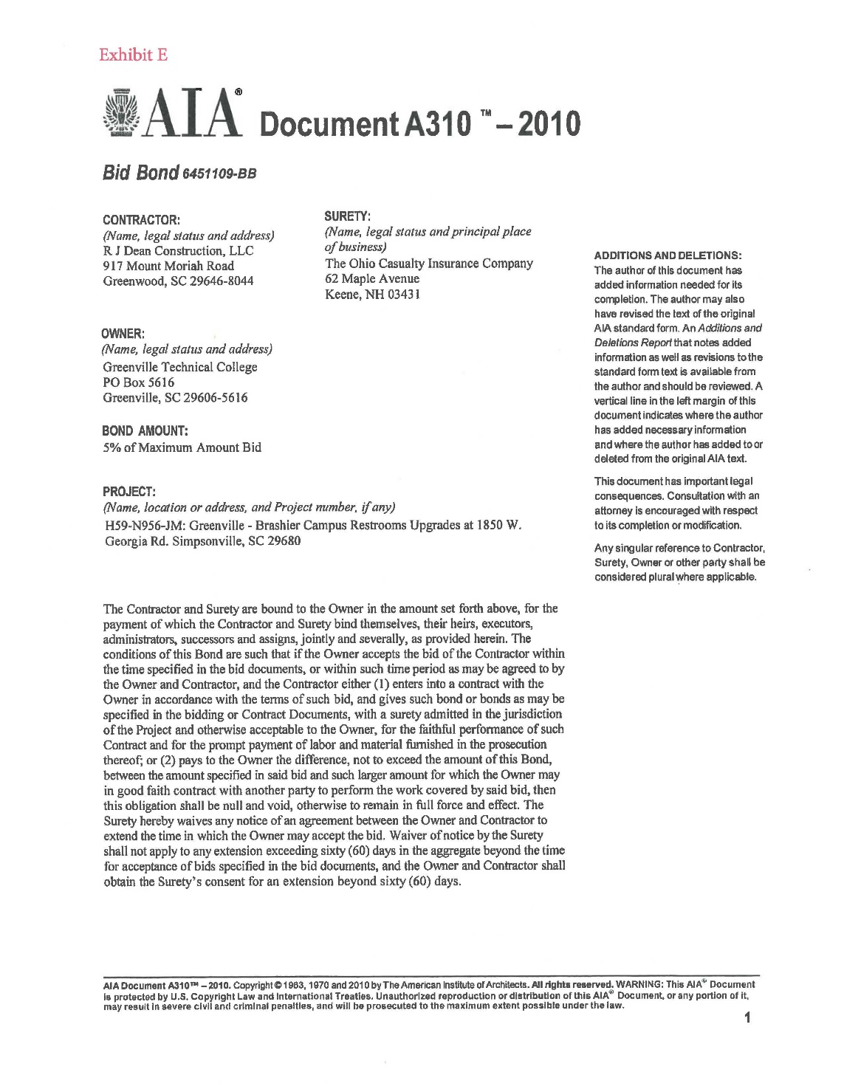

Slide 20
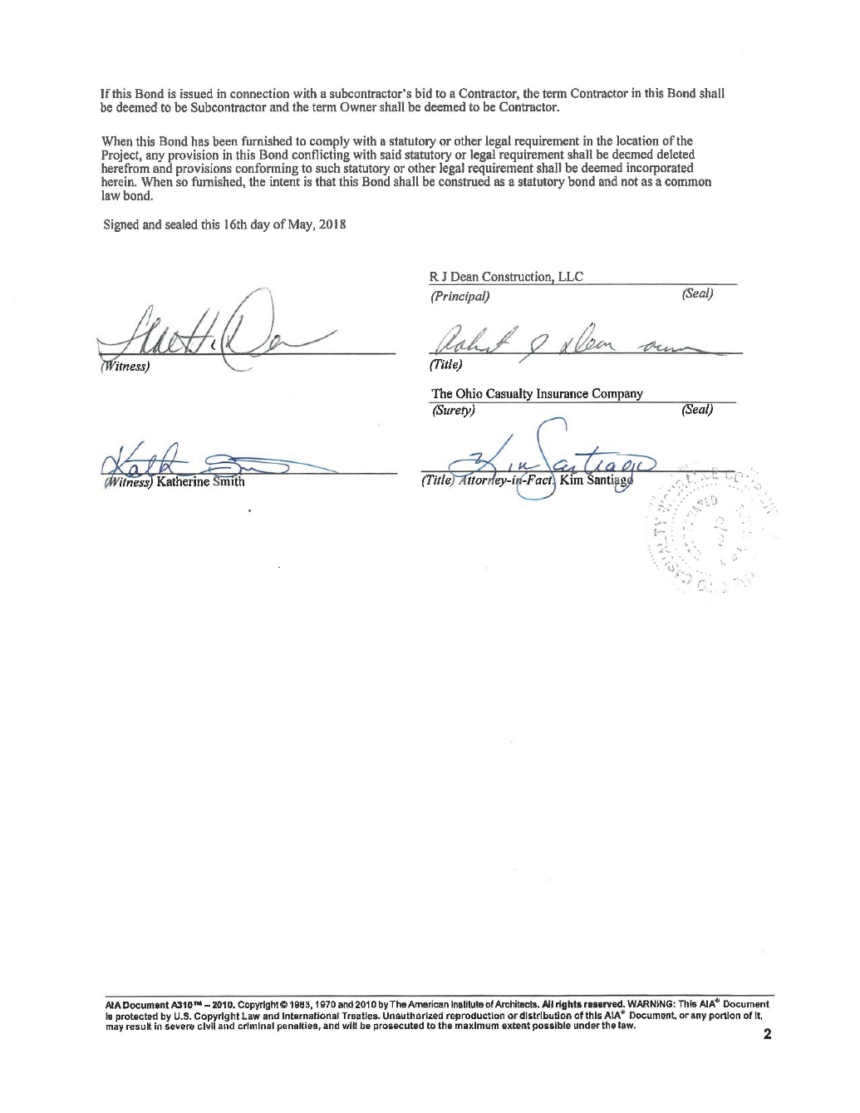
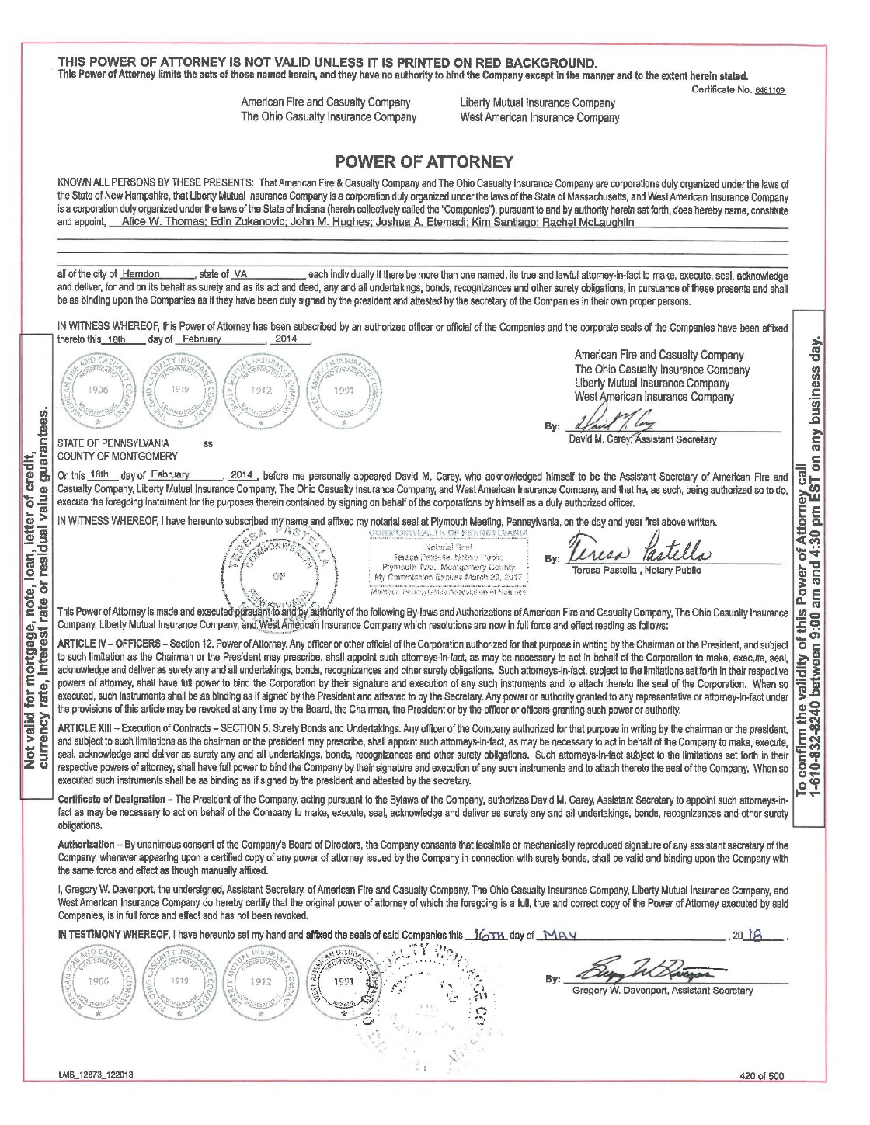

Slide 21
Bid Example #2

Slide 22
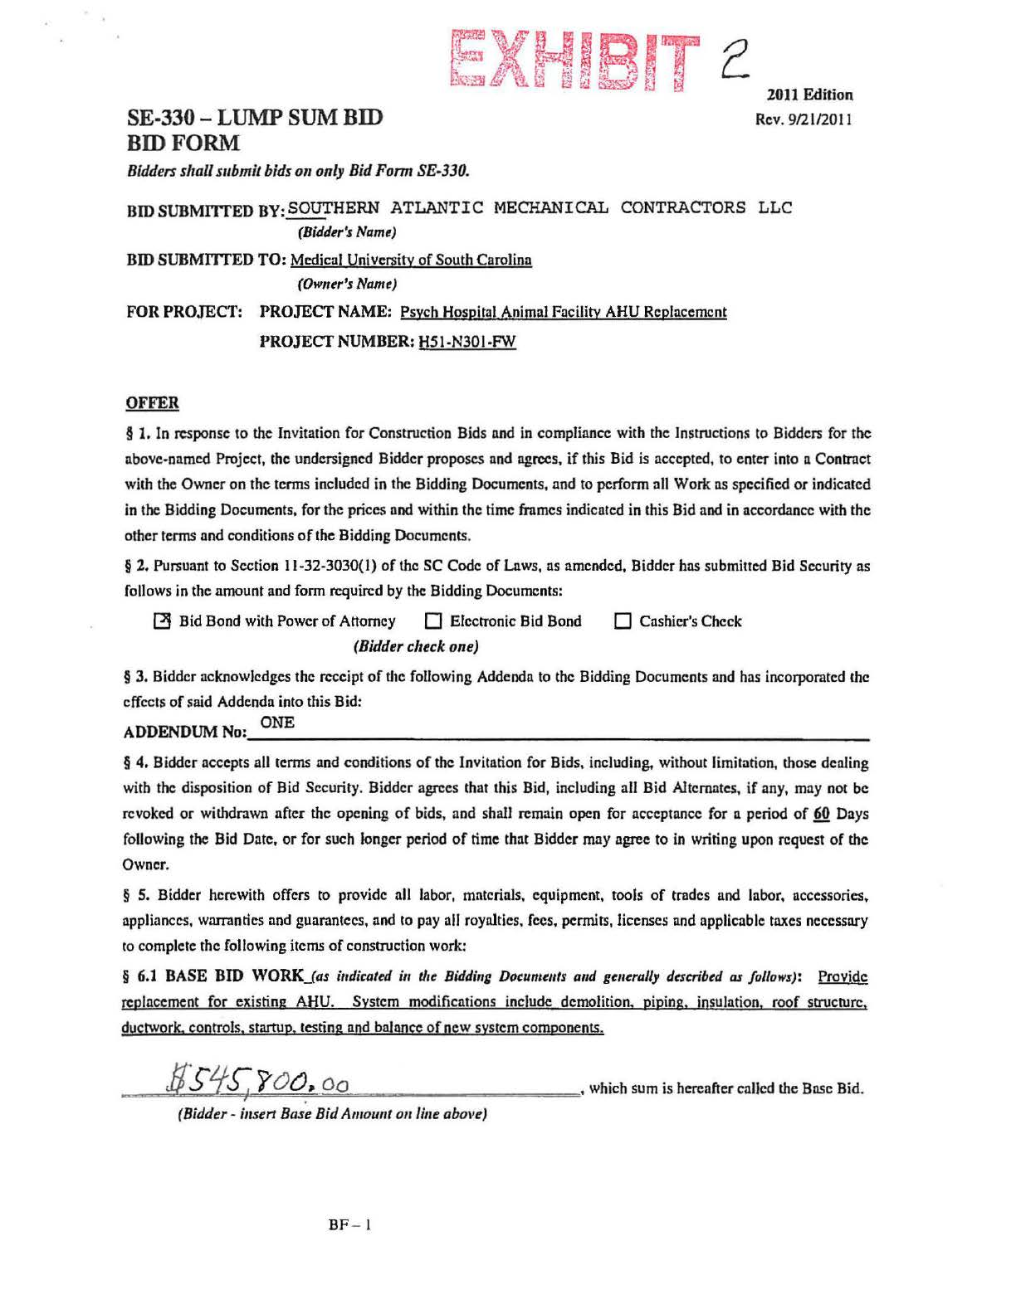
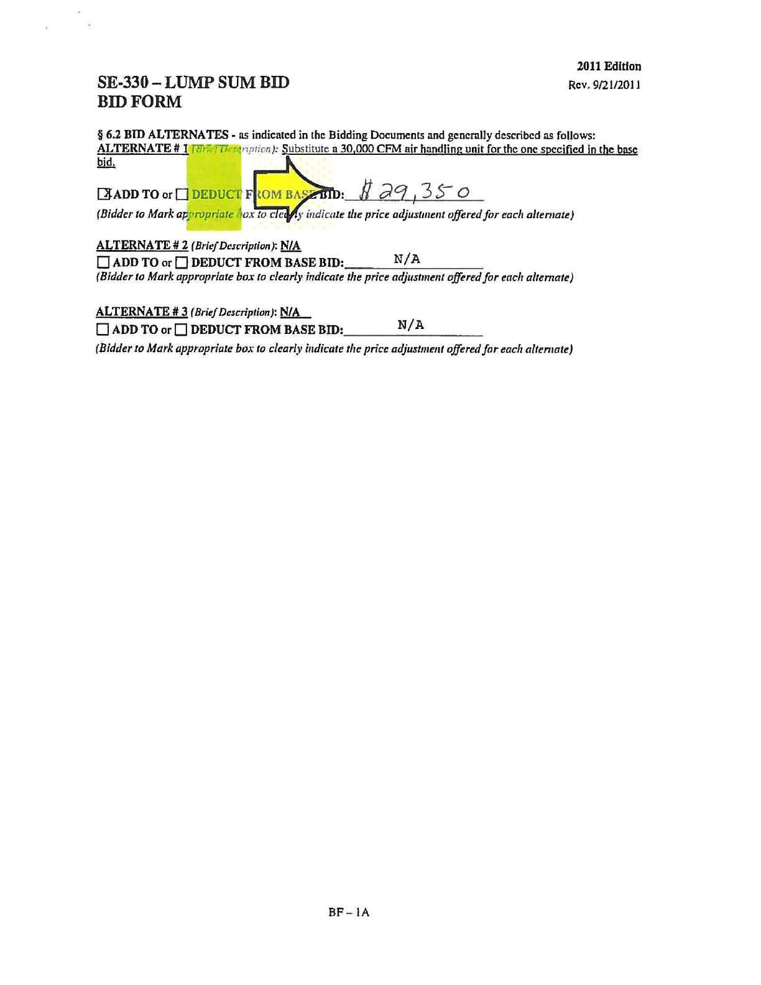

Slide 23
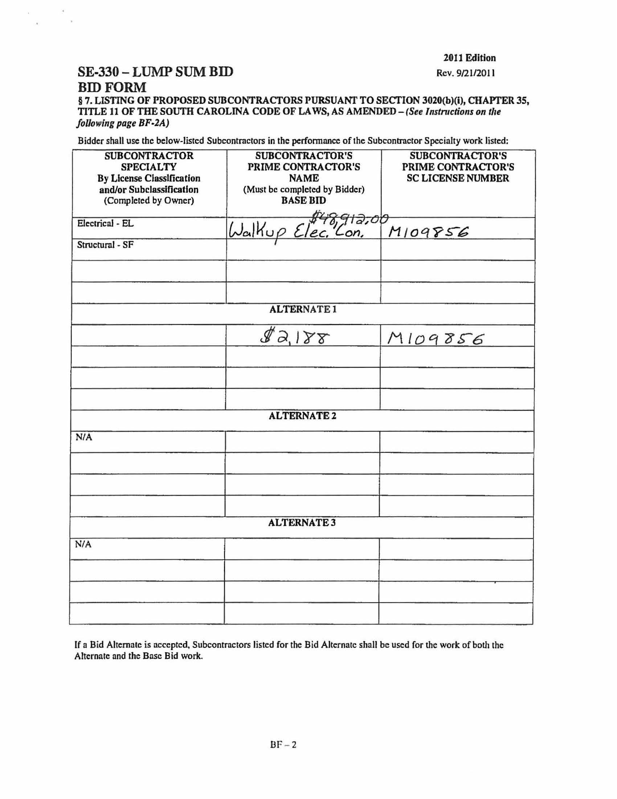
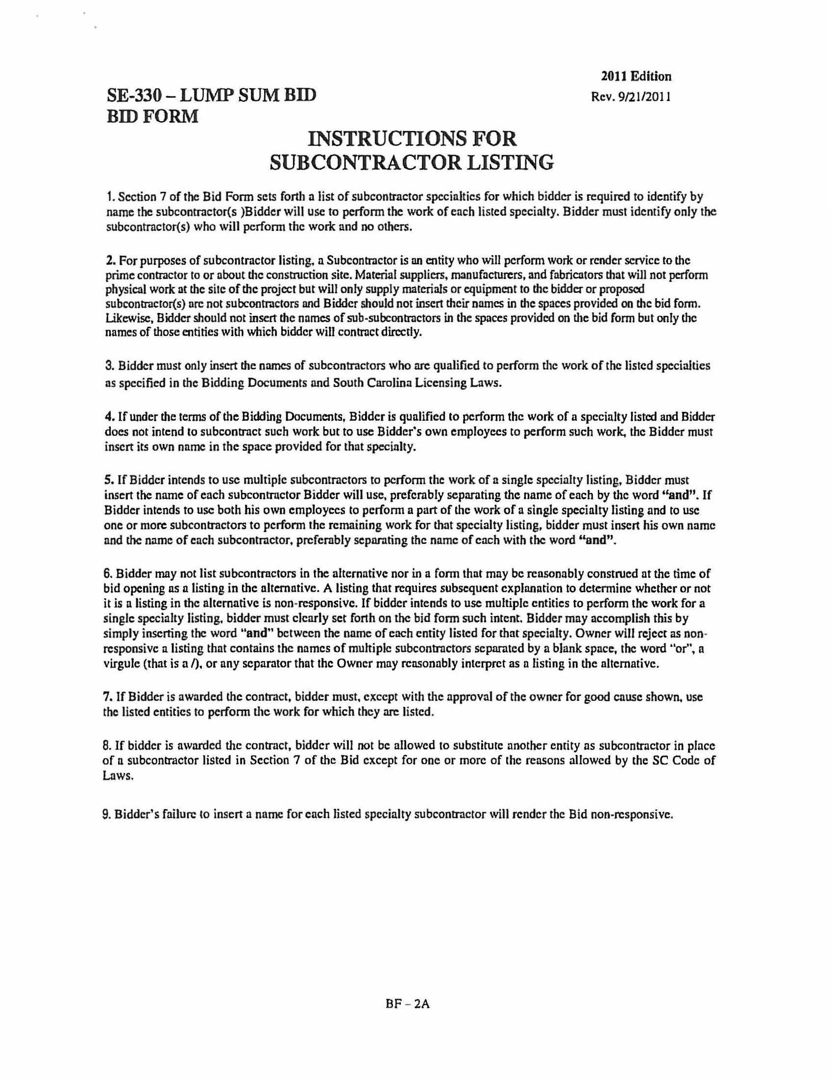

Slide 24
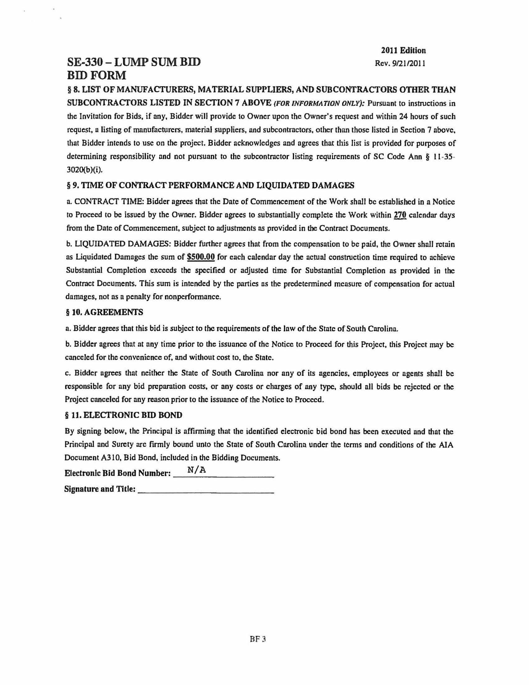
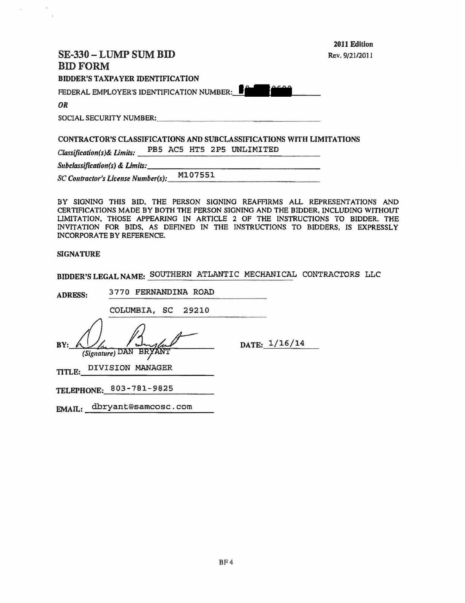

Slide 25
Bid Example #3

Slide 26
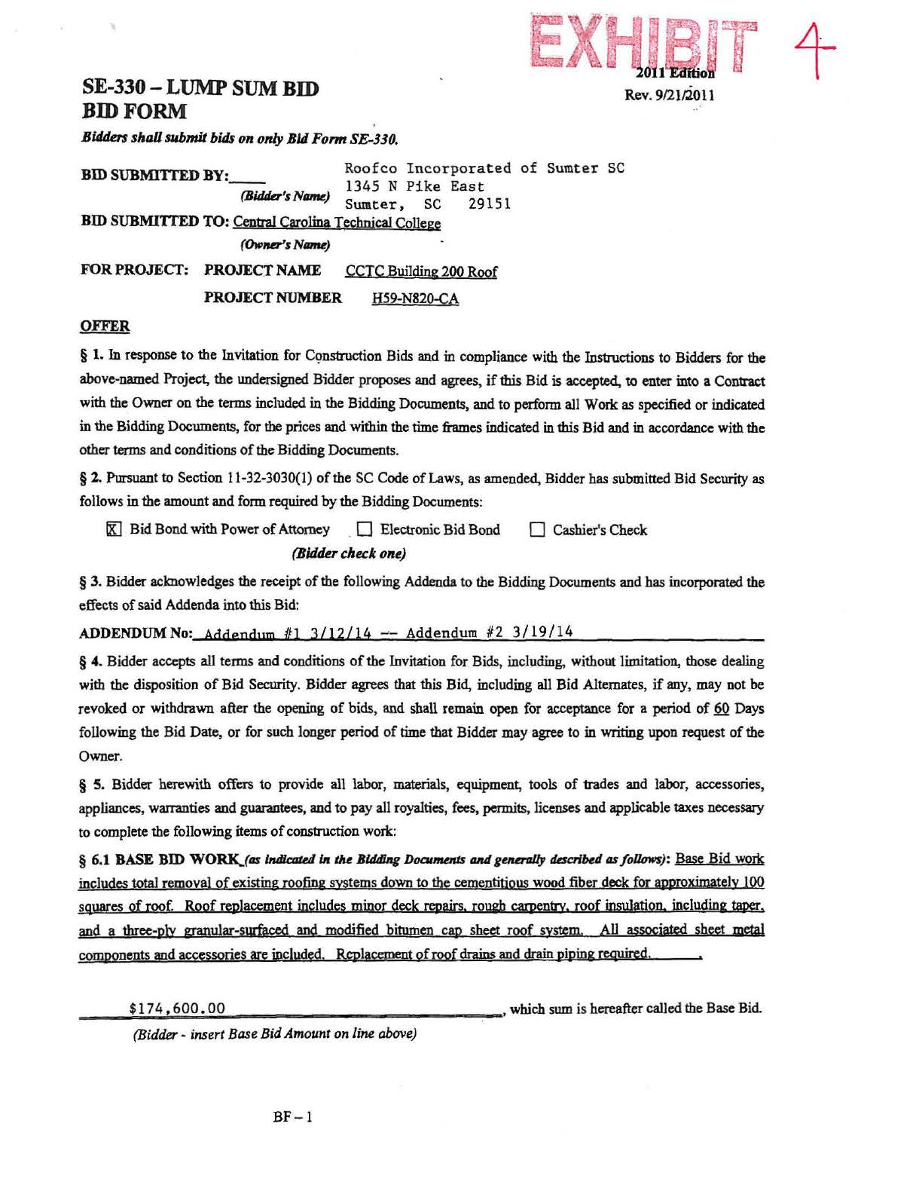
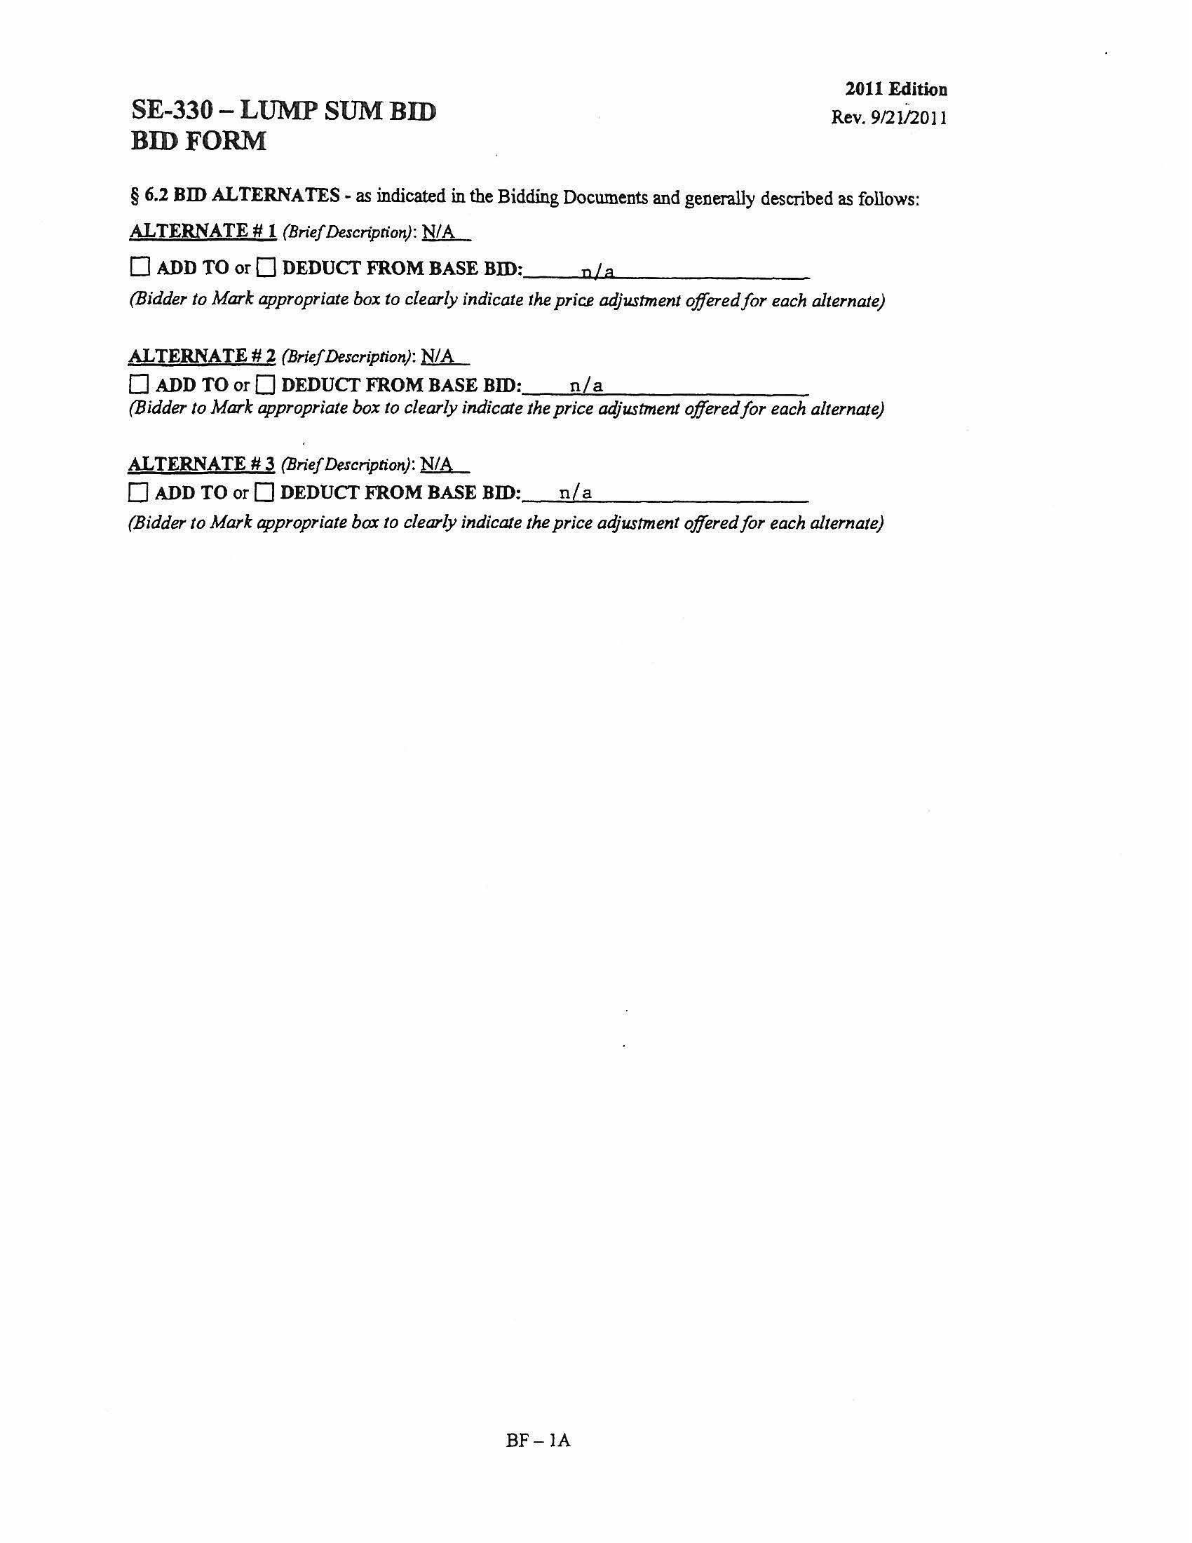

Slide 27
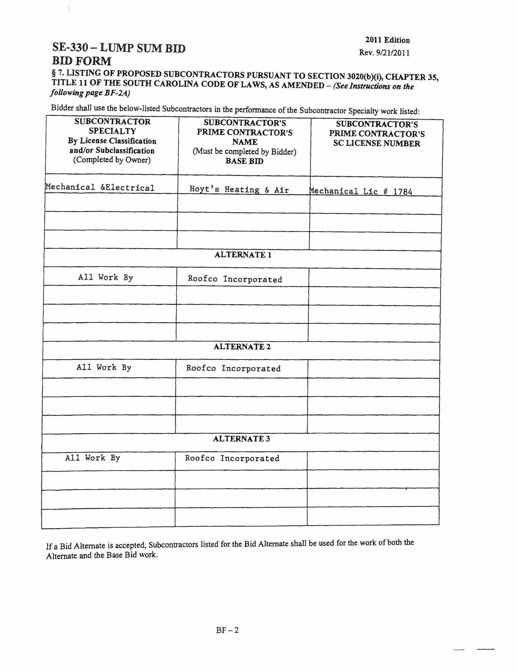
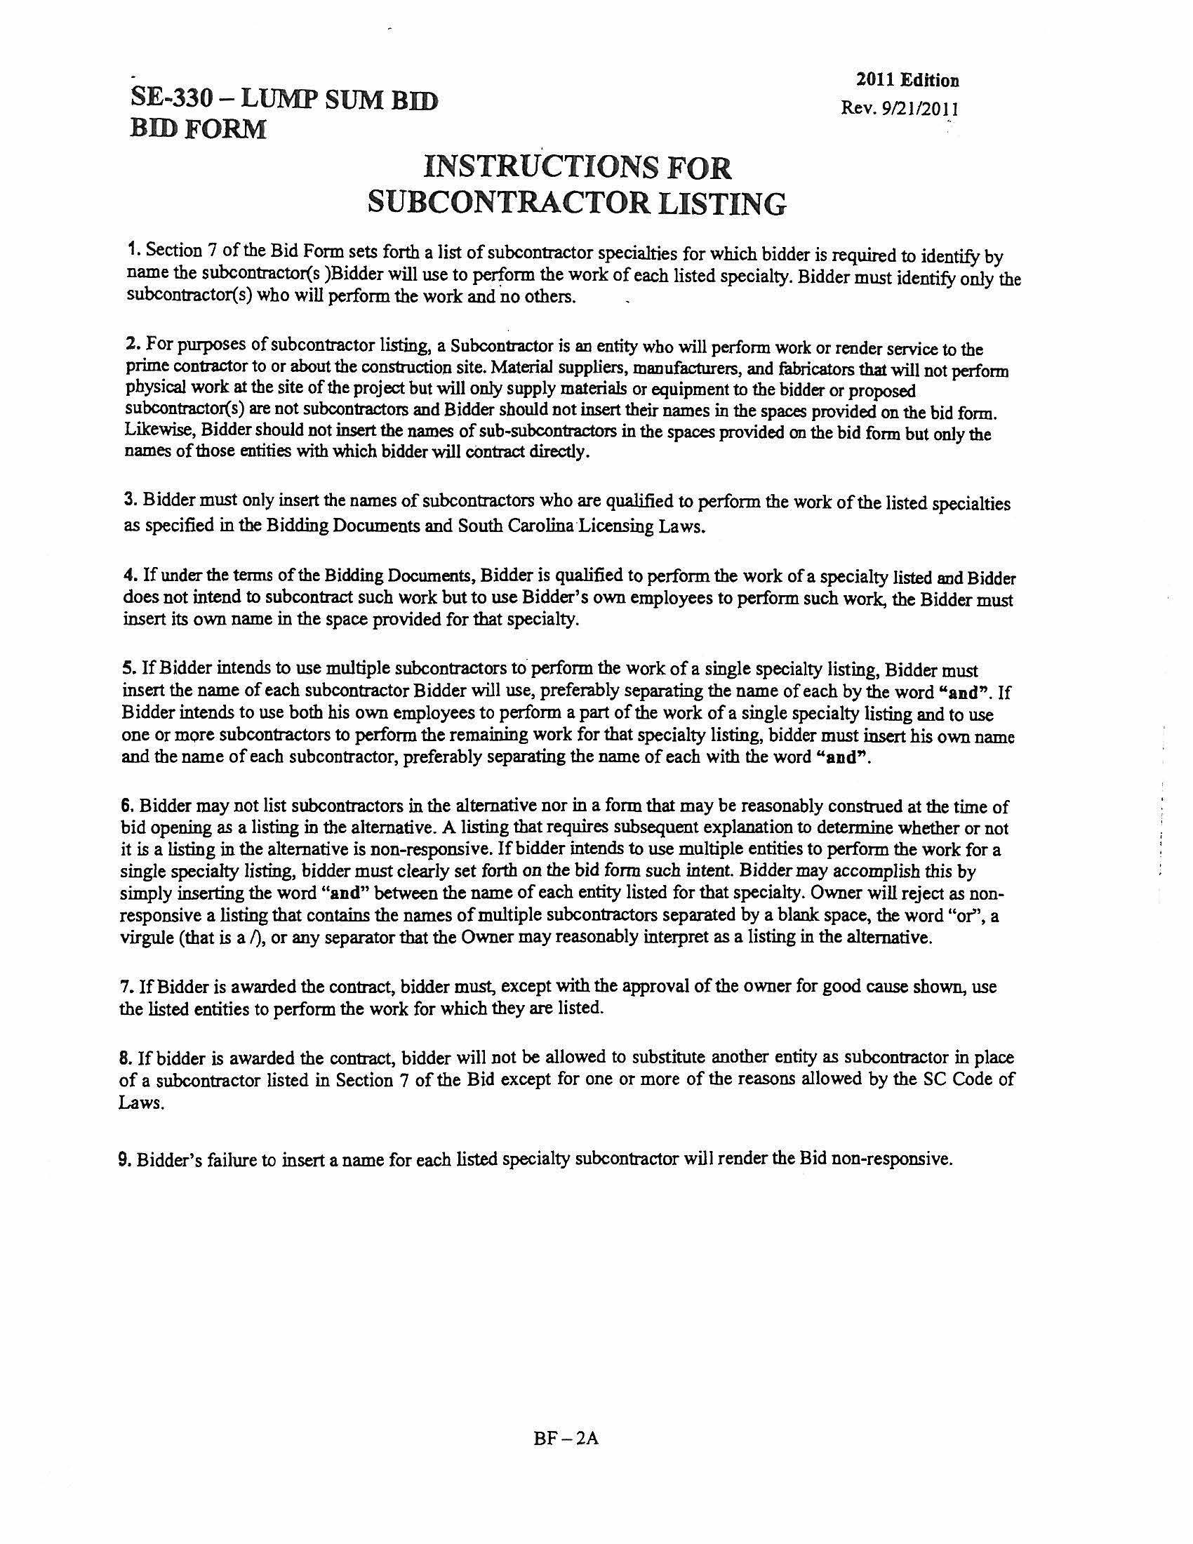

Slide 28
