Slide 1
Auditors-They Are Coming to Get You, or Are They?
Notes:
Introduction of the audit team

Slide 2
Auditors-They Are Coming to Get You, or Are They?
Audit and Certification Team
Crawford Milling, Director
Cherie Ergle, Audit Manager
Ed Welch, Audit Manager
Michelle (Xiao) Chen, Senior Auditor

Slide 3
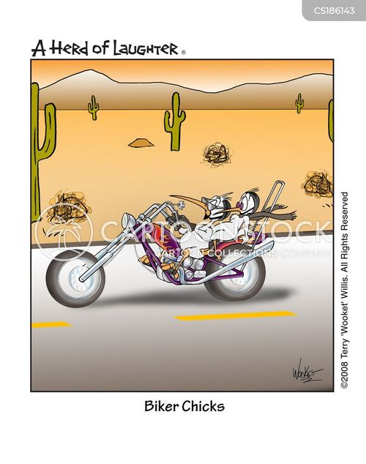
Who We Are
Notes:
Sailing, snow skiing, motorcycle riding

Slide 4
Who We Are
Notes:
Last hike; Table Rock, Pickens, SC
Sky Top Orchard, Flat Rock, NC

Slide 5
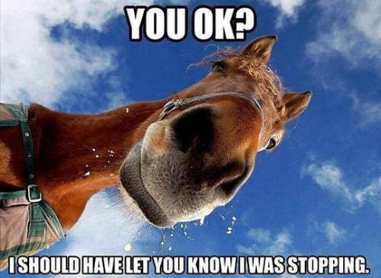
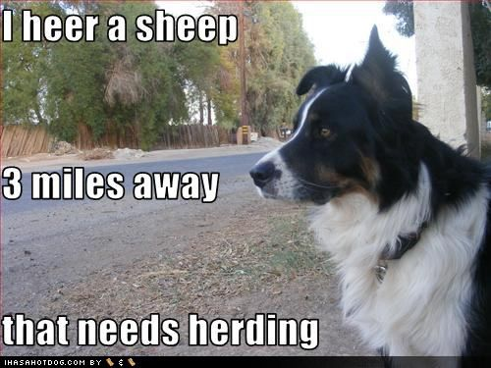
Favorite Pets
Notes:
Shi tzu-McKenzie, Quarter Horse-Sami, Boarder Collie-Blossom

Slide 6
Auditors-They Are Coming to Get You, or Are They?
What We Test For
Using approved written plans, Audit and Certification tests the adequacy of the governmental body’s internal controls in order to ensure compliance with the requirements of this code and the ensuing regulations (11-35-1230)
What We Ask For
Listing of all authorized personnel to procure construction contracts and certification levels
Listing of Construction Projects during the audit period to include project type, project numbers, and project amounts. This should include ALL projects; minor construction projects (less than $100k), major construction projects (greater than $100k), Architect/Engineer (A/E) and related professional services, Indefinite Quantity Contracts (IDQs), and Task Order Contracts (TOCs), emergencies, and sole sources
Internal Policies and Procedures
Notes:
The Project List should include project types (Design Bid Build, CMAR, IDQ etc.). The Project List should include projects started prior to audit period but ongoing during audit period.

Slide 7
Auditors-They Are Coming to Get You, or Are They?
How We Test For Compliance With the Procurement Code
We pick a sample from the construction project list. The sample size can vary according to the number and dollar amounts of total construction projects, certification levels, and assessed risks
We request documents depending on the construction type or project delivery method. Documents must be appropriately approved (signature of authority) and dated.

Slide 8
Auditors-They Are Coming to Get You, or Are They?
Documents Requested for Minor Construction Projects (greater than $10k but less than $100k)
Purchase Requisition
11-35-1550
At least three responsive and responsible bids, or an advertisement in SCBO ( SE 311)
11-35-3030
Payment and performance bonds, if greater than $50k
Notice of Award to the lowest bidder (SE 375)

Slide 9
Auditors-They Are Coming to Get You, or Are They?
Documents Needed for Major Construction Projects-greater than $100k (at a minimum)
Establishment of a Permanent Improvement Project (A-1) or Agency’s Approval of the Project
Written Determination for Project Delivery Method if Other Than Design-Bid-Build (DBB)
Advertisement in SCBO
Invitation for Construction Services (Ex: DBB-SE 310)
Contractor’s Certificate of Insurance
Bid Security
Payment and Performance Bonds (SE 355/357)
Request for Concurrence in Posting Notice of Intent to Award (Ex: DBB-SE 360)
Bid Tab
Notes:
2-47-50 PIP, 11-35-3010 selection of method, 11-35-3030, 19-445-2145(4)

Slide 10
Auditors-They Are Coming to Get You, or Are They?
Documents Needed for Major Construction Projects-greater than $100k (at a minimum) Continued
Notice of Intent to Award (Ex: DBB SE 370)
Change Order, if Applicable (SE 380)
Notice to Proceed (SE 390)
AIA 702 Application & Certification of Payment –retention amount not to exceed 3.5%
Note: Most documents we ask for are listed in the OSE Manual by Construction Delivery Method
https://procurement.sc.gov/manual
Notes:
Maximum retention amount is 3.5% per 11-35-3030 (4)

Slide 11
Auditors-They Are Coming to Get You, or Are They?
Documents Needed for A/E and Other Professional Services Contracts
Small Professional Services Contracts (less than $50,000)
Proposal Letter
Small Professional Services Contract (SE 240)-involves construction, or
Professional Incidental Services Contract (SE 235)-used for studies, master plans, reports, or any services that do not involve construction directly
Payment Request (Invoice)
Notes:
Small Professional Services-<$50k excluding reimbursable expenses. Total values of fees paid to a single firm cannot exceed $150k within a 24 month period.
Splitting of Larger Projects Prohibited. Agencies may not break a project into small projects for the purpose of circumventing the provisions of SC Code Section 11-35-3220 and 11-35-3230.
Note: we are not looking always for the “correct” form, but only that the proper procedures were used in the process.

Slide 12
Auditors-They Are Coming to Get You, or Are They?
Large Professional Services Contracts (greater than $50,000)
Invitation for Professional Services (SE 210)
SCBO Ad
Selection Committee Report for Interview Selection(SE 211)
Notification of Selection for Interview (SE 212)
Professional Services Selection Committee Summary (SE 217
Notification of Selection for Professional Services Contract (SE 219)
Request for Concurrence in Posting Notice of Intent to Award Professional Services Contract (SE 220)
Notice of Intent to Award Professional Services Contract (SE 221)
Payment Request (Invoice)
Notes:
We check for dates; such as the date on the intent to award and the contract date, which cannot begin until after the end of the protest period.
We verify the agency followed the proper procedures listed in the OSE manual. By following the manual, you will be in compliance with the code.

Slide 13
Auditors-They Are Coming to Get You, or Are They?
Documents Needed For Indefinite Quantity Contracts (IDQ)
Invitation for Indefinite Quantity Contract (SE 610)
Selection Committee Report for Interview Selection(SE 611)
Notification of Selection for Interview (SE 612)
Selection Committee Summary (SE 617)
Notification of Selection for Contract Negotiation (SE 619)
Request for Concurrence in Posting Notice of Intent to Award (SE 620)
Notice of Intent to Award (SE 621)
Indefinite Quantity Contract Delivery Order-Small Contract (SE 635), or
Indefinite Quantity Contract Delivery Order-Large Contract (SE 645)
Delivery Order Modification (SE 648) if applicable
Payment Request (Invoice)
Note: We may also verify the dollar amount does not exceed amount allowed within a 24-month period
Notes:
Indefinite Quantity Contracts are professional services contracts that does not procure or specify a defined quantity of services (other than a minimum or maximum quantity) and that provides for the issuance of Delivery Orders for the performance of work during the period of the contract.
For Small IDQ contracts- The sum of all Delivery Orders cannot exceed $50k during a 24-month period. (this amount excludes reimbursable expenses). Total value of fees paid to a single firm may not exceed $150k, excluding reimbursables, for all small professional contracts awarded by the Agency to the firm in a 24-month period.
For Large IDQ contracts- The sum of all Delivery Orders cannot exceed $300k during a 24-month period (this amount excludes reimbursable expenses). Individual Delivery Orders may not exceed $100k.
For Higher Eds- the sum of all Delivery Orders issued during the 24 month period of the contract may not exceed $500k. Individual Delivery Orders may not exceed $200k.

Slide 14
Auditors-They Are Coming to Get You, or Are They?
Documents Needed For Task Order Contracts (TOC)
Invitation for Task Order Contract (SE 655)
TOC Selection Committee Summary (SE 658)
Notification of Selection for Contract Negotiation (SE 619)
Request for Concurrence in Posting Notice of Intent to Award (SE 660)
Notice of Intent to Award (SE 670)
Task Order Contract (SE 680)
Payment and Performance Bonds
Application for Payment (Invoice)
Not receiving at least three responsive bids, or be advertised in SCBO (minor projects)

Slide 15
Auditors-They Are Coming to Get You, or Are They?
Documents Needed For Sole Source/Emergency Procurements
Sole Source
Written Determination (MMO/OSE-102)
Notice of Intent to Sole Source (MMO/OSE-102A)
Reported to DPS
Payment Request/Invoice
Emergency
Written Determination (MMO/OSE-103)
Notice of Emergency (MMO/OSE-103A)
Reported to DPS

Slide 16
Auditors-They Are Coming to Get You, or Are They?
Most Common Findings
Payment/Performance Bonds Not Obtained from Contractor
Artificially Divided Projects
Retention Amount Exceeded Maximum Limit
Sole Source Projects Not Properly Approved, Advertised in SCBO, or Reported to DPS
Emergency Projects Not Reported to DPS
Construction Projects Inappropriately Treated as Exempt from the Code
Agency Procured Projects Over its Certification Level Without OSE’s Oversight
Missing Documentation

Slide 17
Auditors-They Are Coming to Get You, or Are They?
How to Avoid Audit Findings
Know the Code
Follow the Code
Keep Detailed Documentation
Have an Accessible Filing System
Perform a Review of the Procurement Process Using a Checklist
Notes:
Contact OSE for help; receive training in the Procurement Code and the Manual.
Have written procedures
USE OSE Database for documents when overseen by OSE; Use the Triple Alt File for misc. documents.
Use OSE Manual Appendix A-F as a guide for checklists. You can also use this PP Presentation.

Slide 18
Questions?

