Slide 1
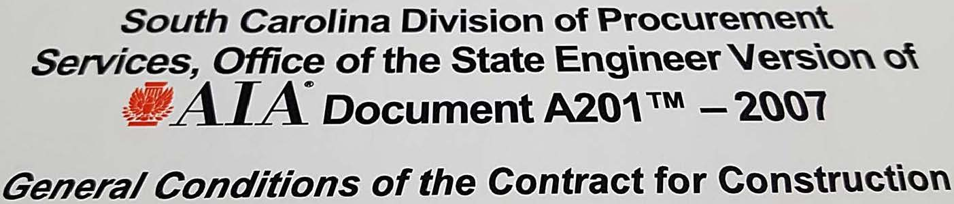
Things you may or may not know about the A201.

Slide 2
The Contract Documents
The Contract
Notice to Proceed
Owners Right to Stop Work
Owner’s Right to Carry Out the Work
Contractor & Applicable codes
Construction Schedules
Shop Drawings
Fire Sprinkler Shop Drawings
Indemnification
Changes in the work
Applications for Payment
Final Completion and Final Payment
Acceptance of Nonconforming Work
Weather Delays

Slide 3
The Contract Documents
What makes up the Contract Documents?

Slide 4
The Contract Documents
What makes up the Contract Documents?
The Agreement (A101)
Conditions of the Contract (A201)
Drawings & Specifications
Addenda issued prior to execution of the contract
The Advertisement
Instructions to bidders (A-701)
Contractors bid
Modifications made after execution of the contract
  Change Orders
  Construction Change Directives
  Minor Changes in the Work

Slide 5
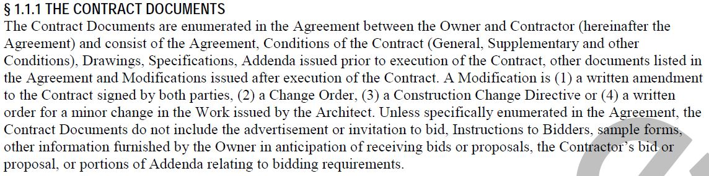
The Contract Documents

Slide 6
The Contract Documents
The Contract
Notice to Proceed
Owners Right to Stop Work
Owner’s Right to Carry Out the Work
Contractor & Applicable codes
Construction Schedules
Shop Drawings
Fire Sprinkler Shop Drawings
Indemnification
Changes in the work
Applications for Payment
Final Completion and Final Payment
Acceptance of Nonconforming Work
Weather Delays

Slide 7
The Contract
What is the Contract?

Slide 8
The Contract
What is the Contract?
The Contract Documents form the contract for construction.

Slide 9
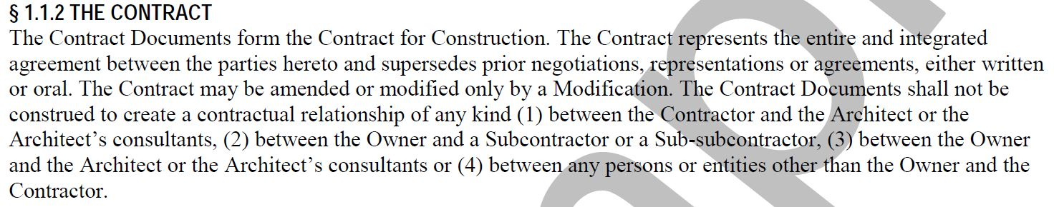
The Contract

Slide 10
The Contract Documents
The Contract
Notice to Proceed
Owners Right to Stop Work
Owner’s Right to Carry Out the Work
Contractor & Applicable codes
Construction Schedules
Shop Drawings
Fire Sprinkler Shop Drawings
Indemnification
Changes in the work
Applications for Payment
Final Completion and Final Payment
Acceptance of Nonconforming Work
Weather Delays

Slide 11
Notice to Proceed
What is established with the Notice to Proceed?

Slide 12
Notice to Proceed
What is established with the Notice to Proceed?
Notice to Proceed is issued by the Owner
SE-390
Contract Time
Substantial Completion
Liquidated Damages

Slide 13

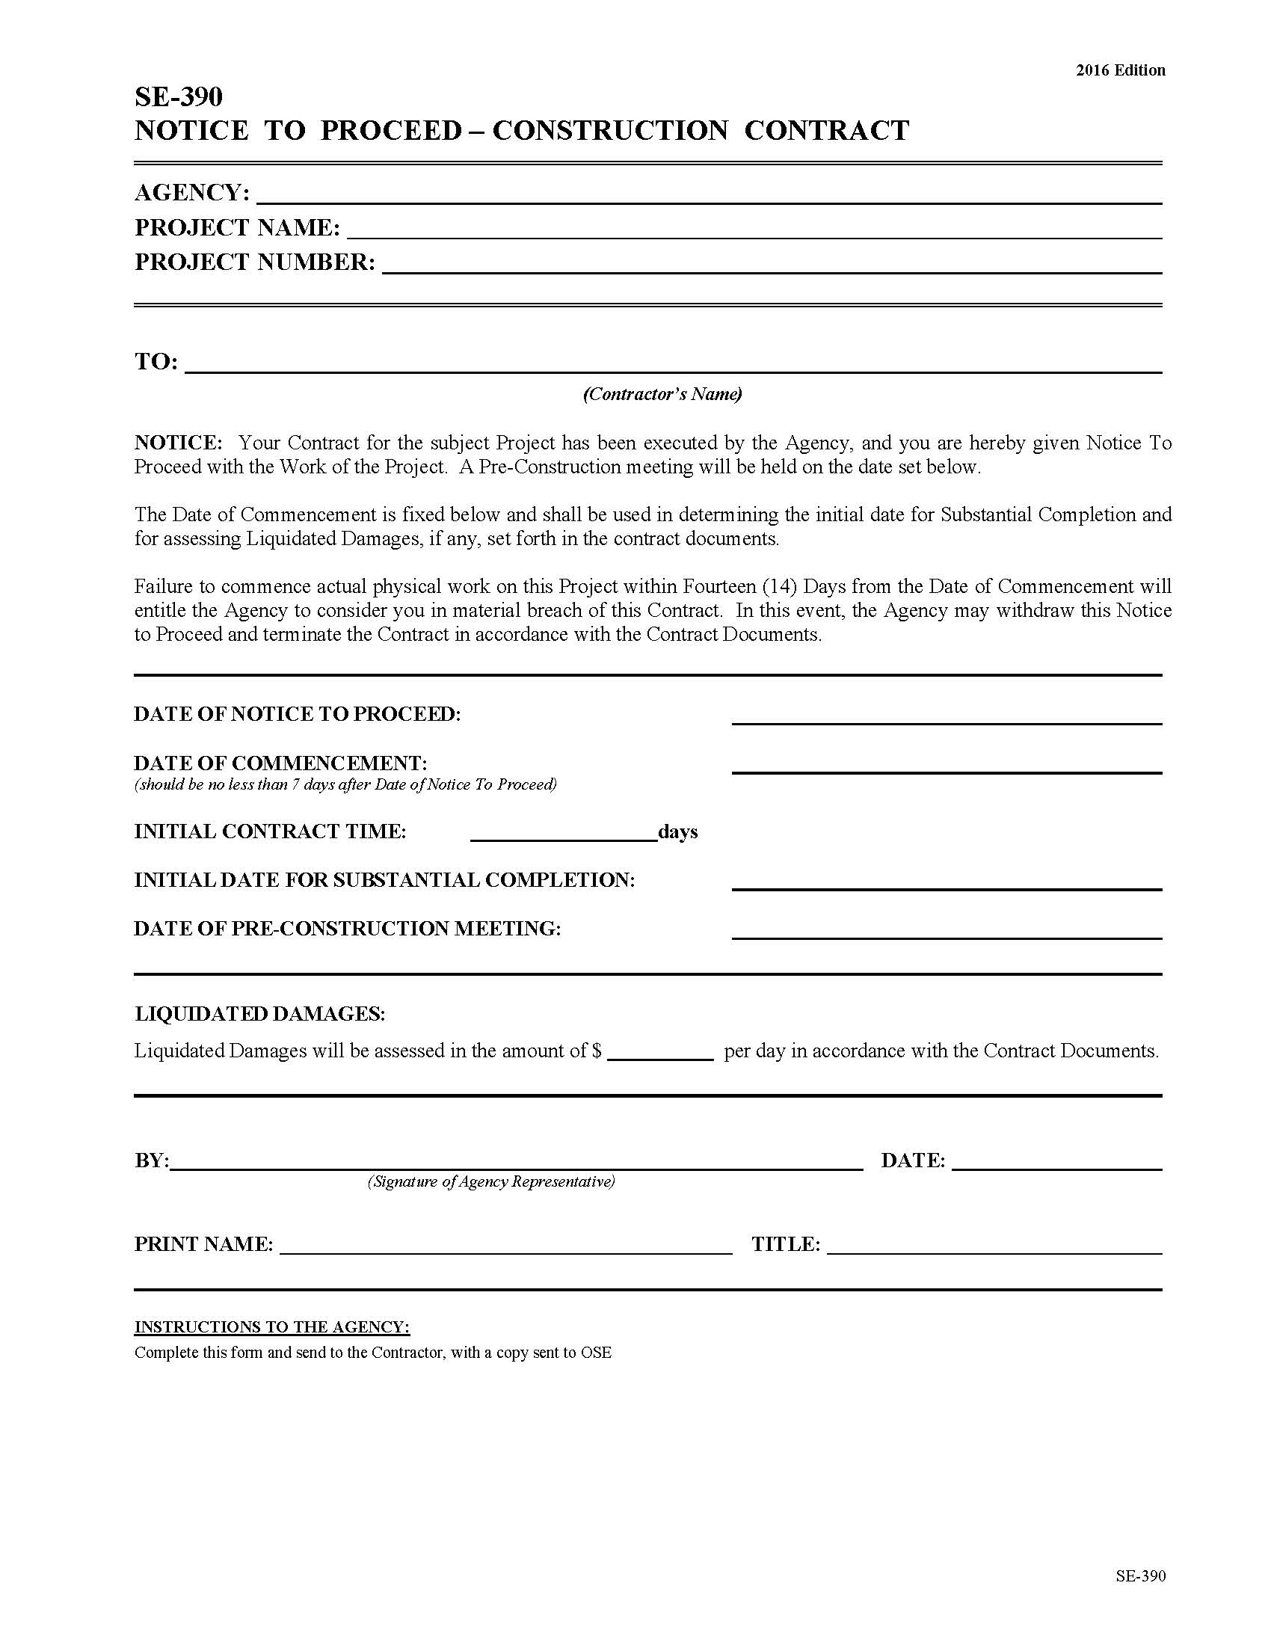
Notice to Proceed

Slide 14
The Contract Documents
The Contract
Notice to Proceed
Owners Right to Stop Work
Owner’s Right to Carry Out the Work
Contractor & Applicable codes
Construction Schedules
Shop Drawings
Fire Sprinkler Shop Drawings
Indemnification
Changes in the work
Applications for Payment
Final Completion and Final Payment
Acceptance of Nonconforming Work
Weather Delays

Slide 15
Owner’s Right to Stop Work
When does the owner have the right to stop work?

Slide 16
Owner’s Right to Stop Work
When does the owner have the right to stop work?
When the Contractor fails to correct Work that is not in accordance with the Contract Documents
When the contractor repeatedly fails to carry out the Work in accordance with the Contract Documents
Correction of the work can be before or after Substantial Completion and the contractor will bear the cost of repairing the work and can include the cost of architectural services

Slide 17
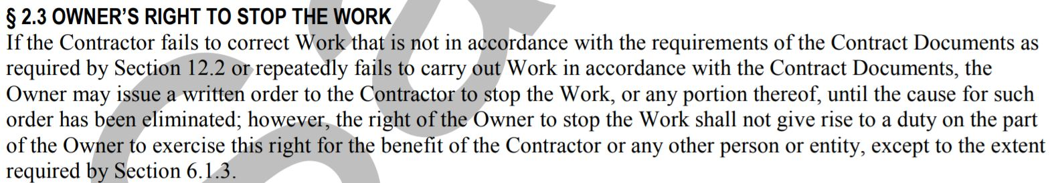
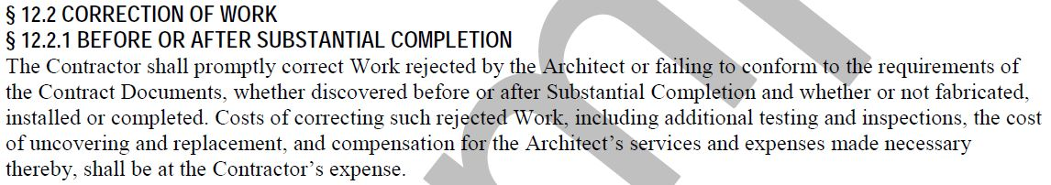
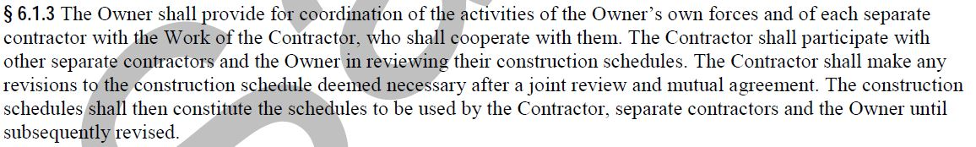
Owner’s Right to Stop Work

Slide 18
The Contract Documents
The Contract
Notice to Proceed
Owners Right to Stop Work
Owner’s Right to Carry Out the Work
Contractor & Applicable codes
Construction Schedules
Shop Drawings
Fire Sprinkler Shop Drawings
Indemnification
Changes in the work
Applications for Payment
Final Completion and Final Payment
Acceptance of Nonconforming Work
Weather Delays

Slide 19
Owner’s Right to Carry Out the Work
When does the owner have the right to
carry out the work?

Slide 20
Owner’s Right to Carry Out the Work
When does the owner have the right to
carry out the work?
If the contractor defaults or neglects to carry out the Work in accordance with the Contract Documents and fails within a ten-day period after receipt of written notice

Slide 21
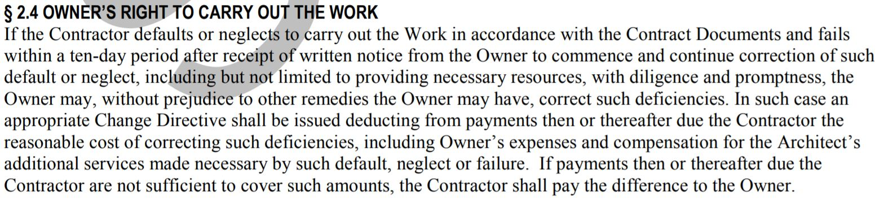
Owner’s Right to Carry Out the Work

Slide 22
The Contract Documents
The Contract
Notice to Proceed
Owners Right to Stop Work
Owner’s Right to Carry Out the Work
Contractor & Applicable codes
Construction Schedules
Shop Drawings
Fire Sprinkler Shop Drawings
Indemnification
Changes in the work
Applications for Payment
Final Completion and Final Payment
Acceptance of Nonconforming Work
Weather Delays

Slide 23
Contractor & Applicable Codes
Is the contractor required to ascertain that the contract documents are in accordance with applicable laws and codes?

Slide 24
Contractor & Applicable Codes
Is the contractor required to ascertain that the contract documents are in accordance with applicable laws and codes?
The contractor is not required to ascertain that the contract documents are in accordance with applicable laws and codes
However if the contractor performs work knowing it to be contrary to applicable laws and codes, the contractor shall assume responsibility for such work and bear the costs to correct

Slide 25
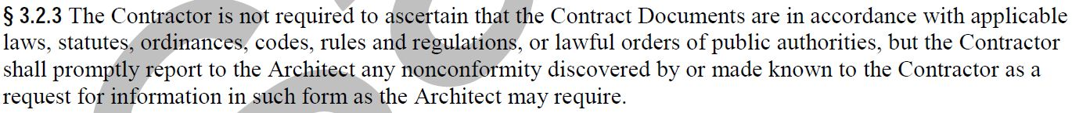
Contractor & Applicable codes

Slide 26
The Contract Documents
The Contract
Notice to Proceed
Owners Right to Stop Work
Owner’s Right to Carry Out the Work
Contractor & Applicable codes
Construction Schedules
Shop Drawings
Fire Sprinkler Shop Drawings
Indemnification
Applications for Payment
Final Completion and Final Payment
Acceptance of Nonconforming Work
Weather Delays

Slide 27
Construction Schedules
When and how often should construction schedules be updated?

Slide 28
Construction Schedules
When and how often should construction schedules be updated?
The Contractor shall promptly after being awarded the Contract prepare and submit a construction schedule for the work.
The construction schedule shall be updated at appropriate intervals as required by the contract
The pay application if required by the owner or architect requires an updated construction schedule

Slide 29
The Contract Documents
The Contract
Notice to Proceed
Owners Right to Stop Work
Owner’s Right to Carry Out the Work
Contractor & Applicable codes
Construction Schedules
Shop Drawings
Fire Sprinkler Shop Drawings
Indemnification
Applications for Payment
Final Completion and Final Payment
Acceptance of Nonconforming Work
Weather Delays

Slide 30
Shop Drawings, Product Data and Samples
What do Shop Drawings represent?

Slide 31
Shop Drawings, Product Data and Samples
What do Shop Drawings represent?
Shop Drawings and similar submittals are not Contract Documents
Their purpose is to demonstrate the way by which the Contractor proposes to conform to the information given and the design concept expressed in the Contract Documents
Shop drawings are reviewed and approved by the contractor prior to submitting to the architect for approval

Slide 32
The Contract Documents
The Contract
Notice to Proceed
Owners Right to Stop Work
Owner’s Right to Carry Out the Work
Contractor & Applicable codes
Construction Schedules
Shop Drawings
Fire Sprinkler Shop Drawings
Indemnification
Applications for Payment
Final Completion and Final Payment
Acceptance of Nonconforming Work
Weather Delays

Slide 33
Fire Sprinkler Shop Drawings
Who prepares the Fire Sprinkler Shop Drawings and how are they submitted?

Slide 34
Fire Sprinkler Shop Drawings
Who prepares the Fire Sprinkler Shop Drawings and how are they submitted?
Prepared by a licensed sprinkler contractor
The fire sprinkler contractor shall certify the shop drawings and submit for review and approval
The Architects engineer of record shall review and approve and submit them to the State Fire Marshal for review and approval
Neither the contractor or subcontractor shall submit drawings directly to the State Fire Marshal for approval without written approval from OSE

Slide 35
The Contract Documents
The Contract
Notice to Proceed
Owners Right to Stop Work
Owner’s Right to Carry Out the Work
Contractor & Applicable codes
Construction Schedules
Shop Drawings
Fire Sprinkler Shop Drawings
Indemnification
Applications for Payment
Final Completion and Final Payment
Acceptance of Nonconforming Work
Weather Delays

Slide 36
Indemnification
What is Indemnification?

Slide 37
Indemnification
What is Indemnification?
To the fullest extent permitted by law the Contractor shall indemnify and hold harmless the Owner, Architect, Architects consultants, and agents and employees from and against claims, damages, losses and expenses, including attorneys fees, resulting out of the performance of the Work, but only to the extent caused by the negligent acts or omissions of the Contractor or a subcontractor.

Slide 38
The Contract Documents
The Contract
Notice to Proceed
Owners Right to Stop Work
Owner’s Right to Carry Out the Work
Contractor & Applicable codes
Construction Schedules
Shop Drawings
Fire Sprinkler Shop Drawings
Indemnification
Applications for Payment
Final Completion and Final Payment
Acceptance of Nonconforming Work
Weather Delays

Slide 39
Application for Payment
What is included in the application for payment?

Slide 40
Application for Payment
What is included in the application for payment?
Itemized application in accordance with the schedule of values
It shall be notarized
It shall reflect retainage
It can reflect stored materials if such materials have applicable insurance
Contractor shall pay the Subcontractor within 7 days after receipt of payment
The owner can request written evidence from the contractor that subs have been properly paid
Payment by the owner does not constitute acceptance of the Work

Slide 41
Application for Payment
What is included in the application for payment?
If the architect does not certify the pay request within 7 days of issuance or if the owner does not pay within 21 days of issuance, then the contractor may upon 7 additional days written notice Stop Work until paid

Slide 42
The Contract Documents
The Contract
Notice to Proceed
Owners Right to Stop Work
Owner’s Right to Carry Out the Work
Contractor & Applicable codes
Construction Schedules
Shop Drawings
Fire Sprinkler Shop Drawings
Indemnification
Applications for Payment
Final Completion and Final Payment
Acceptance of Nonconforming Work
Weather Delays

Slide 43
Final Completion and Final Payment
When is Final Completion achieved and Final payment released ?

Slide 44
Final Completion and Final Payment
When is Final Completion achieved and Final payment released ?
If not agreed otherwise at substantial completion final completion shall be no later than 30 days after substantial completion
Upon receipt of the contractors written notice that work is ready for final inspection and receipt of the final pay request and inspection has been performed

Slide 45
The Contract Documents
The Contract
Notice to Proceed
Owners Right to Stop Work
Owner’s Right to Carry Out the Work
Contractor & Applicable codes
Construction Schedules
Shop Drawings
Fire Sprinkler Shop Drawings
Indemnification
Applications for Payment
Final Completion and Final Payment
Acceptance of Nonconforming Work
Weather Delays

Slide 46
Acceptance of Nonconforming Work
How is nonconforming work accepted?

Slide 47
Acceptance of Nonconforming Work
How is nonconforming work accepted?
The Owner can accept work that is not in accordance with the Contract Documents
The Owner may do so instead of requiring its removal and correction
If this is the case the Contract Sum will be reduced as appropriate and equitable

Slide 48
The Contract Documents
The Contract
Notice to Proceed
Owners Right to Stop Work
Owner’s Right to Carry Out the Work
Contractor & Applicable codes
Construction Schedules
Shop Drawings
Fire Sprinkler Shop Drawings
Indemnification
Applications for Payment
Final Completion and Final Payment
Acceptance of Nonconforming Work
Weather Delays

Slide 49
Weather Days
How many days of adverse weather are anticipated at the job site each month?

Slide 50
Weather Days
How many days of adverse weather are anticipated at the job site each month?
5 days of adverse weather are anticipated each month
The contractor can claim additional days beyond the 5 anticipated
The remedy for this condition is an extension of time only
The contractor must turn in monthly with the pay request rain days requested

