Slide 1
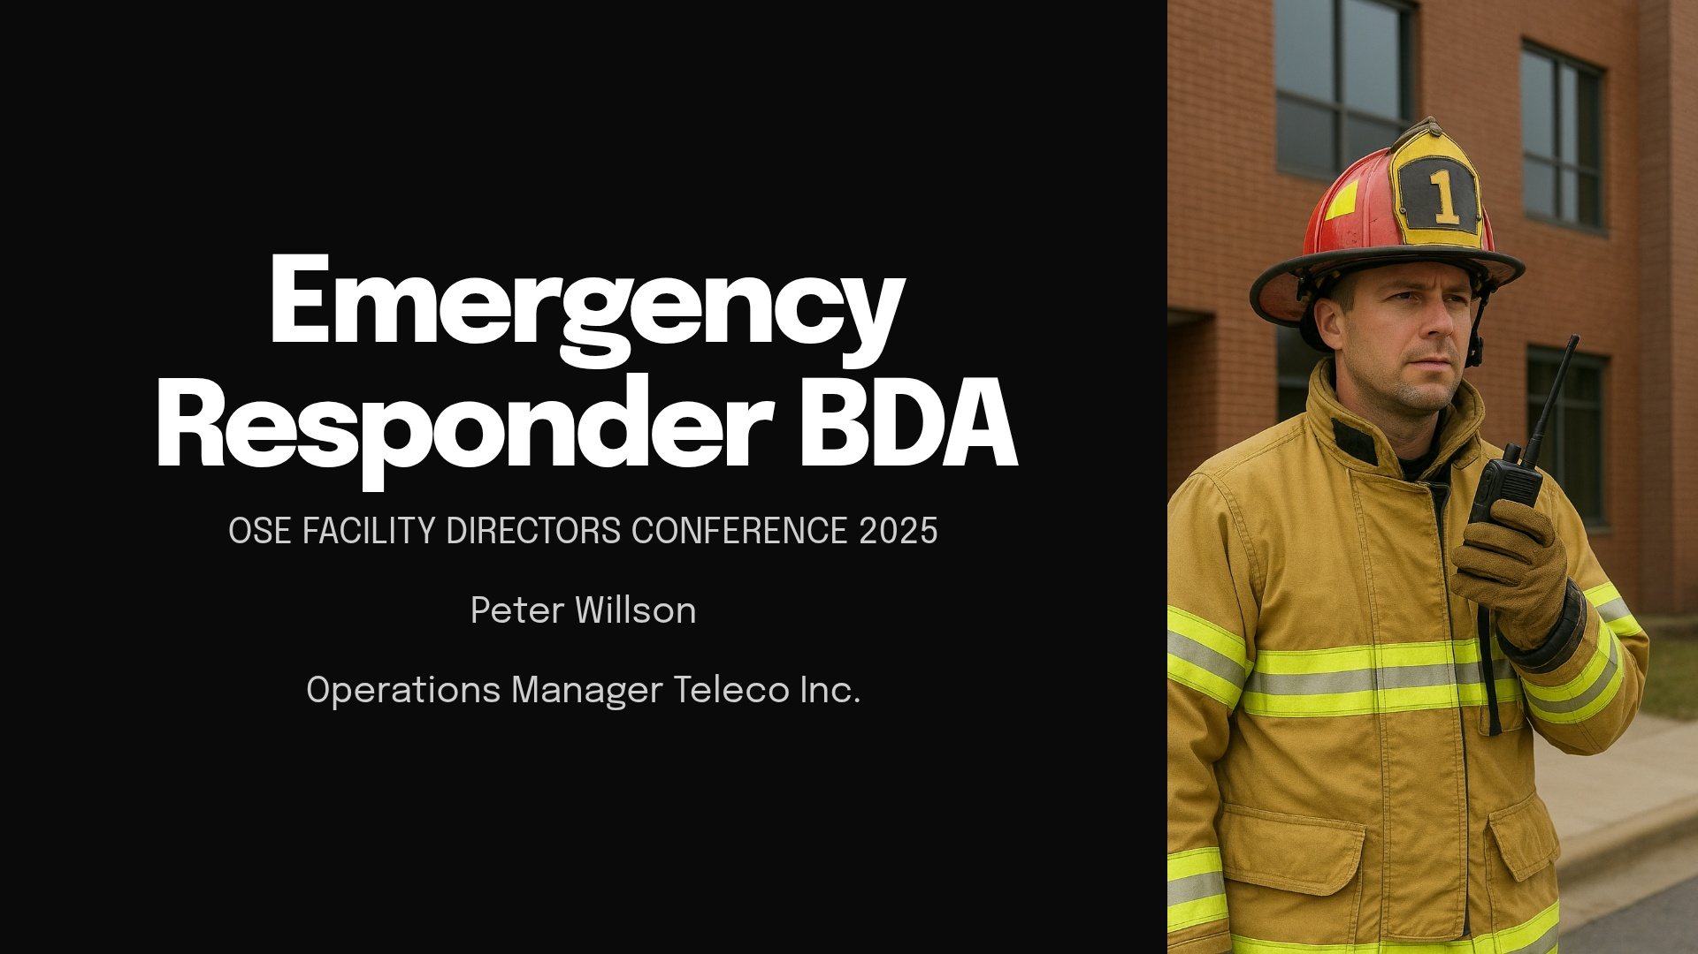

Slide 2
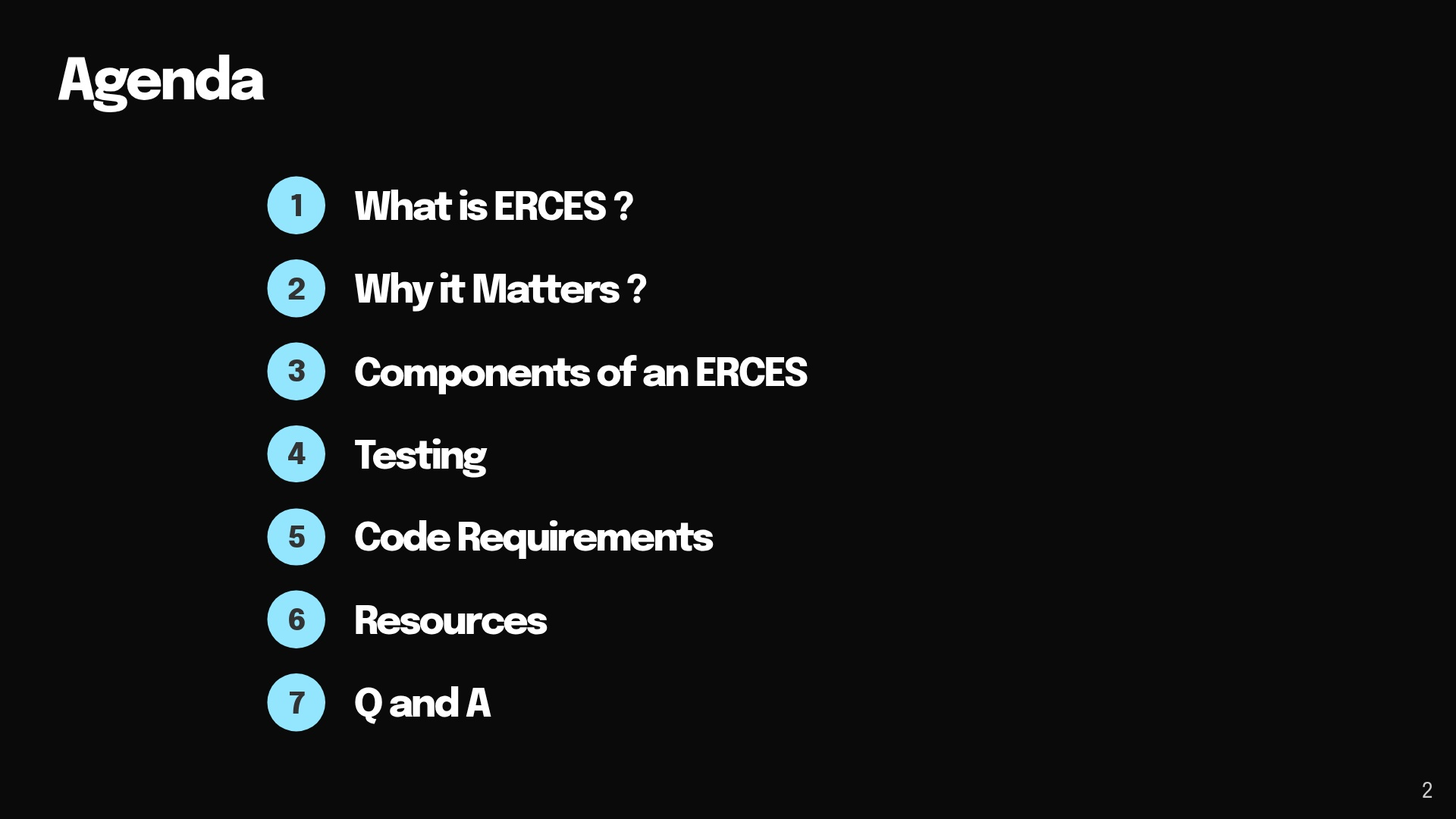

Slide 3
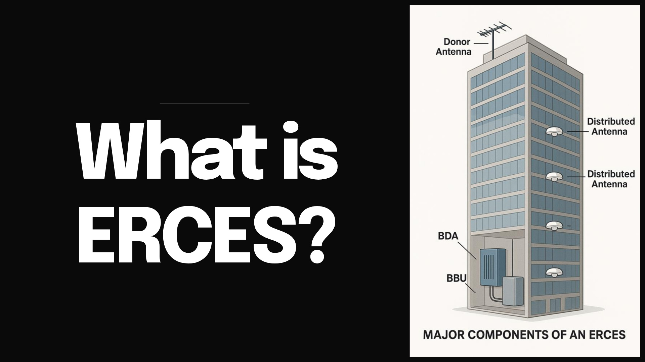
Notes:
What does ERCES stand for?

Slide 4
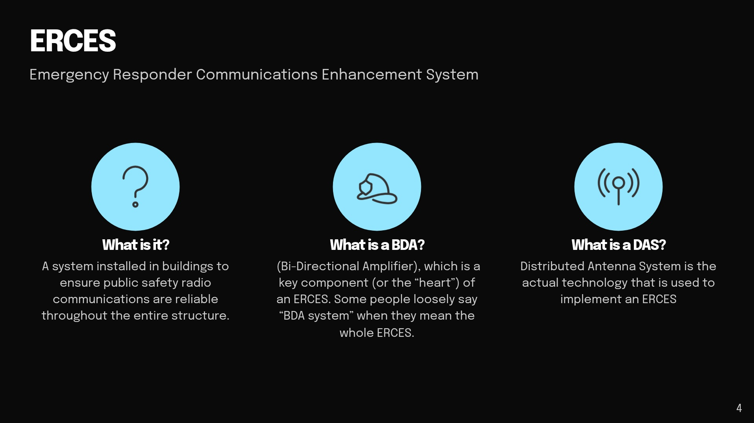
Notes:
Can anyone tell me what an ERCES is?
What does a BDA do? It takes outside signal and amplifies it inside. It also takes the signal from inside and amplifies it to transmit to the tower
A bda has between 85-90 db of gain depending on the brand

Slide 5
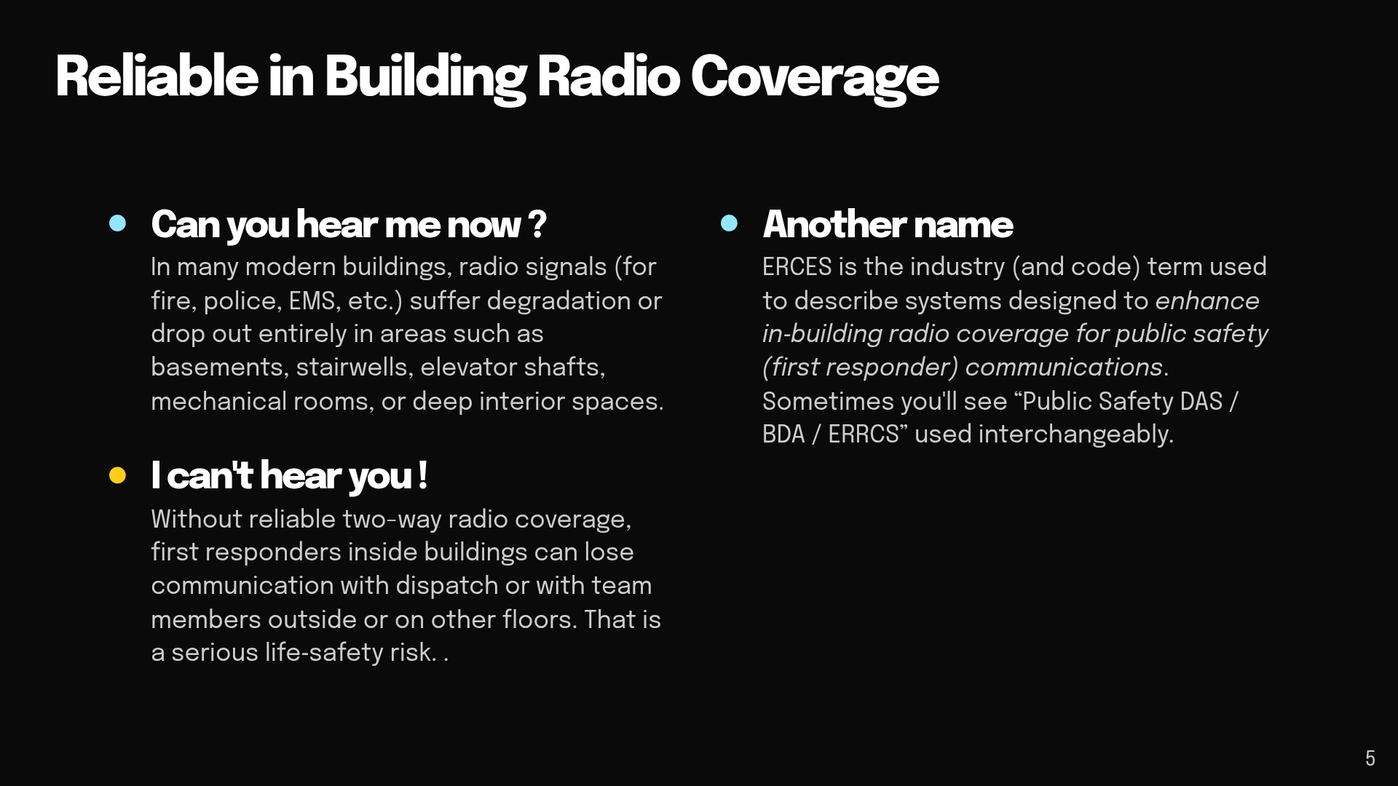

Slide 6
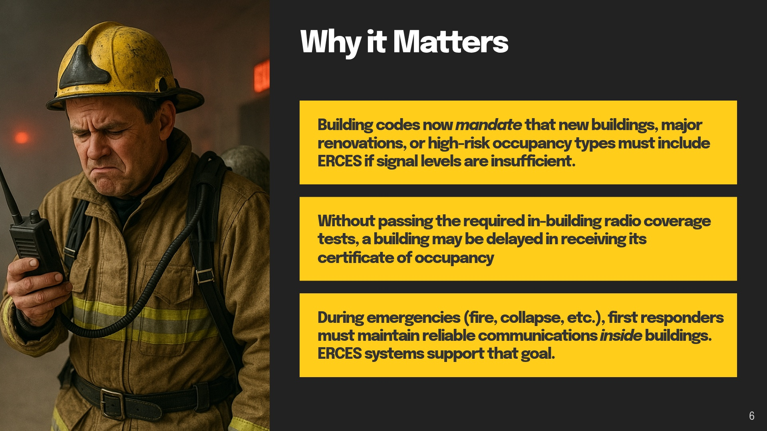

Slide 7
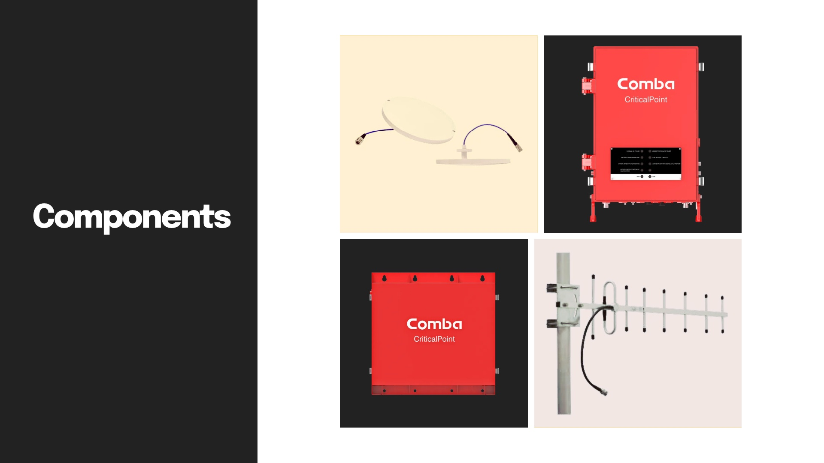
Notes:
Anyone recognize these parts?

Slide 8
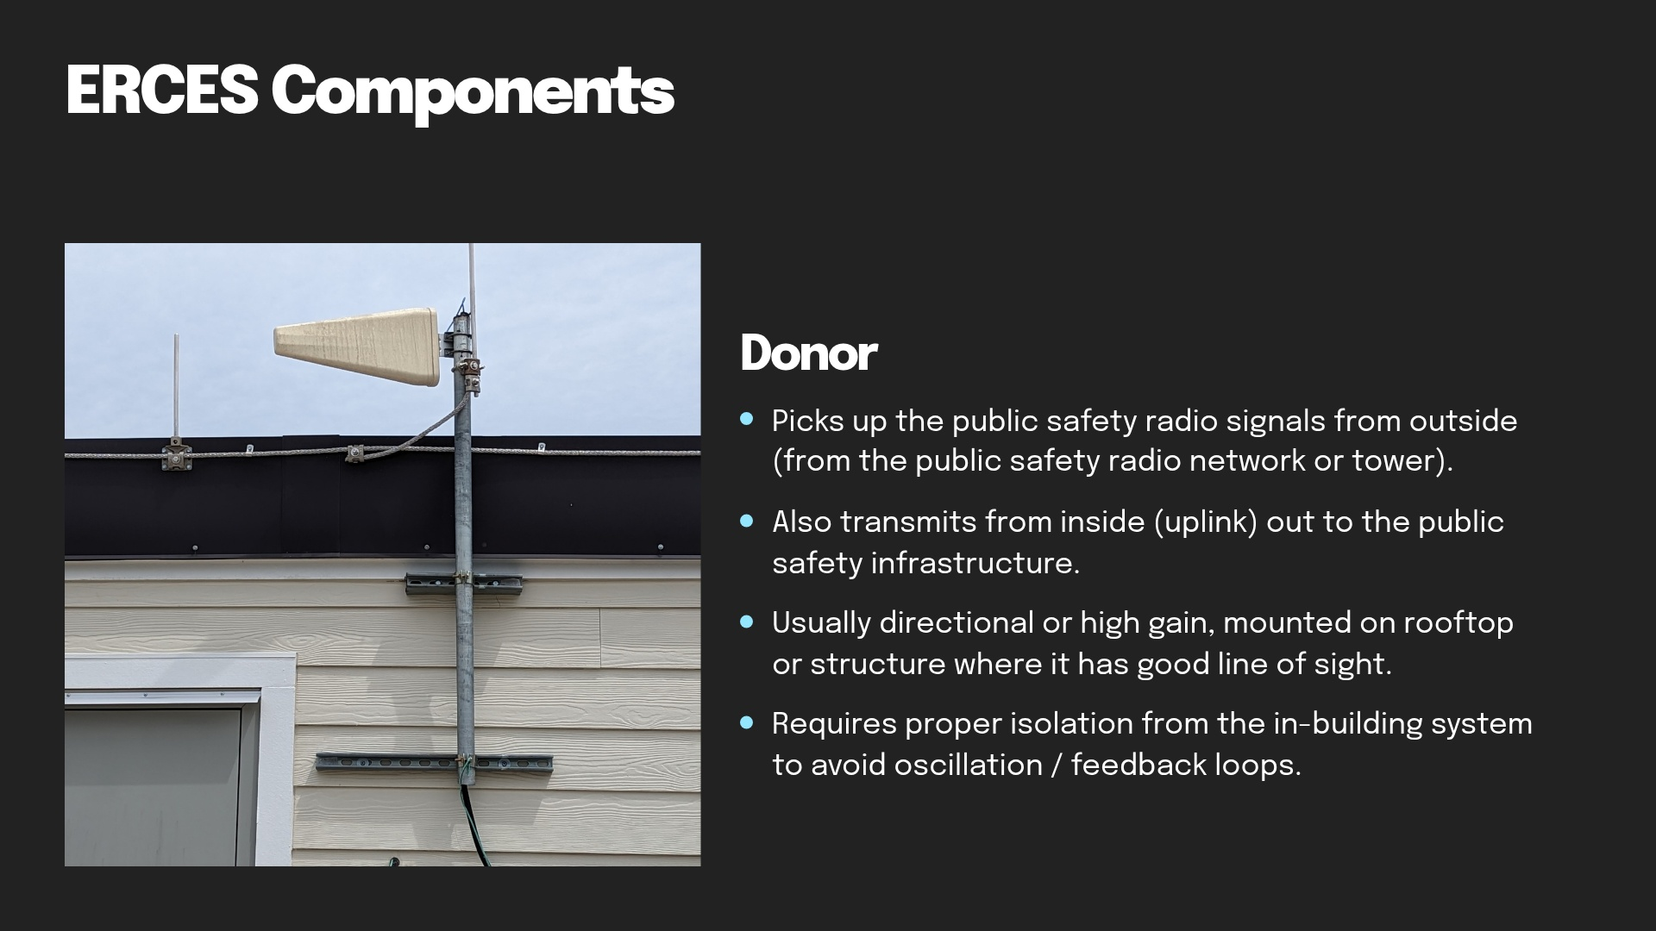
Notes:
What is the common name for these?
Who knows what uplink is vs downlink?
High gain antennas
High isolation. It’s in the antenna patterns
It needs to point towards the donor tower

Slide 9
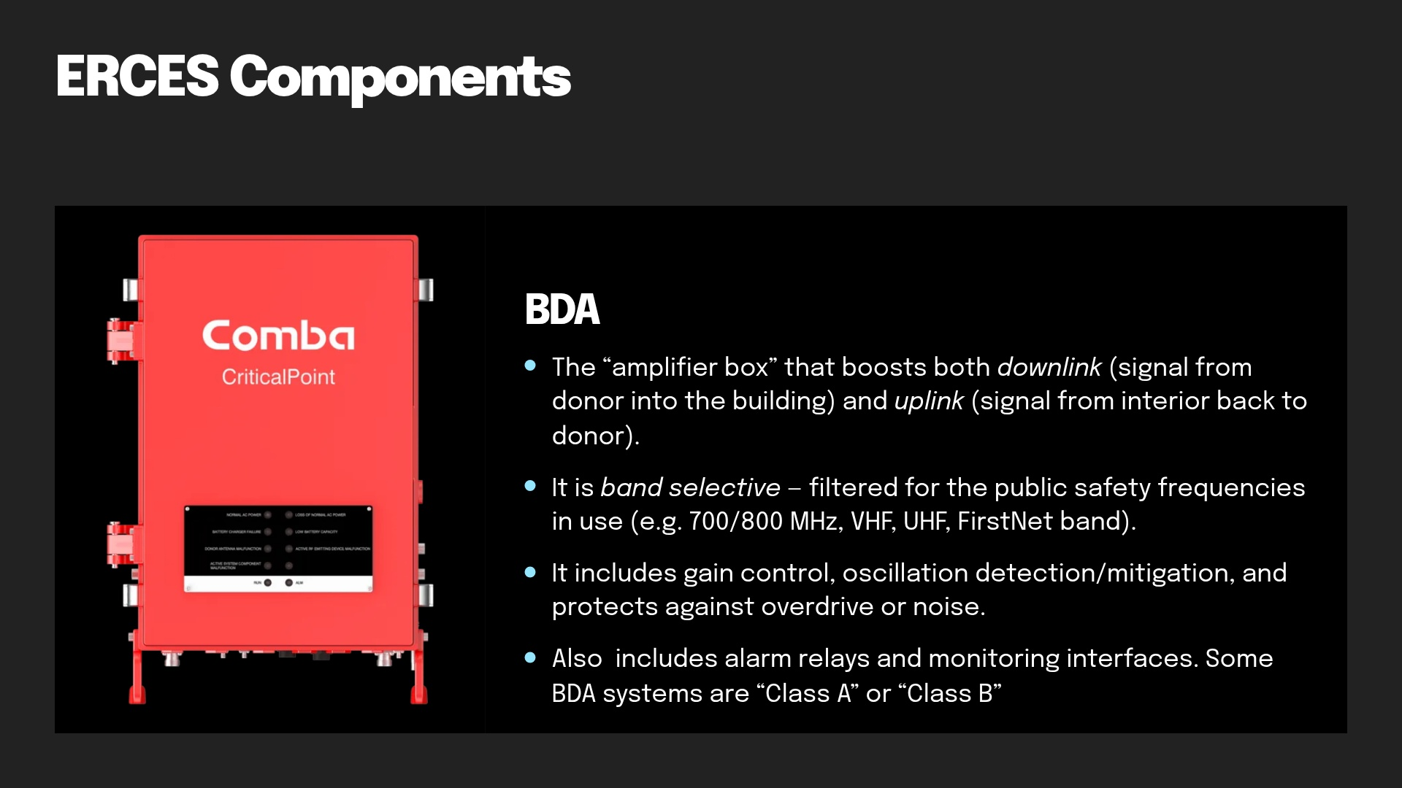
Notes:
This provides both the uplink and downlink amplification.
Who is still using VHF/UHF Here?
Fiber DAS. Can put more BDA’s and more coverage using fiber.
You do not want multiple Donor antennas in the same area. Can cause interference and noise. This impacts the radio network and can blank out areas from small to large.

Slide 10
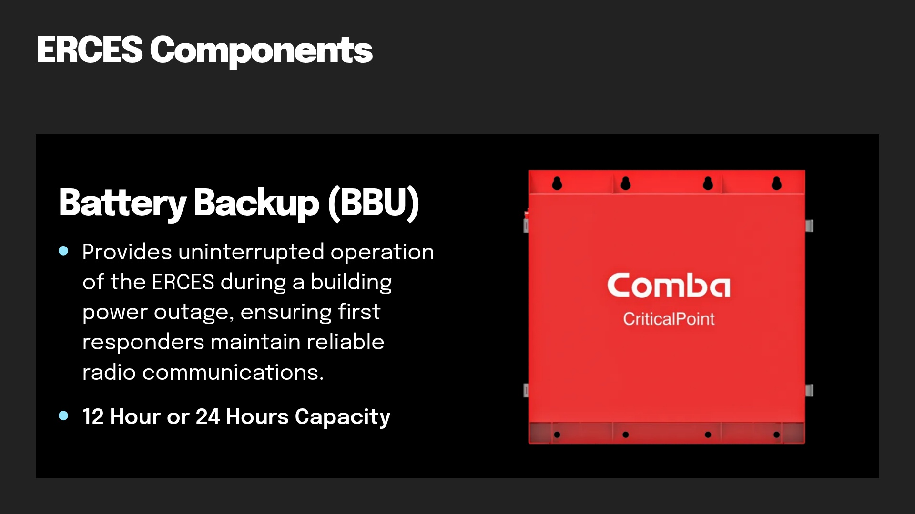
Notes:
Lead acid and Lithium batteries.
12, 24, 48 versions.
SC current requirements are 12hrs.

Slide 11
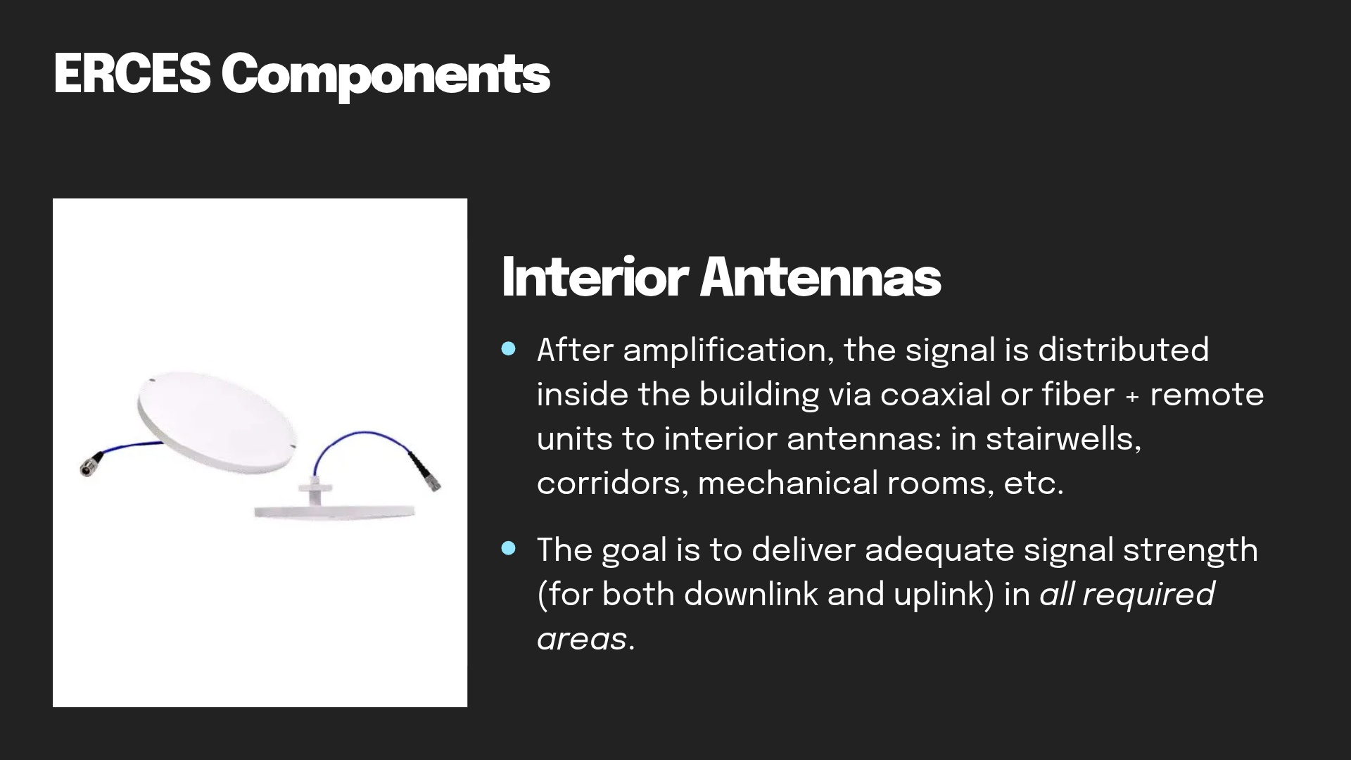
Notes:
Both omni and directional antennas
Band specific
Proper mounting
They are made of plastic
They will not survive long in a fire

Slide 12
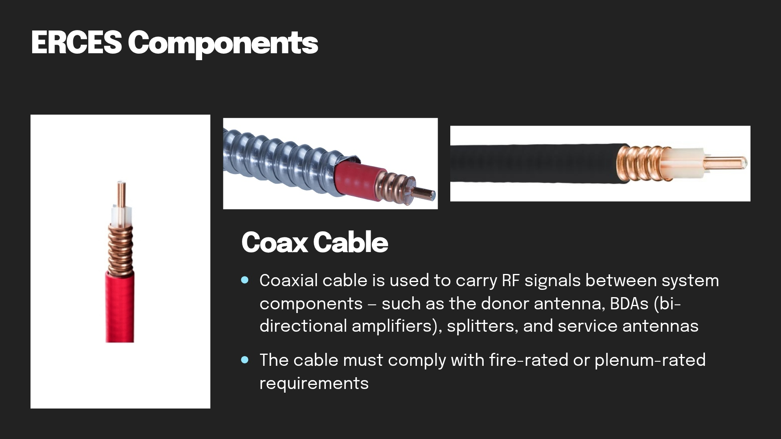
Notes:
Plenum Rated Cable
Red cable is usually used for the inside serving antenna system
Code does not define the cable color
Black coax is usually used for donor antennas and underground runs.
Armored COAX this provides cable survivability rating of 1. Can also run plenum coax in conduit to provide same ratings
Protect donor run. If exposed outside on long runs it needs to be in conduit. Needs to be protected inside the building.
Dragon Skin Coax. 2 hour rated.

Slide 13
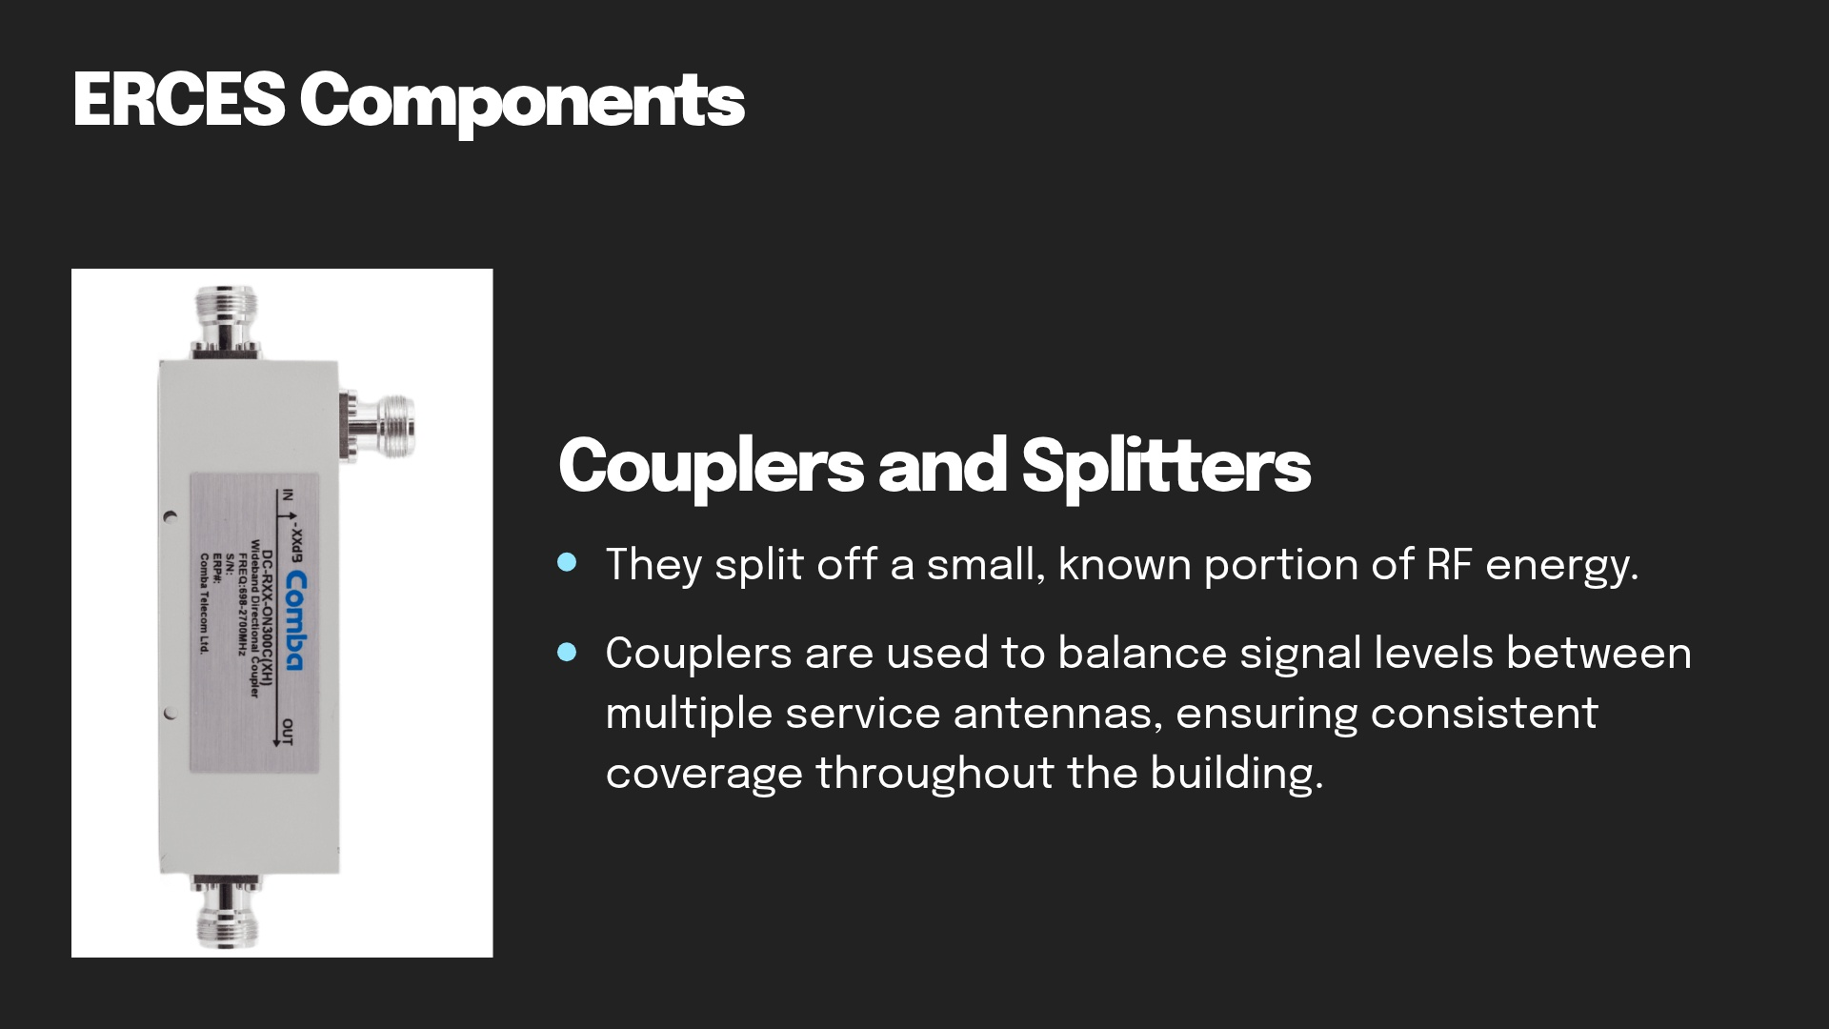
Notes:
This splits RF
Small portions of RF
Used to balance the coverage and make it even across the system

Slide 14
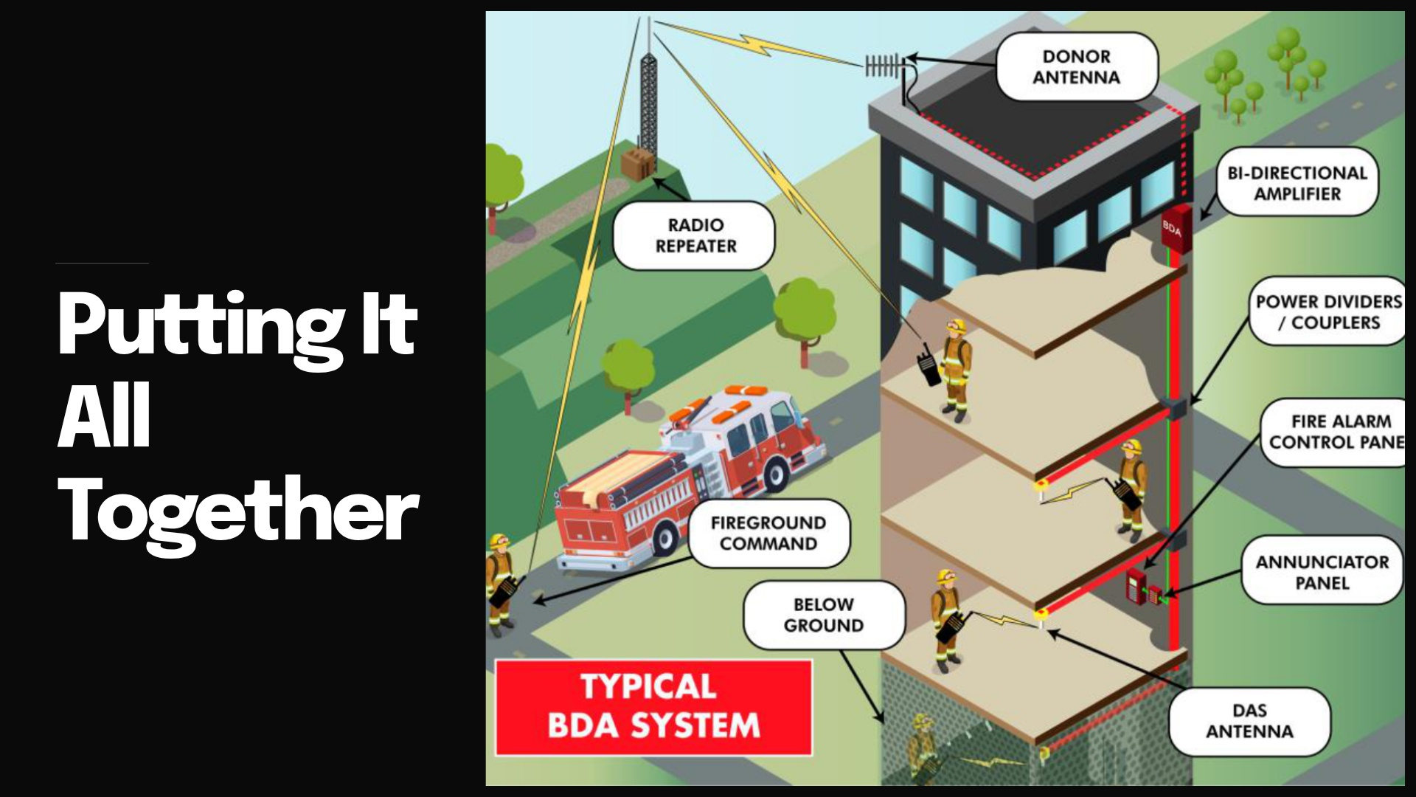

Slide 15
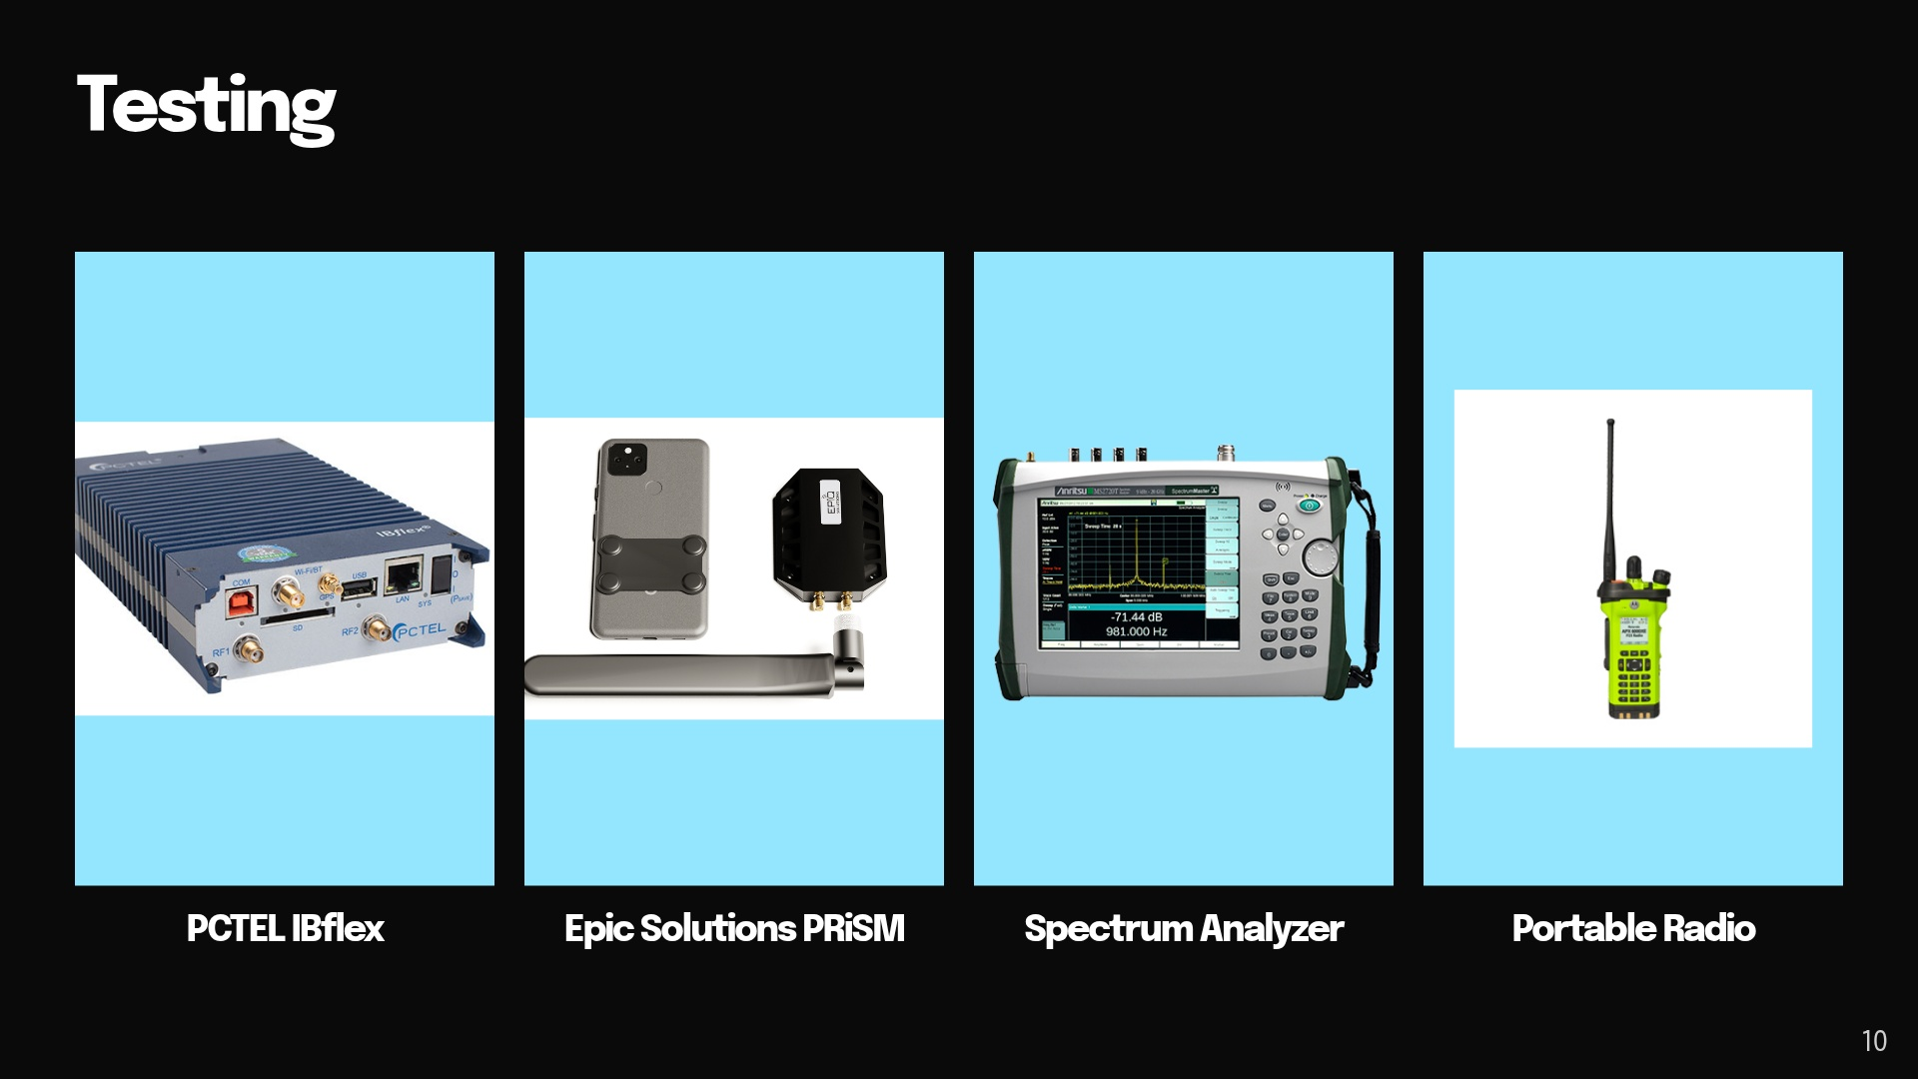

Slide 16
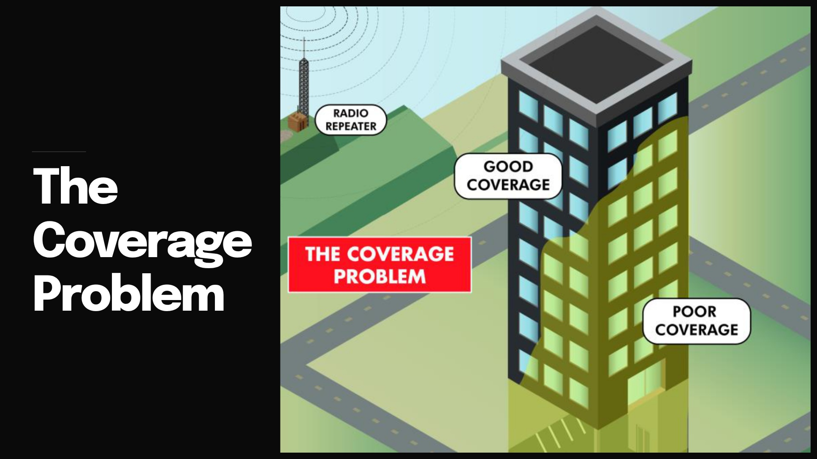

Slide 17
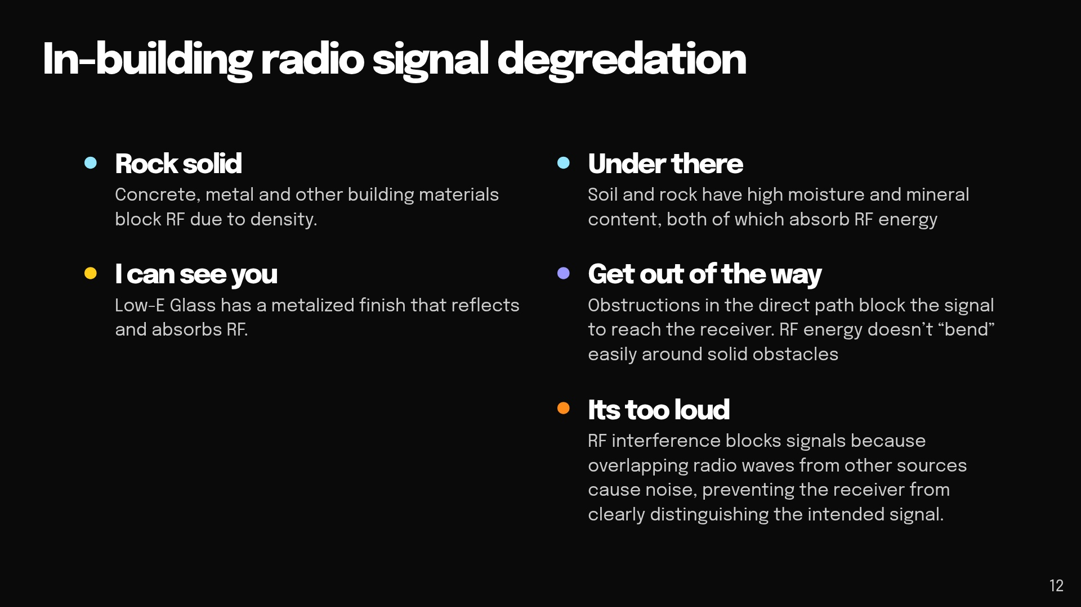

Slide 18
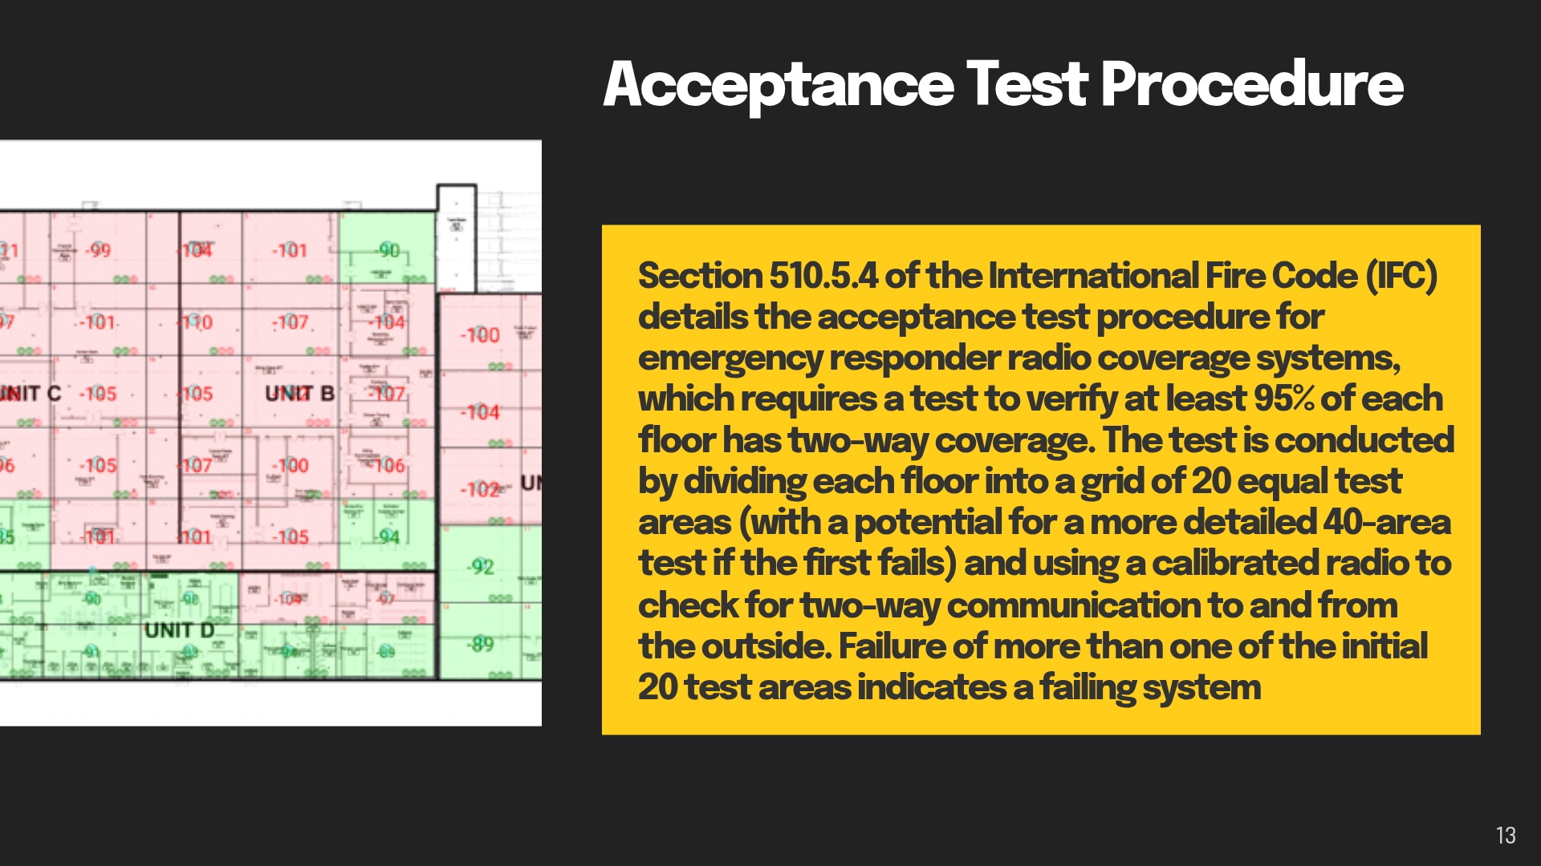

Slide 19
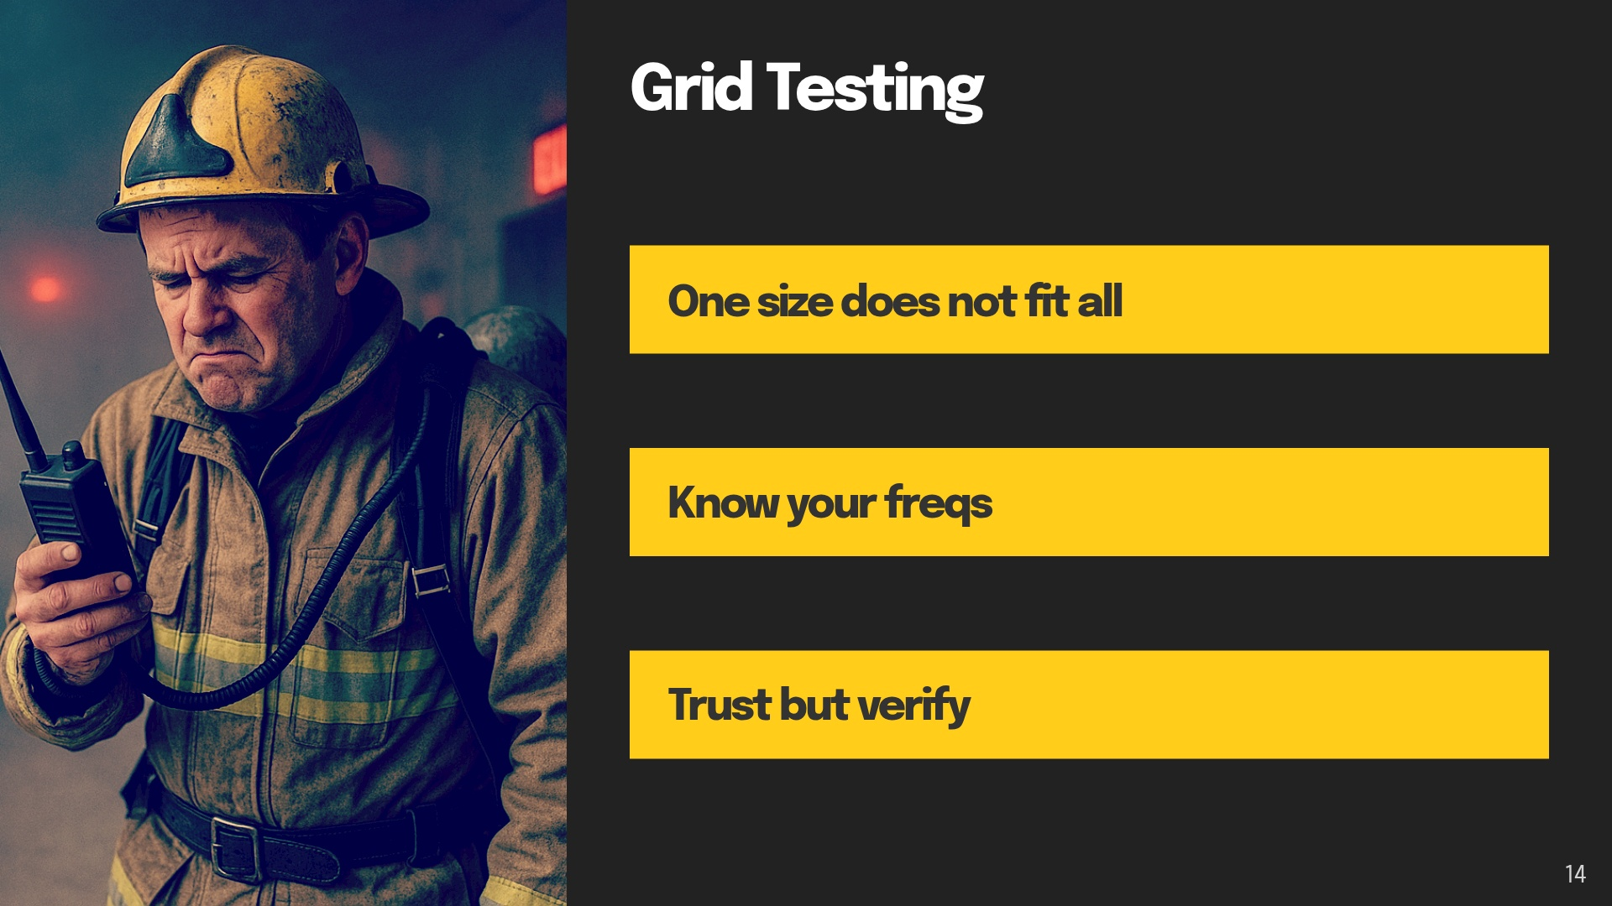
Notes:
Is 20 grids the right answer for a Million sqft building? If you broke up a million sqft building each square would be slightly smaller than a football field (50k sqft vs 57sqft)
Are you verifying the frequencies in the reports?
Reach out to Randy Childress with the state for Palmetto 800. Your local county radio shop ofr UHF/VHF etc
Tests can be falsified. Verify passing tests

Slide 20
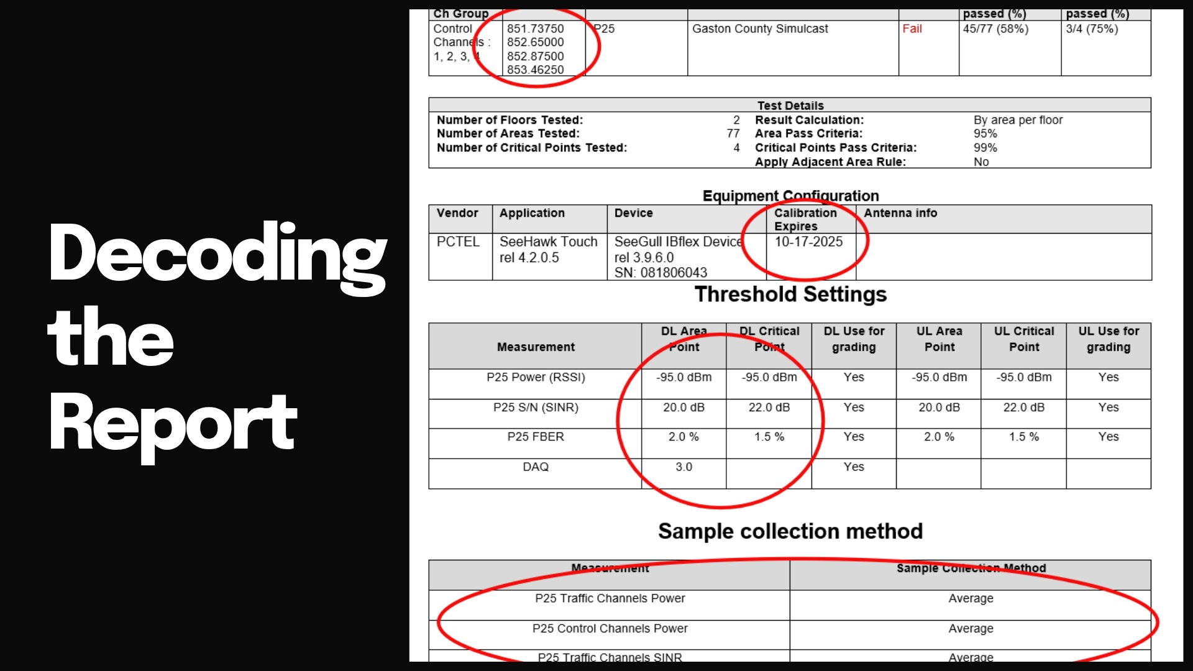

Slide 21
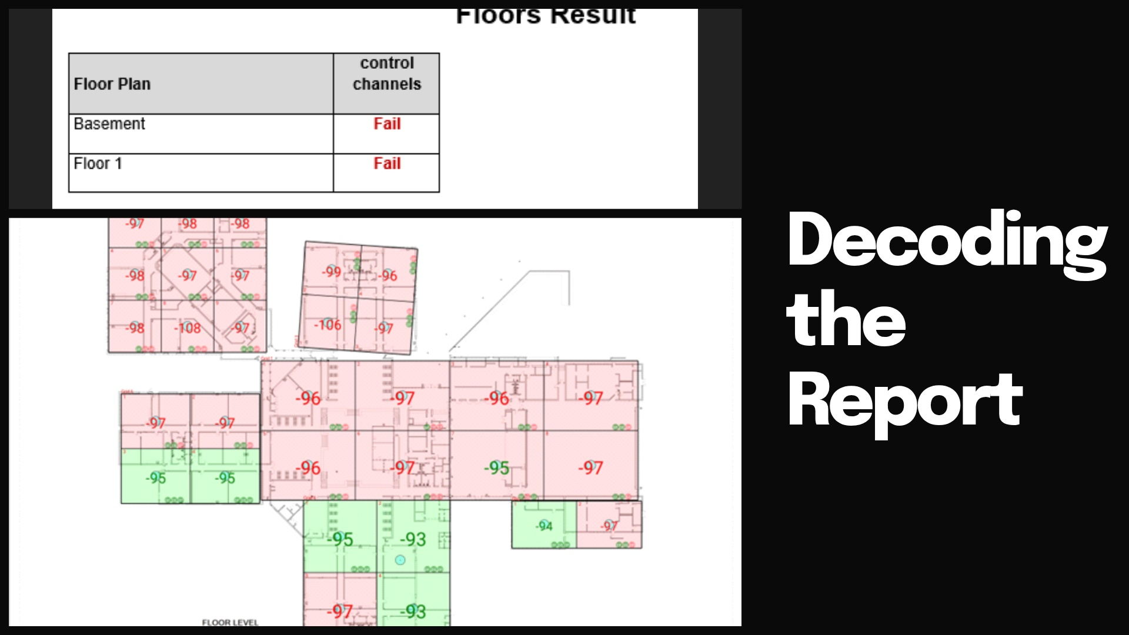

Slide 22
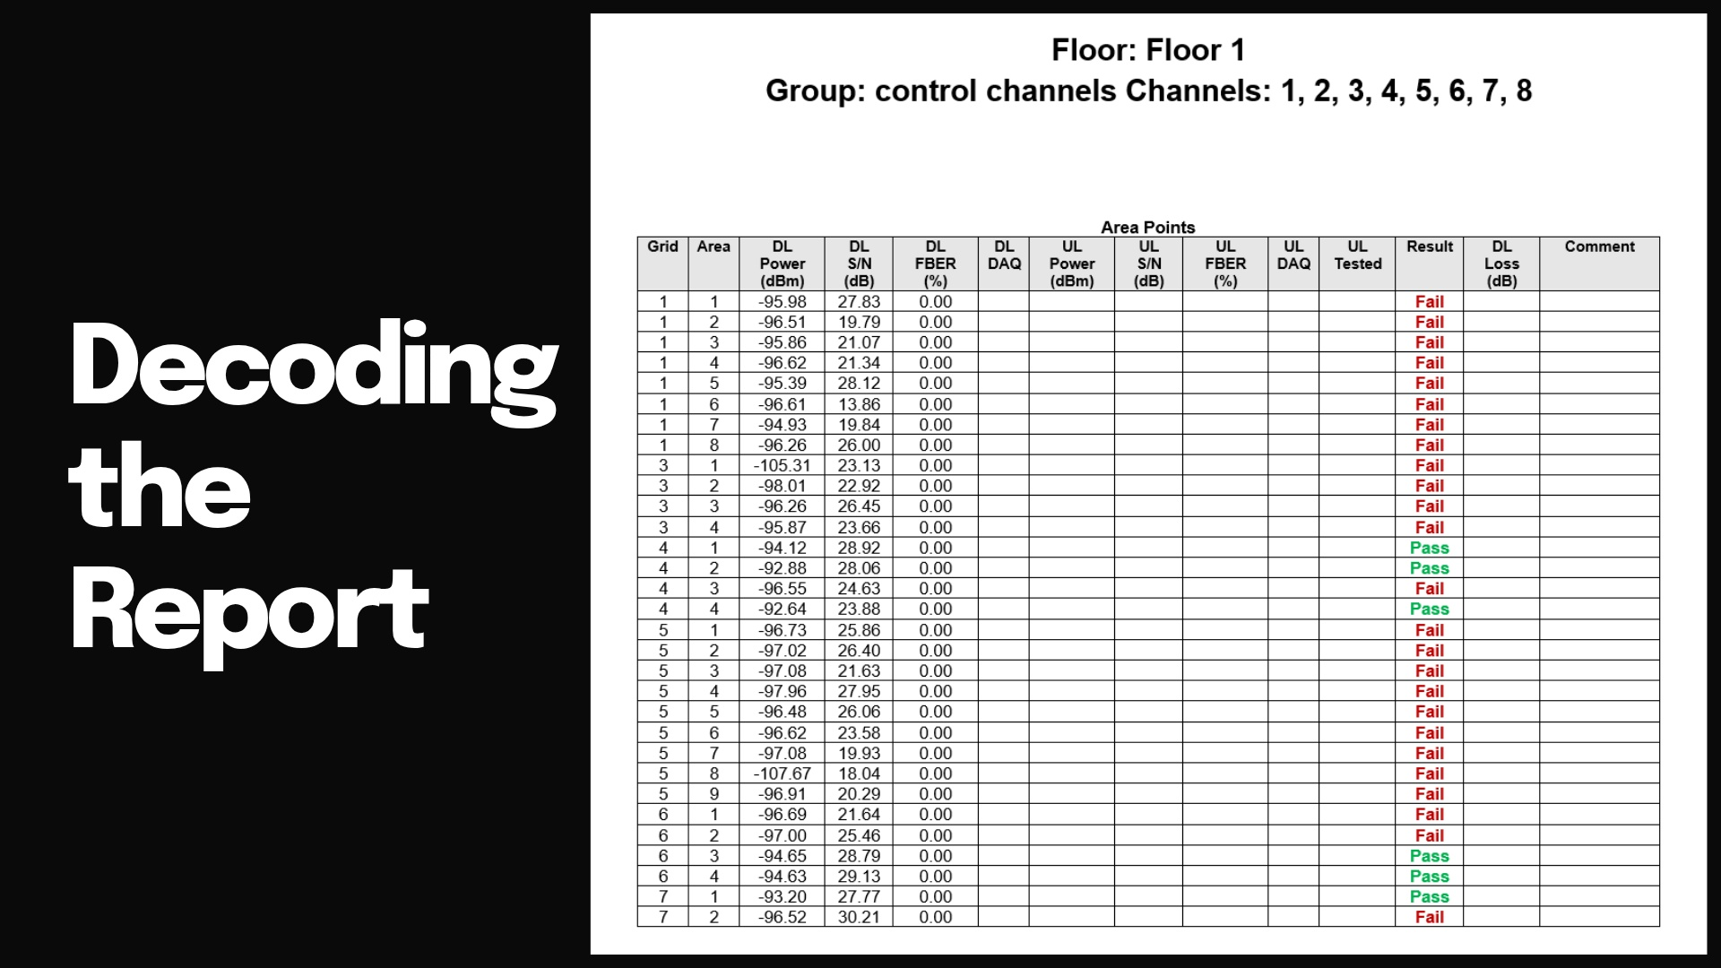
Notes:
RF tests only tell half the story. You will notice the UL Columns are not filled out.
Why?
Uplink testing is only supported with a PCTEL Seehawk Monitor.
Lend a radio to test and add DAQ when available.
Delivered Audio Quality Metrics (DAQ):
DAQ 1 Unusable. Speech present but not understandable.
DAQ 2 Speech understandable with considerable effort. Requires frequent repetition due to noise/distortion. DAQ 3 Speech understandable with slight effort. Requires occasional repetition due to noise/distortion. DAQ 3.4 Speech understandable without repetition. Some noise/distortion present.
DAQ 4 Speech easily understood. Occasional noise/distortion present.
DAQ 5 Speech easily understood.

Slide 23
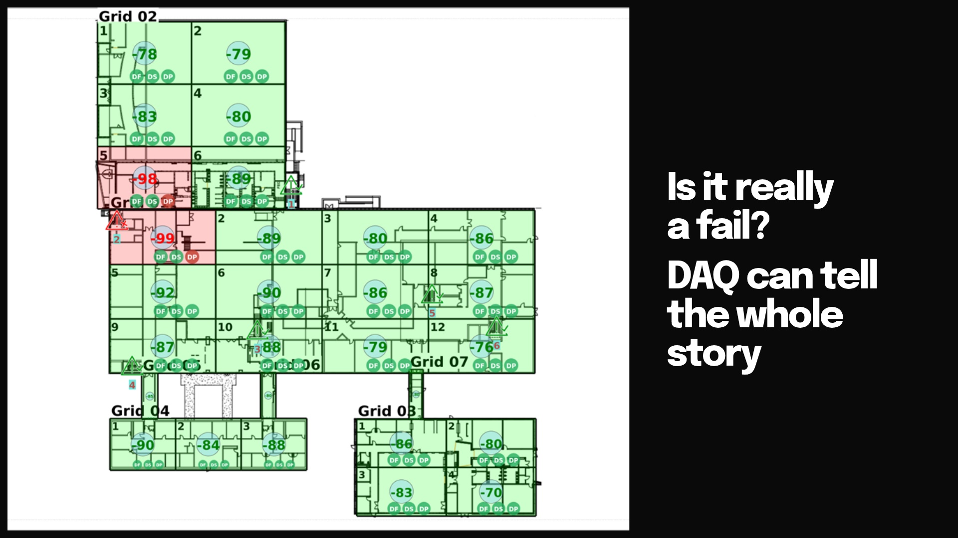
Notes:
I bet radios would work fine here. Would you rather a DAQ test or the hassle and expense of putting in a ERCES system when its not needed?

Slide 24
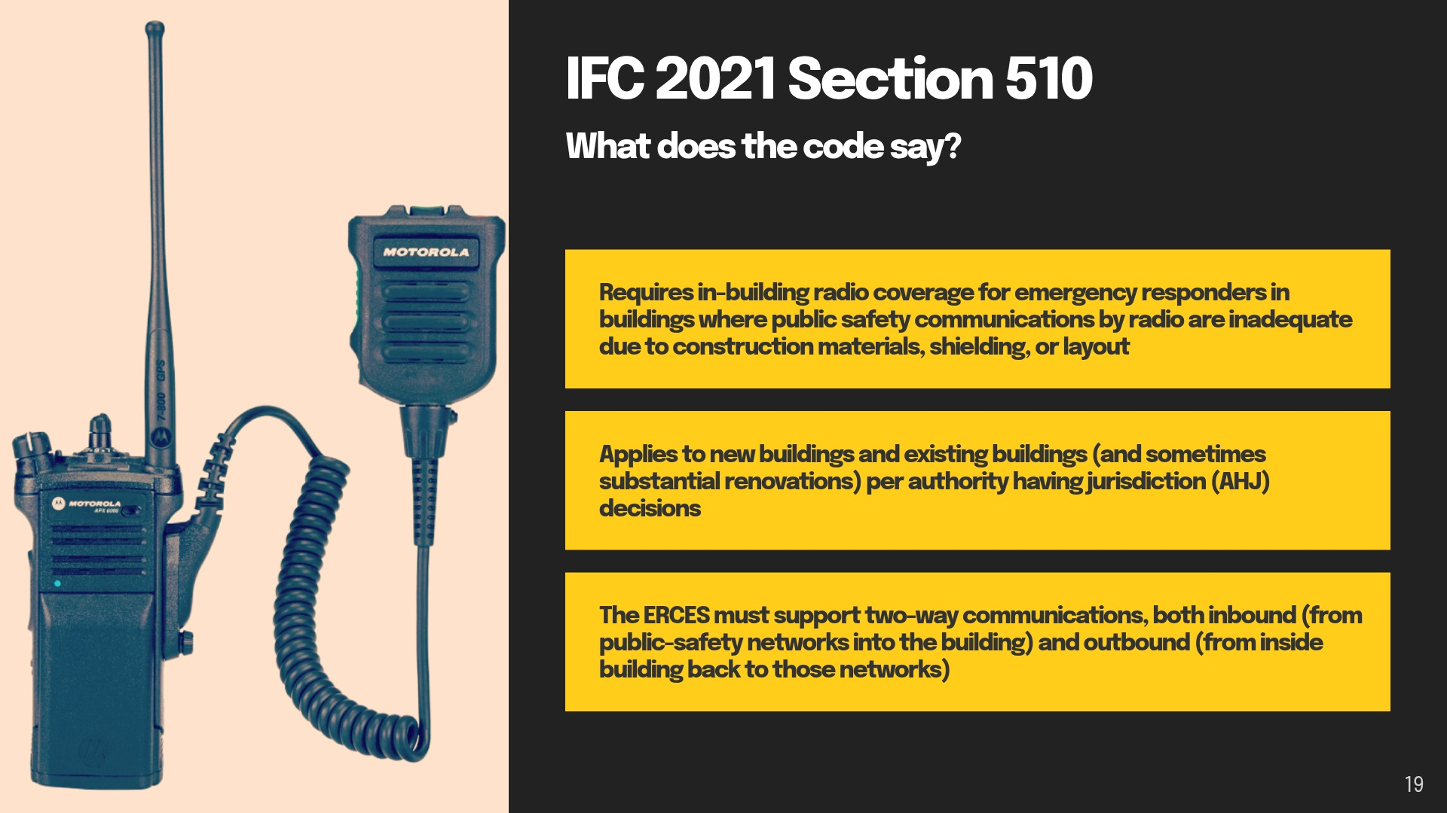

Slide 25
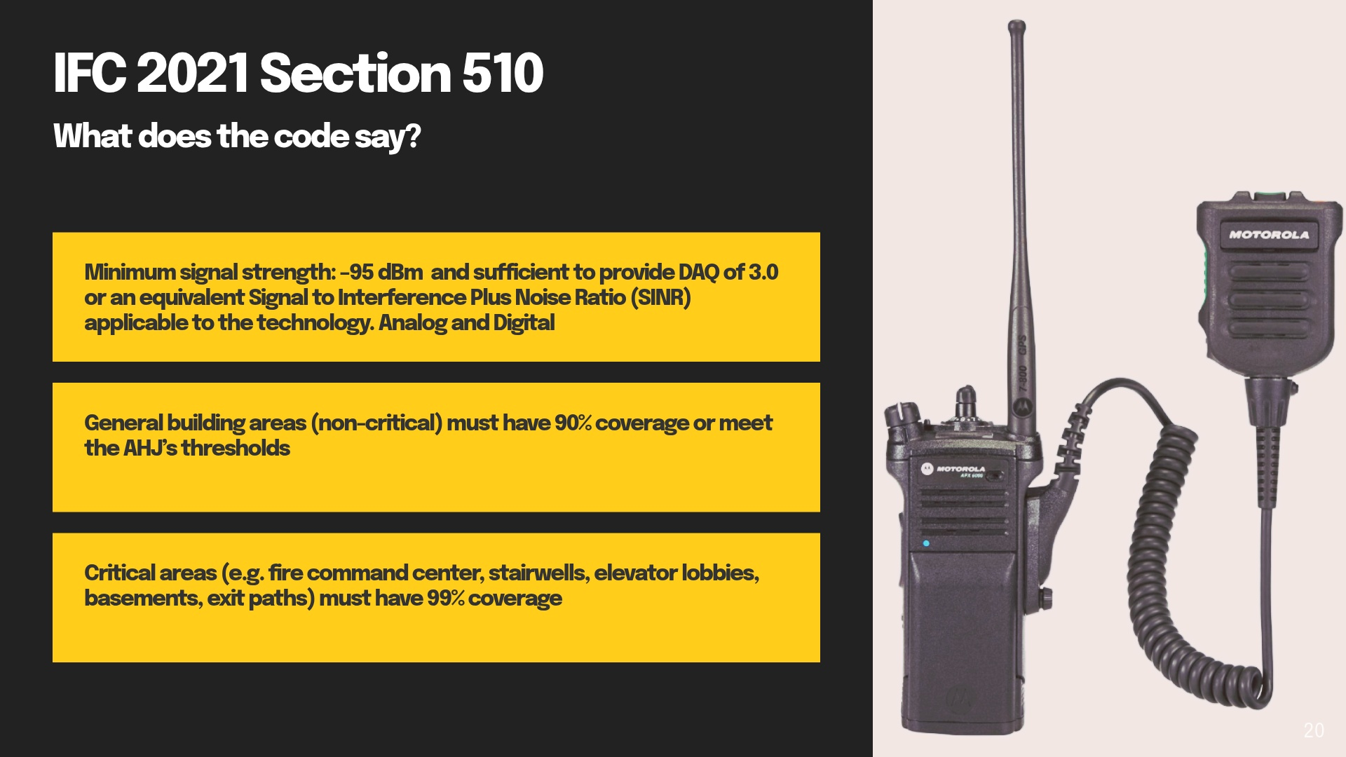

Slide 26
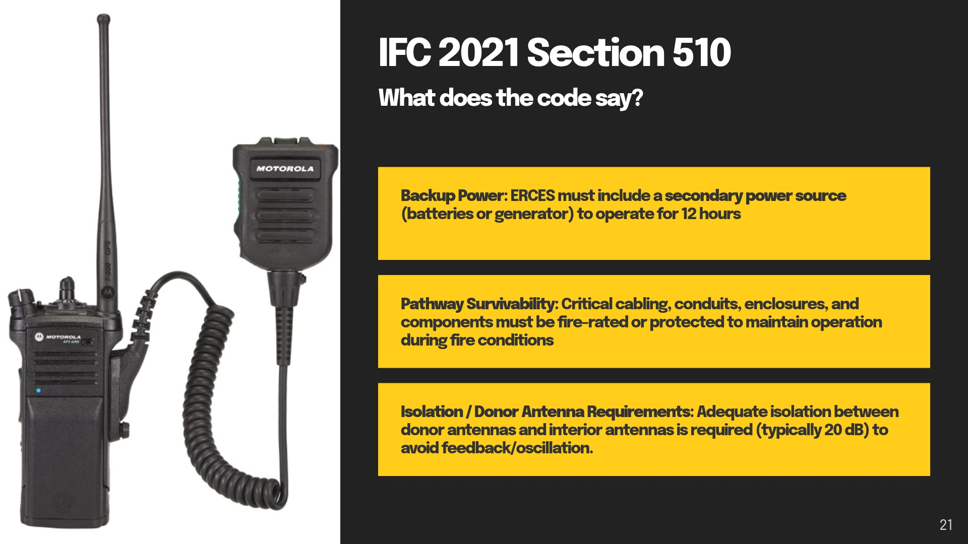

Slide 27
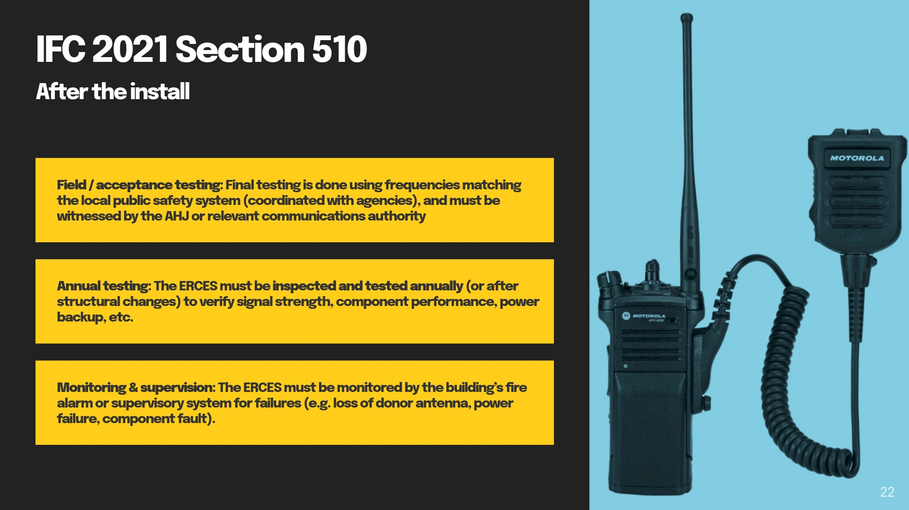

Slide 28
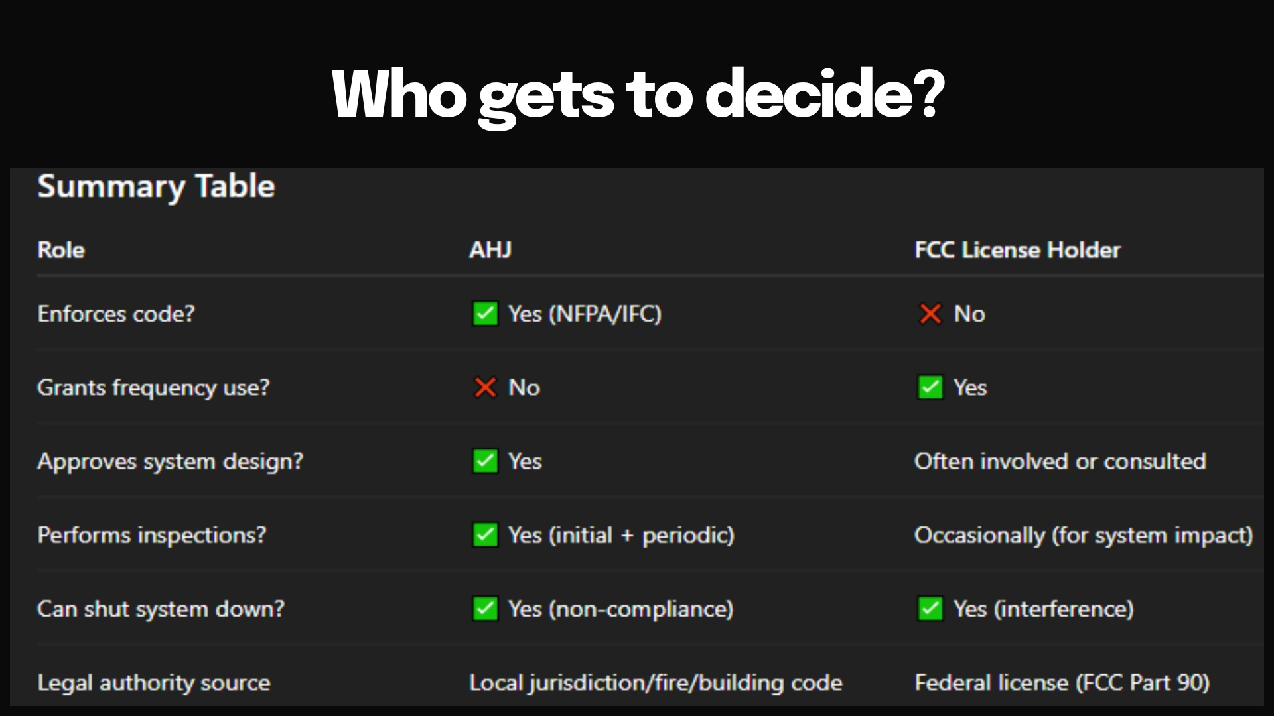
Notes:
FCC License holder must be contacted, and permission must be granted to turn on an ERCES system.
License holder can prevent an ERCES from being used.

Slide 29
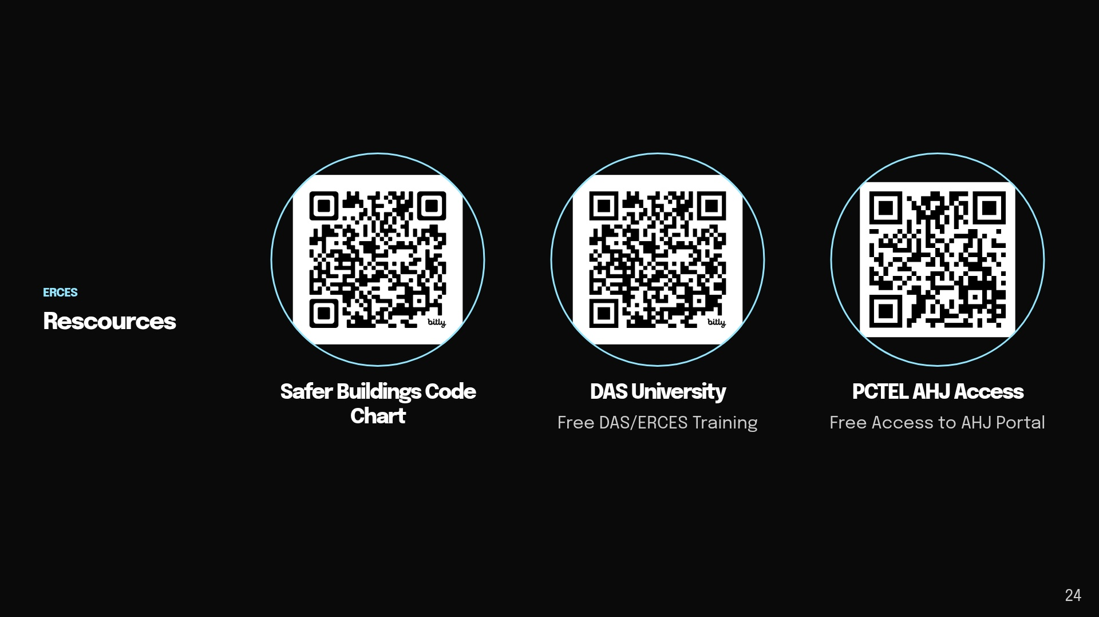

Slide 30


Slide 31
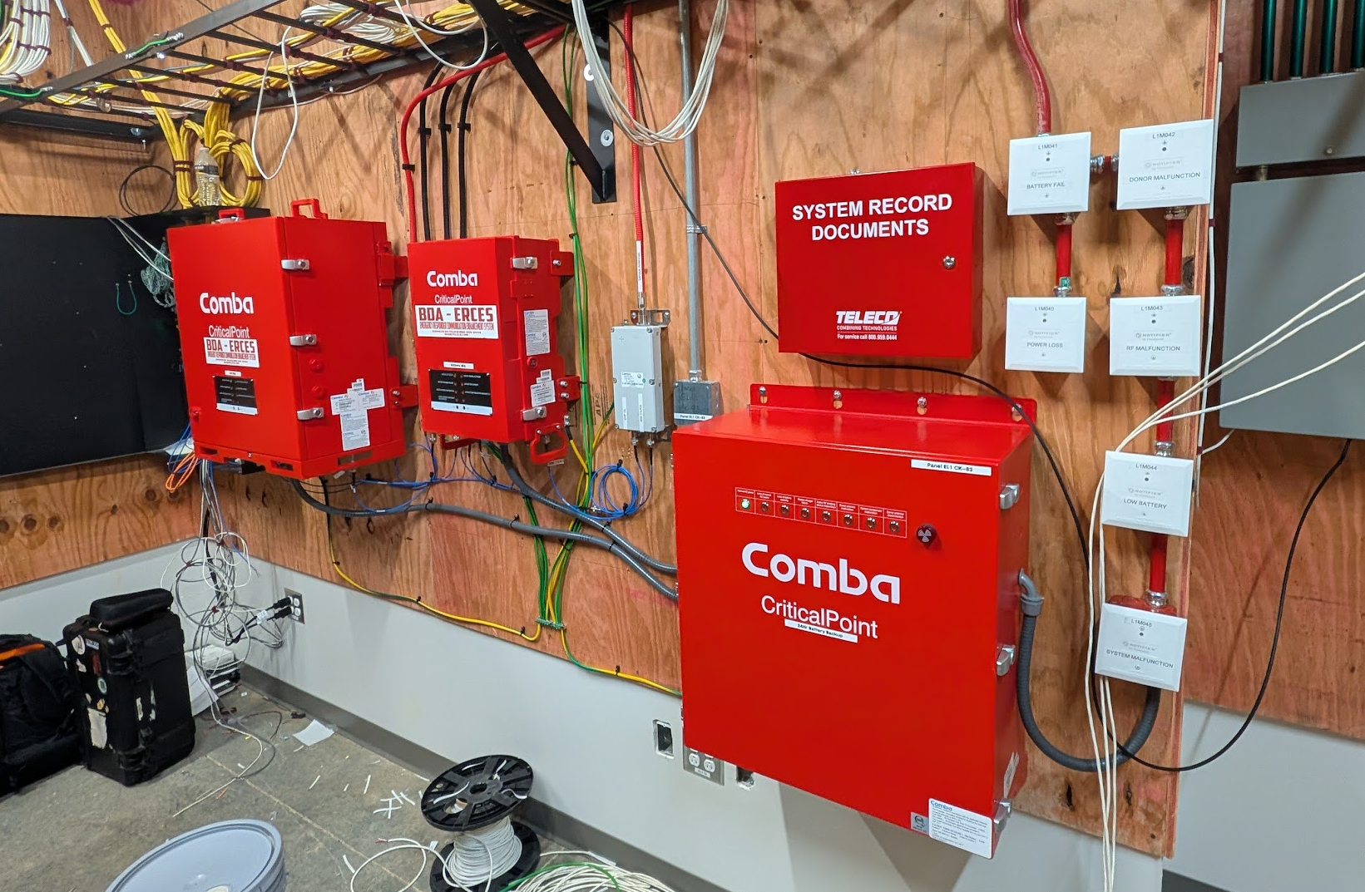

Slide 32
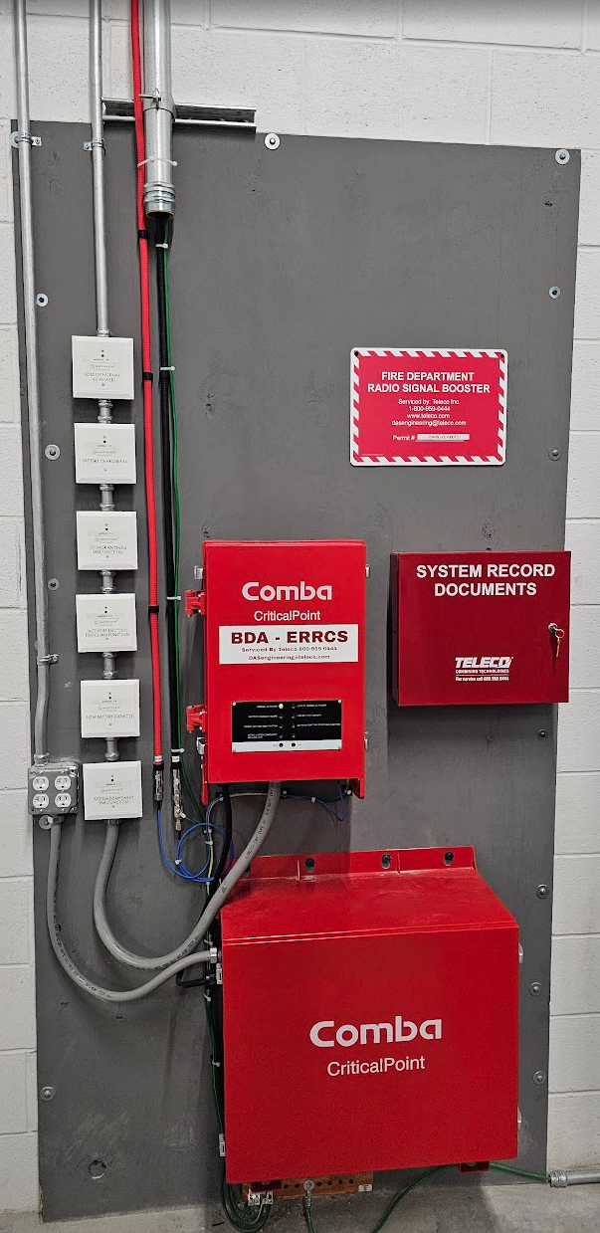

Slide 33
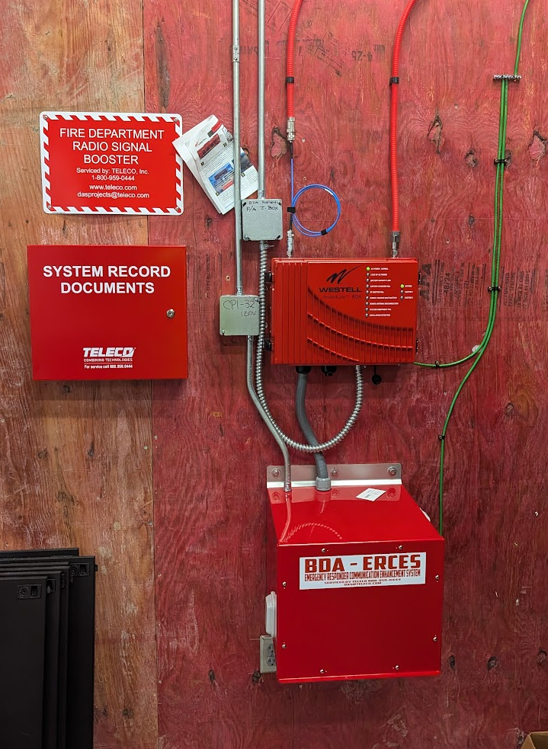

Slide 34
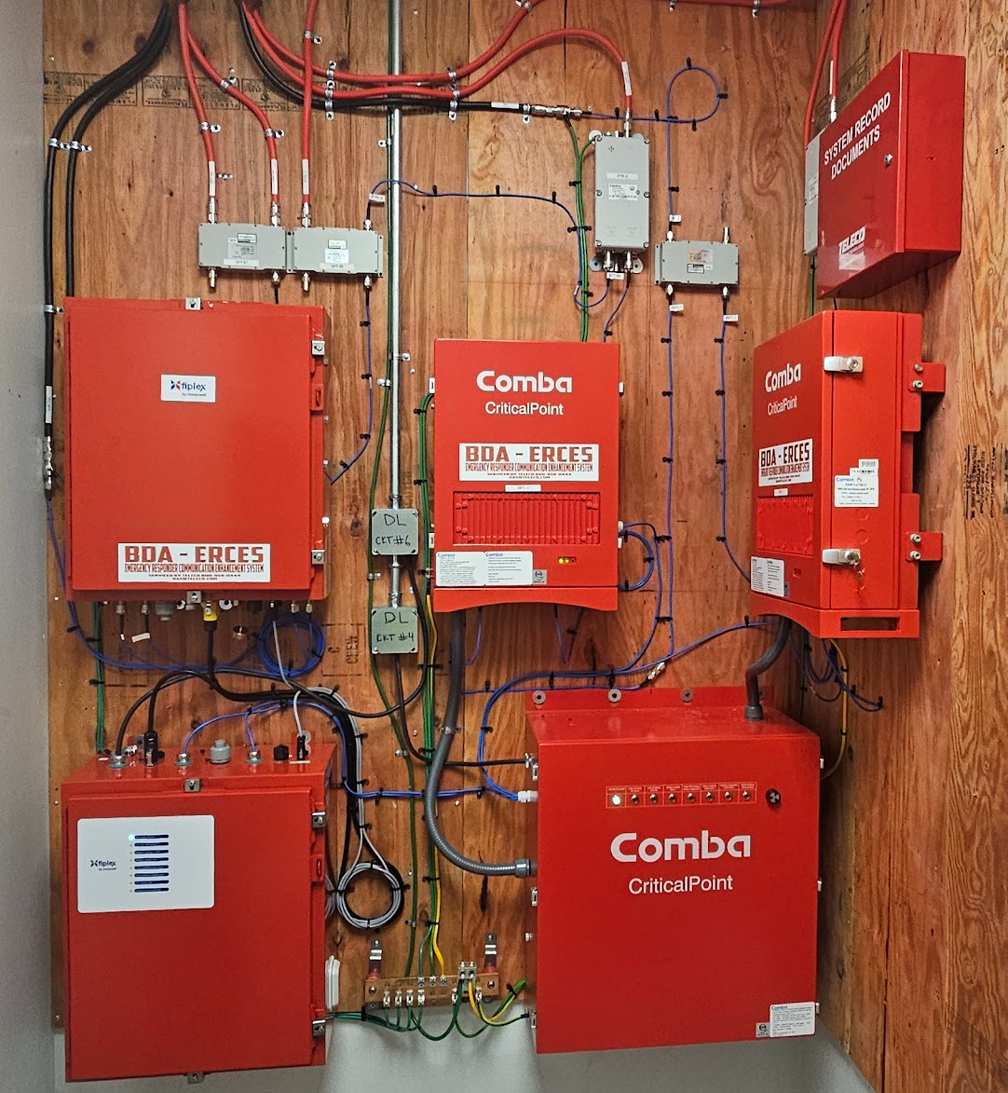

Slide 35
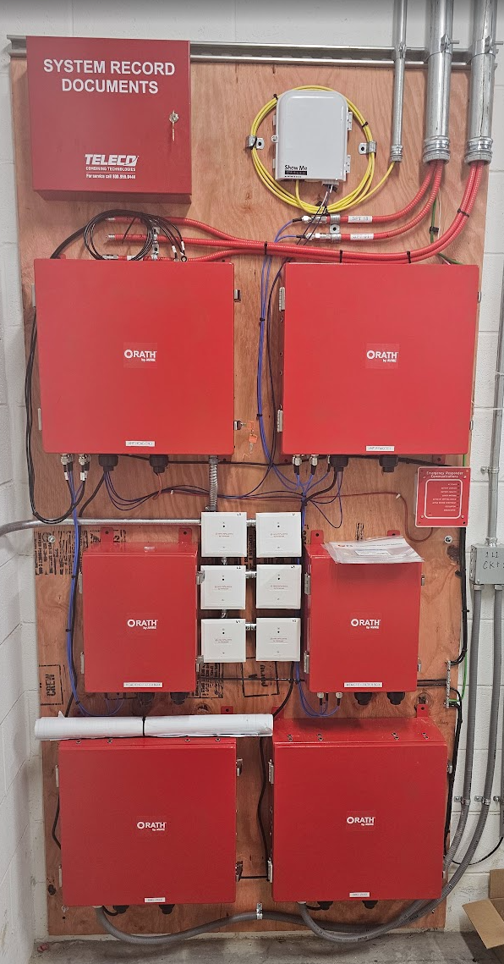

Slide 36
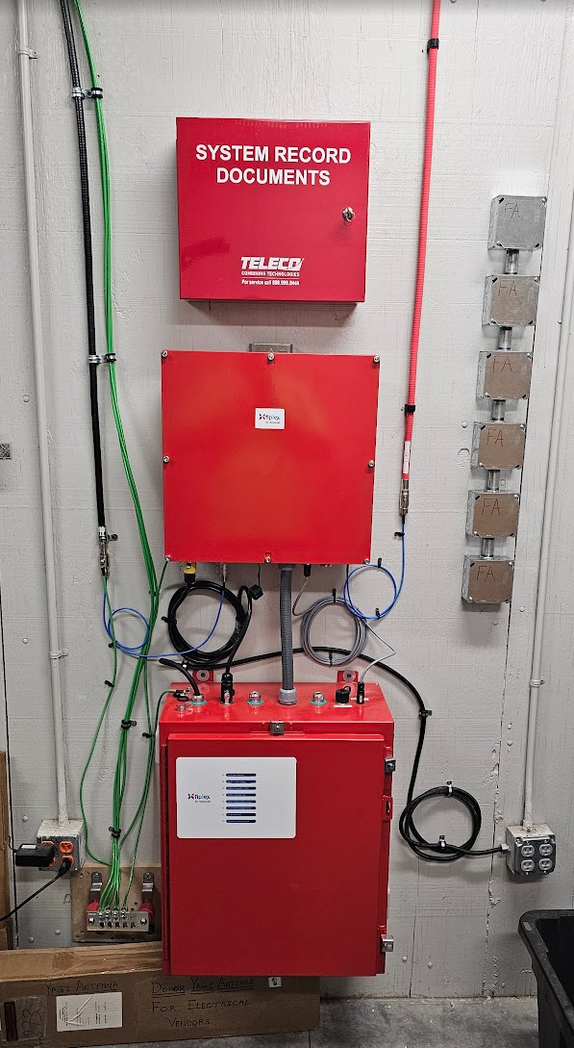

Slide 37
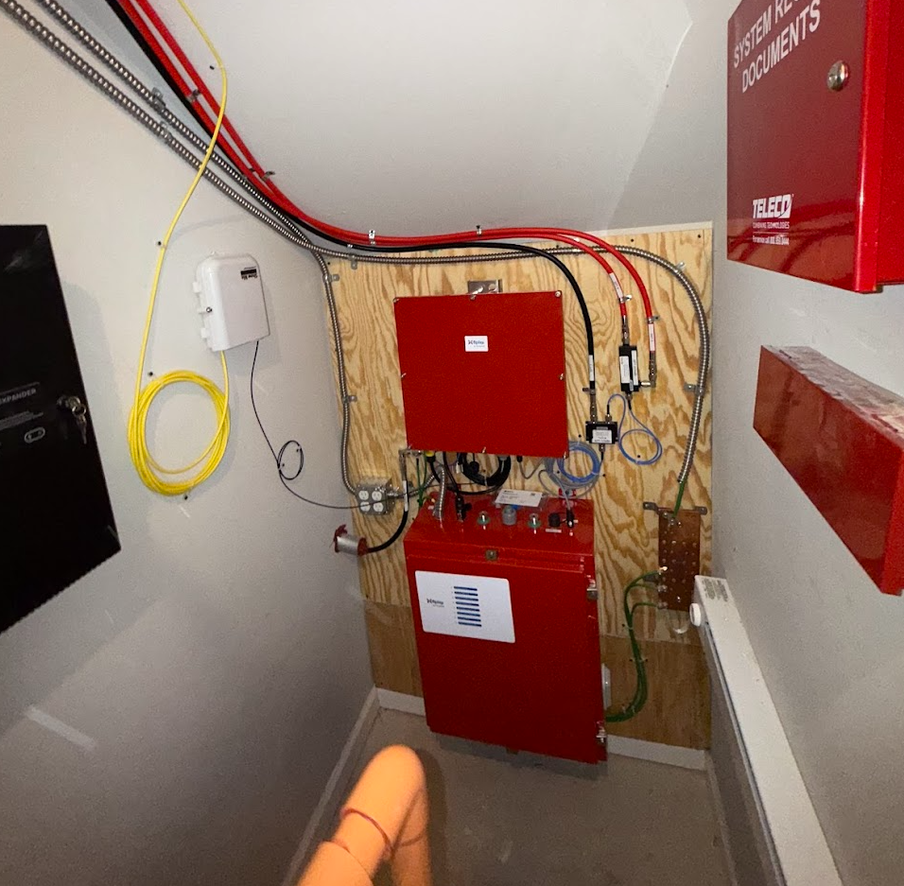

Slide 38
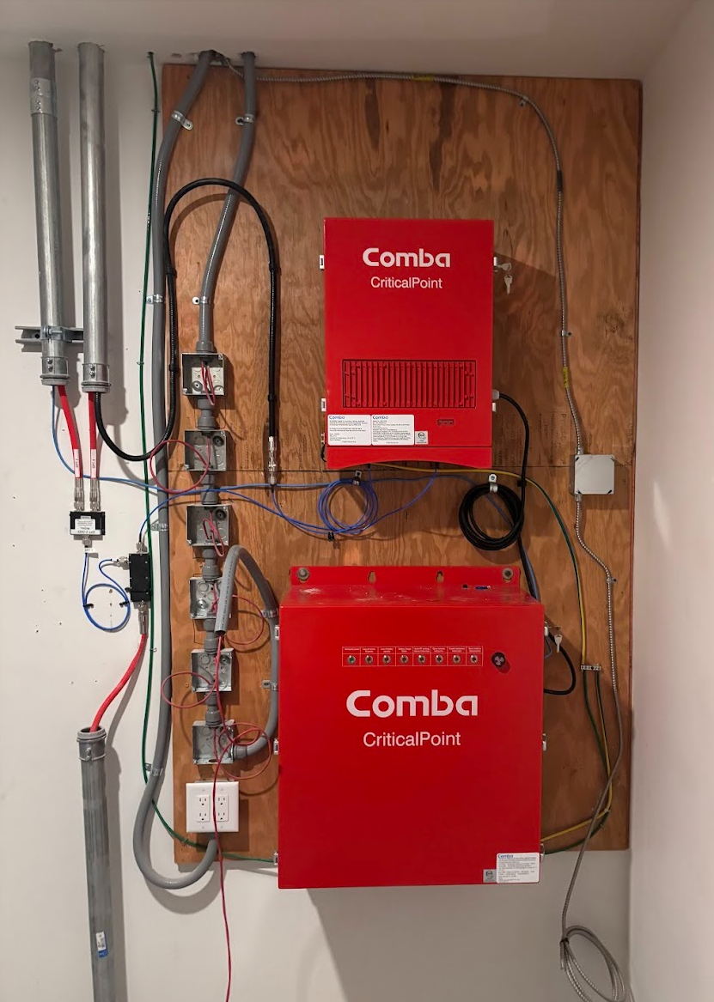

Slide 39
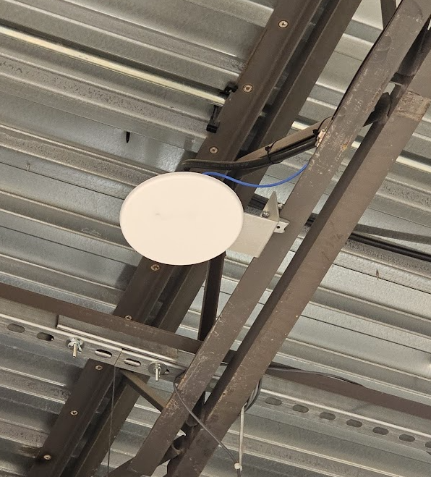

Slide 40
