Slide 1


ADA Accessibility in Construction
Channon Chambers, MCP, CBO, CFM
Clemson University
Building Official
fchambe@clemson.edu
(864)643-6216
https://cufacilities.sites.clemson.edu/documents/capital/ADA%20Checklist%20for%20Existing%20Buildings.pdf

Slide 2
State Regulations:
Accessibility compliance is found in a myriad of laws and codes.
The Office of State Engineer (OSE) is the Authority Having Jurisdiction (AHJ) for state property.
OSE has delegated building code enforcement authority for Clemson University, outside of capital projects, to the Facilities Building Official.
The building official is charged with enforcing the following adopted codes and standards:

Slide 3

Adopted codes and standards:
International Building Code,
International Existing Building Code,
International Fire Code,
International Fuel Gas Code, International Mechanical Code,
International Plumbing Code,
International Property Maintenance Code, International Residential Code,
2009 International Energy Conservation Code, and
Energy Performance Requirements: (LEED) (Green Globes)
International Swimming Pool and Spa Code, International Wildland-Urban Interface Code,
Standard for Bleachers, Folding and Telescopic Seating, and Grandstands, ICC Performance Code,
National Electrical Code (NEC), National Electrical Safety Code (NESC)
International Private Sewage Disposal Code and DHEC requirements.
International Zoning Code/ local zoning ordinances, South Carolina: Procurement Code, Contractors Licensing Act
Modular Buildings Construction Act, Building Standards in Floodplain Areas (FEMA),
Telephone Equipment Room and Communications/Data Systems Policies (OTIS)
Elevator, Code, & Regulations, ASME A17.1
State Fire Marshal rules, regulations, and policies…

Slide 4
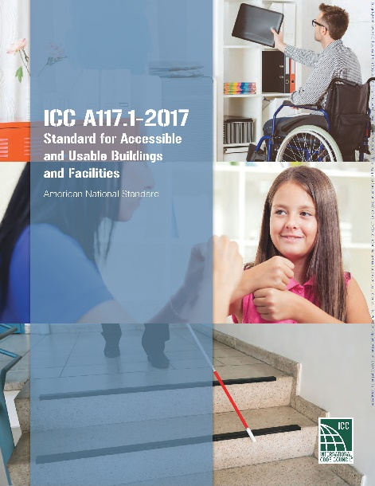
Latest edition of the ICC A117.1, Accessible and Useable Buildings and Facilities. Note that this is the standard adopted by the South Carolina Accessibility Act, but this requirement does not relieve the Agency (Clemson University) or the design professional from the Federal Statutory requirements that design, and construction comply with the Americans with Disabilities Act Accessibility Guidelines for Buildings and Facilities.

Slide 5
The International Building Code (IBC) or South Carolina Building Code requirements are separate from the federal standards and are enforced by the local jurisdiction. Local jurisdictions do not have the authority to enforce the federal mandates. However, the regulations in the IBC and associated ICC Standard for Accessible and Usable Buildings and Facilities (A ll7.1) are very similar to the federal standards. Both have been accepted by HUD as "safe harbor" documents and the design is deemed to comply with the FFHA. In many cases, the code is more restrictive than the federal requirements.
The scoping requirements of the IBC start out by requiring all new sites, buildings, structures, facilities, elements and spaces, temporary or permanent, to be accessible to people with physical disabilities.

Slide 6
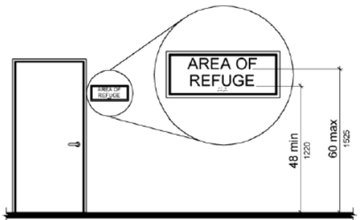
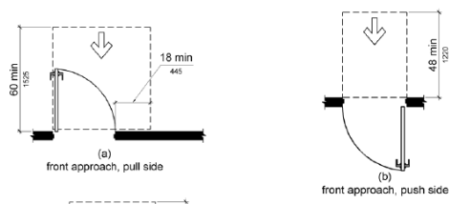
Federal Regulations:
Prior to the ADA, The Architectural Barriers Act and the Federal Fair Housing Act (FFHA 504) are laws that requires facilities designed, built, altered or leased with Federal funds to be accessible and to provide accessible living facilities for people with disabilities. The FFHA is enforced by the U.S. Department of Housing and Urban Development (HUD). It also has design guidelines that provide the minimum requirements with which the design and construction must comply.

Slide 7
Federal Regulations:
In 1990, President George H. W. Bush signed the American with Disabilities Act (ADA). It was a civil rights legislation to provide a clear and comprehensive national mandate for the elimination of discrimination against individuals with disabilities.
The ADA consists of five titles outlining protections in the following areas:
Employment
State and local government services
Public accommodations
Telecommunications
Miscellaneous Provisions

Slide 8
Federal Regulations:
Title II of ADA pertains to the programs, activities and services provided by public entities. Clemson University must comply with this section of the Act, as it specifically applies to public service agencies.
“no qualified individual with a disability shall, by reason of such disability, be excluded from participation in or be denied the benefits of the services, programs, or activities of a public entity, or be subjected to discrimination by any such entity.”
The ADA references the Americans with Disabilities Act Standard for Accessible Design (2010 ADA) for buildings and facilities if the construction was commenced after January 26, 1992.

Slide 9
Individuals with disabilities must be provided an equally effective opportunity to participate in or benefit from a public entity's aids, benefits, and services
A “Disability” is broadly defined by law. It includes mental health conditions, autism spectrum disorder, ADD/ADHD, chronic health issues, learning disabilities, sensory and physical disabilities, and acute health issues and temporary injuries.
An organization is required to make reasonable modifications in policies, practices, or procedures when the modifications are necessary to avoid discrimination on the basis of disability, unless the organization can demonstrate that making the modifications would fundamentally alter the nature of the service, program, or activity.

Slide 10
Exceptions:
There is no general “grandfather clause” in the ADA that exempts older facilities.
The Standards apply differently depending on whether the Agency is providing access to programs or services in existing facilities or, is altering an existing facility or building a new facility.
For example, if a story is located above or below the accessible level, and the story is 3,000 square feet or less in floor area, an accessible route may not be required. However, this exception is not applicable for Title II institutions.
Accessibility may be provided using the International Existing Building Code (IEBC)

Slide 11
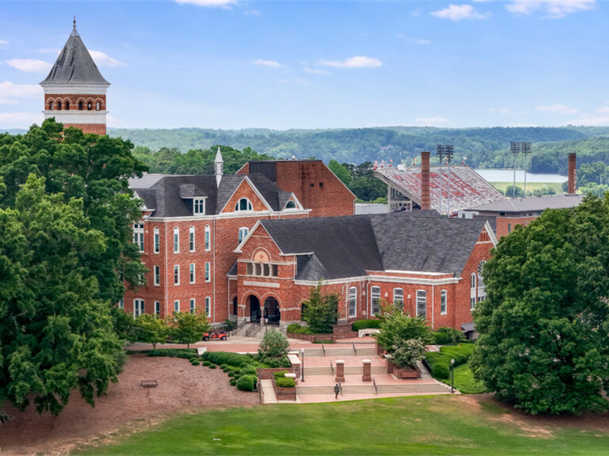

Slide 12
Exceptions:
“Technically Unfeasible” is OSE term for
Structurally impracticable only in those rare circumstances when the unique characteristics of terrain prevent the incorporation of accessibility features.
Alterations even to historic properties shall comply, to the maximum extent feasible without changing the significance of the property.
Alterations deemed disproportionate to the overall alteration (IEBC 305) when the cost exceeds 20 % to provide an accessible path of travel to the primary function area. A title II entity may not use the disproportionality exception to providing an accessible route as part of its obligation to provide program accessibility.

Slide 13
OSE Manual: 5.6.5 Accessibility by the Physically Disabled
If in the opinion of the A/E, the building cannot provide accessibility to the physically disabled due to technical unfeasibility, the A/E must provide, during Schematic Design submittal:
  1. A prioritized list of deficiencies.
  2. The reasons supporting a finding of technical unfeasibility; and
  3. Design alternatives.
After reviewing the Schematic Design, OSE may consider “technical infeasibility” as an acceptable rationale for less than full compliance.

Slide 14
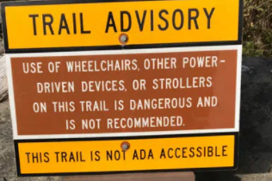
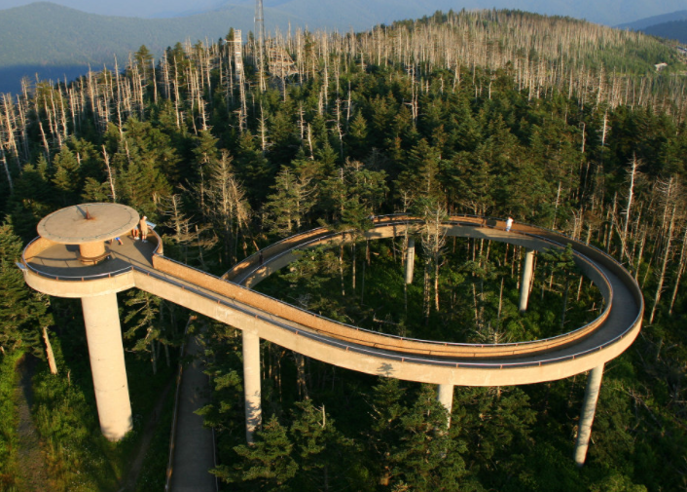
Notes:
The second exception is “Technically Unfeasible” or “Structurally impracticable ”. Other exceptions include Limited Access Spaces and Machinery Spaces, Equipment Spaces for repair and monitoring, Walk-in coolers and freezers accessed only by employees, Employee Work Areas less than 300 square feet where elevation change is required.
Detached one- and two-family dwellings and their accessory structures, R-1 owner occupied bed and breakfast
Construction sites, Utility Buildings Farms but Agricultural Buildings require access to paved work areas and areas open to general public.

Slide 15
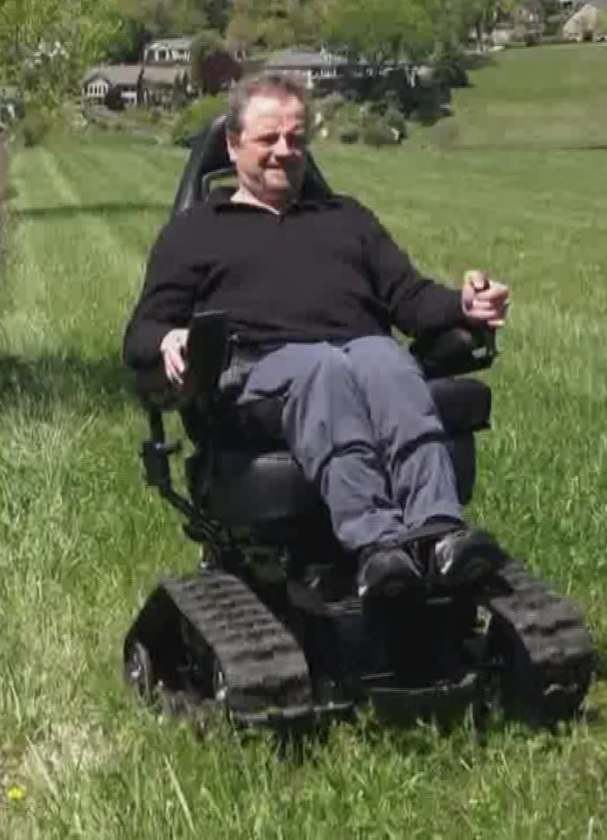
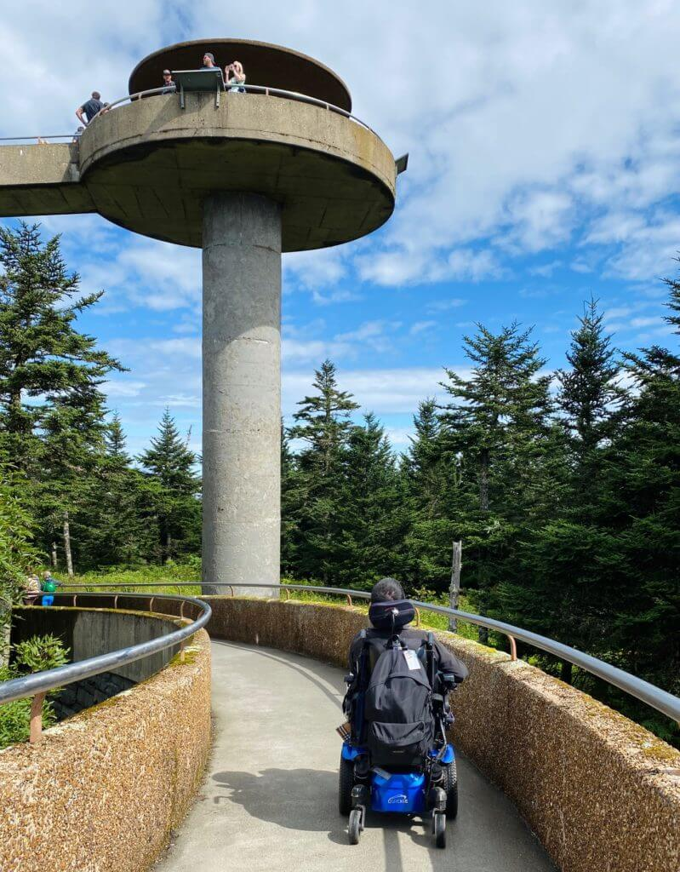
Notes:
New technologies are changing opportunities. Aira Tech Corp is a technology company providing access to visual information, anytime, anywhere. This service is a live, human-to-human professional assistance service for people who are blind or have low vision.

Slide 16
IEBC 306.7.1 Alterations affecting an area containing a primary function.
Where an alteration (or change of occupancy) affects the accessibility to, or contains an area of primary function, the route to the primary function area shall be accessible. The accessible route to the primary function area shall include toilet facilities and drinking fountains serving the area of primary function.
Exceptions:
  1.The costs of providing the accessible route are not required to exceed 20 percent of the costs of the alterations affecting the area of primary function.
  2.This provision does not apply to alterations limited solely to windows, hardware, operating controls, electrical outlets and signs.
  3.This provision does not apply to alterations limited solely to mechanical systems, electrical systems, installation or alteration of fire protection systems and abatement of hazardous materials.
  4.This provision does not apply to alterations undertaken for the primary purpose of increasing the accessibility of a facility.
  5.This provision does not apply to altered areas limited to Type B dwelling and sleeping units.

Slide 17
Priorities:
Parking and Transit Stops
Approach and Entrance
Primary Function
Access to Public Restrooms
Provide an "accessible route." A continuous, unobstructed path from site arrival to primary function and public facilities.
The accessible route must coincide with or be located in the same area as the general circulation path.
For example, the person with the dis­ability cannot be required to go outside the building to get to a space where an unimpaired person could get there by just going through the building.

Slide 18
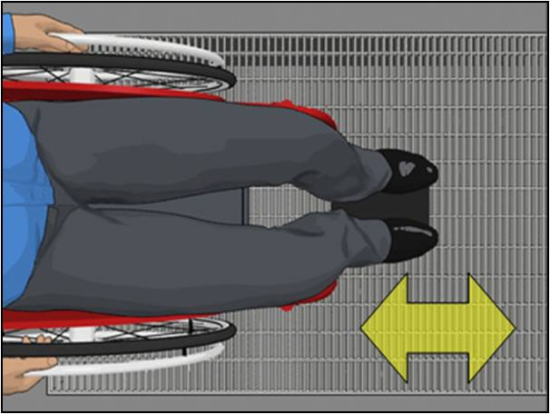
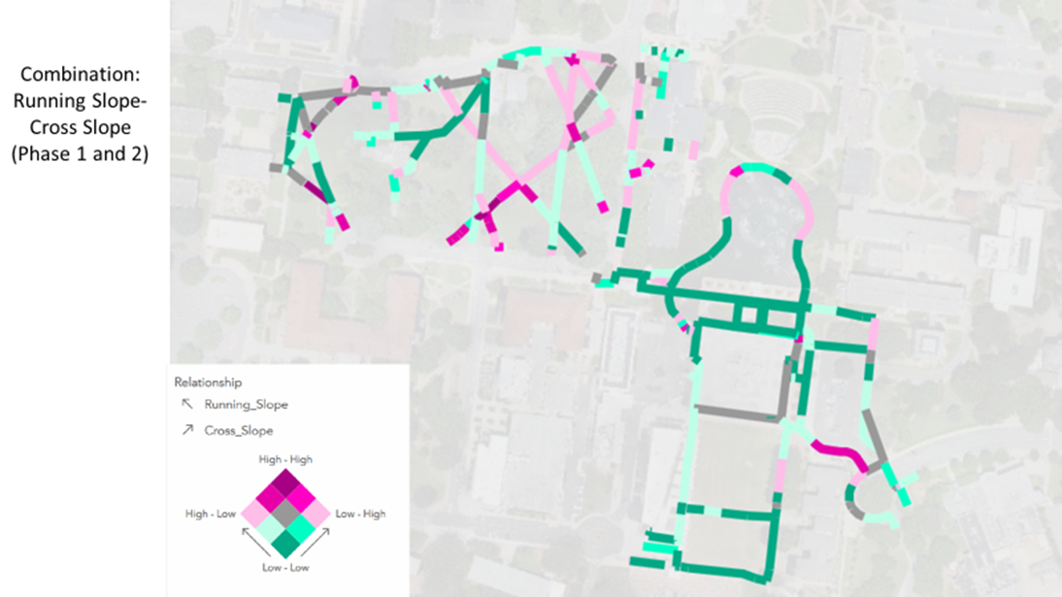
Accessible Path Into the Building
An accessible path must be provided from points where people arrive at the property such as bus stops, parking spaces, passenger loading zones and public streets or sidewalks to the accessible building entrance.
At least 60 percent of the public entrances into a building must be accessible.
This means that if two public entrances are provided, both must be accessible.

Slide 19
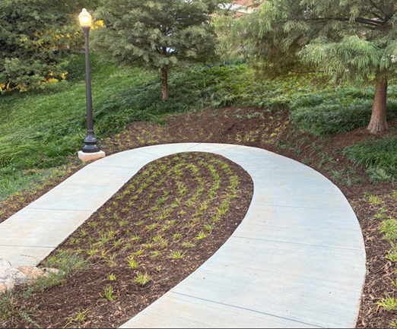

Slide 20
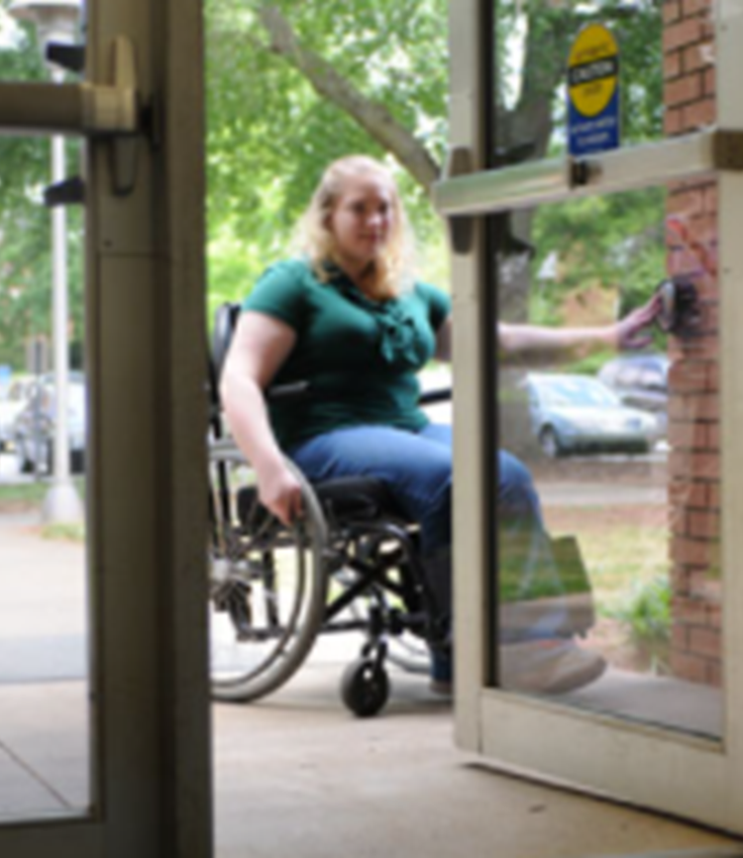
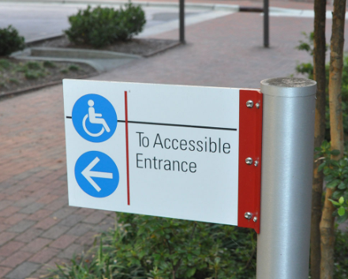


Slide 21
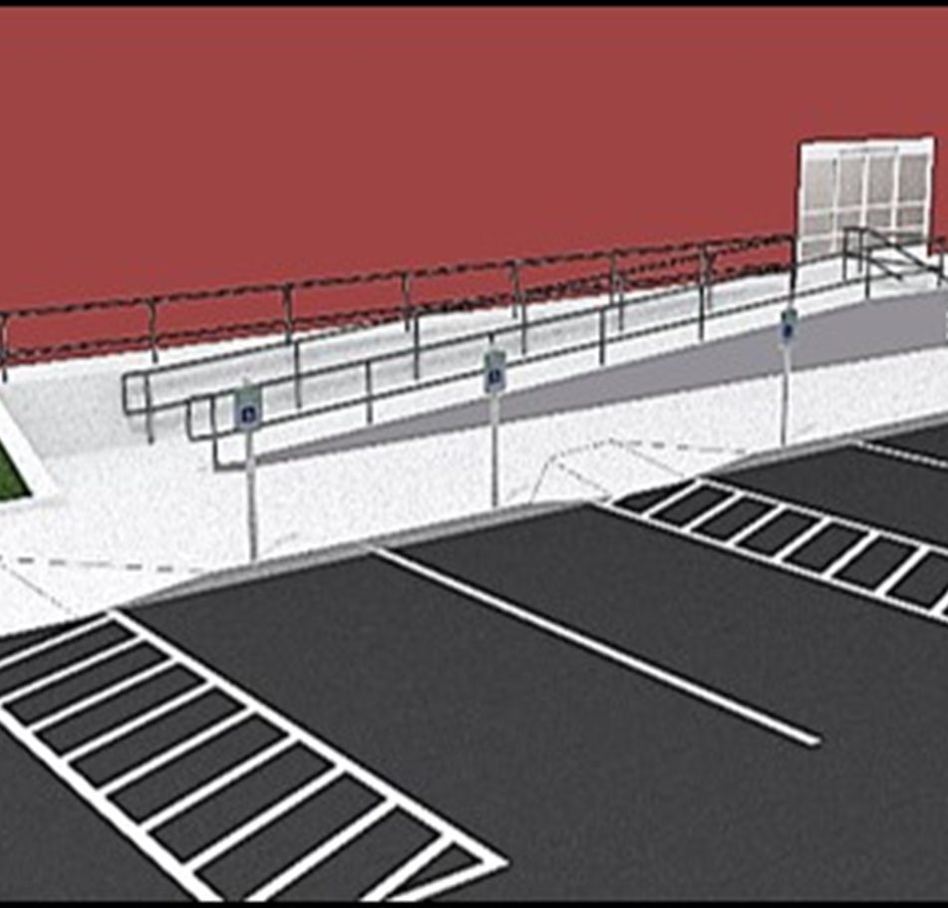
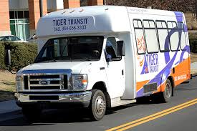
Accessible Path Into the Building
An accessible path must be provided from points where people arrive at the property such as bus stops, parking spaces, passenger loading zones and public streets or sidewalks to the accessible building entrance.
Where parking is provided, a minimum number of accessible spaces must be provided on the shortest route to an accessible building entrance.

Slide 22
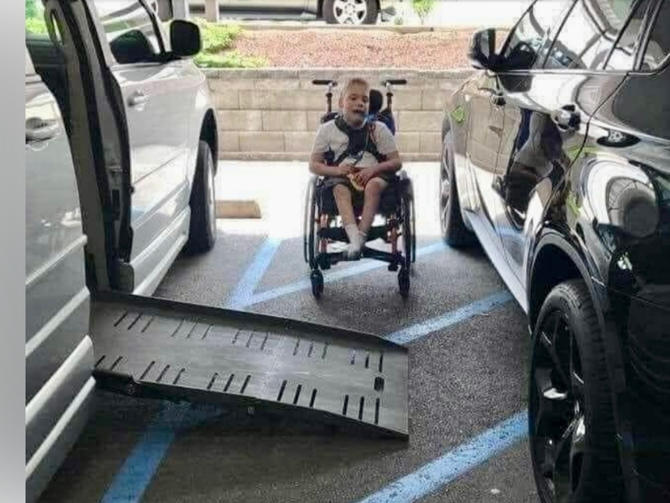

Slide 23
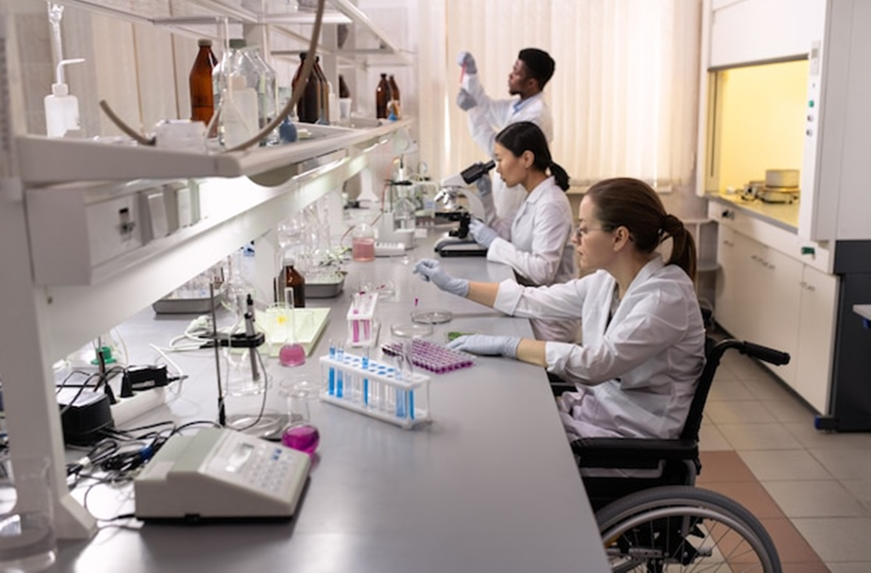
Accessible Path Through the Building
After a person gets into the building, an accessible route be provided. Multi-story facilities are required to have an accessible route to each accessible level of the building.

Slide 24
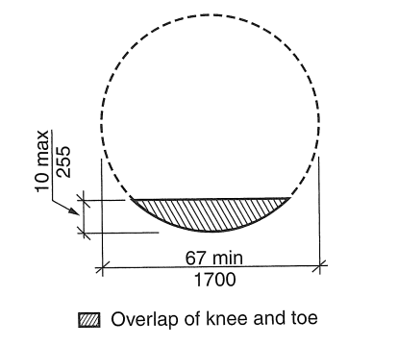
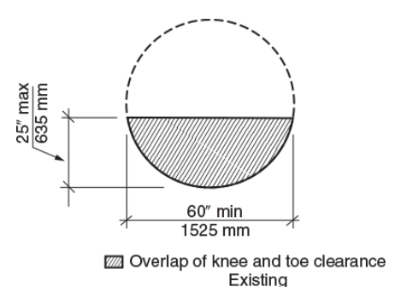
Furniture layout:
Be cognizant of placement of furniture and equipment from a mindset of someone with a disability. Equipment should be located adjacent to accessible routes and keep egress routes clear. For those in a wheelchair, 67 (new) or 60 (existing) inches of clear turning space is needed to allow them to be able to pull in and out of their workspace. Barriers to someone using a wheelchair will also be an impediment to others trying to exit in an emergency.

Slide 25
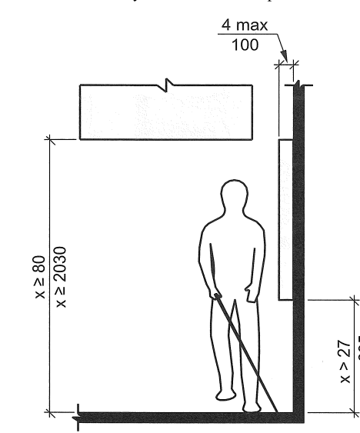
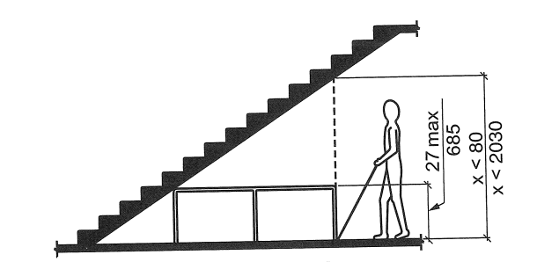
Remove protruding objects:
Proper housekeeping is essential so everyone including the visually impaired can exit away from a hazardous occurrence or fire, in a safe and efficient manner.

Slide 26
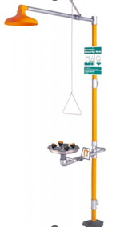
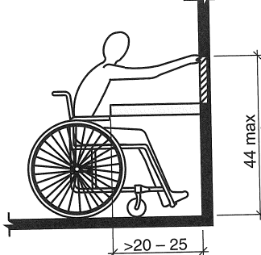
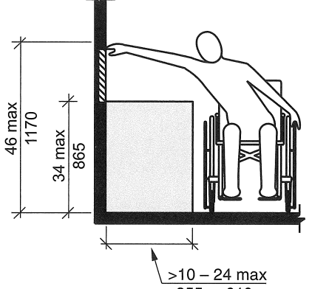
Reach range:
Modification of the depth and height of fume hoods or safety showers may be necessary to limit exposure to hazardous chemical fumes, vapors, and splashes. Likewise, shelves located above the height of anyone trying to access chemicals or equipment may create a hazard. Most wheelchair reach ranges are from 15 to 48 inches high depending upon obstructions.

Slide 27
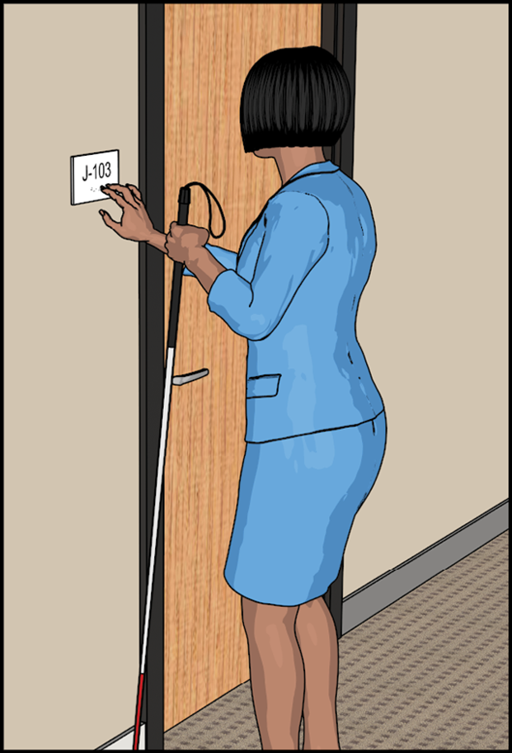
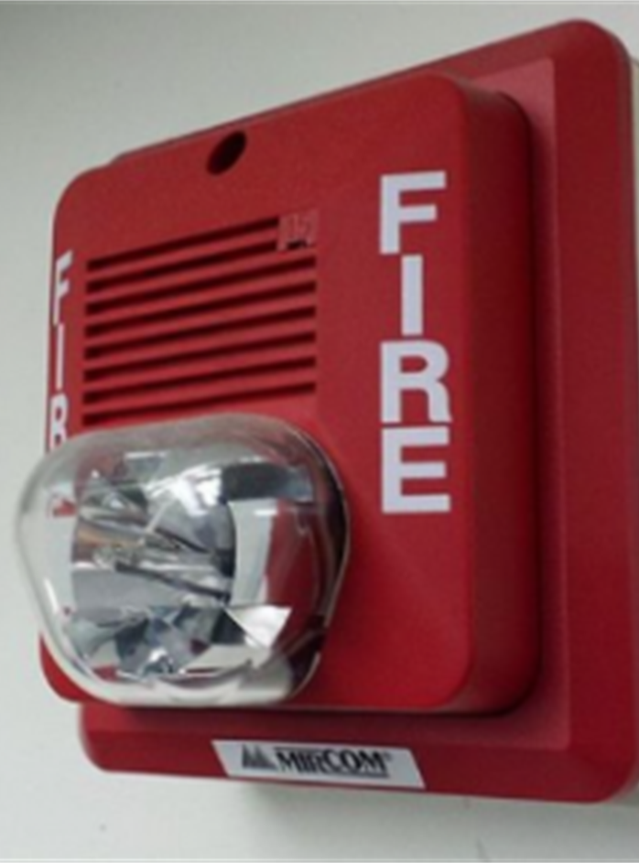

Design for different sensory needs:
There must be accessible signage for people who also have low vision.
For people with hearing loss, fire and toxic gas alarms should include strobes or flashing lights as well as sound.

Slide 28
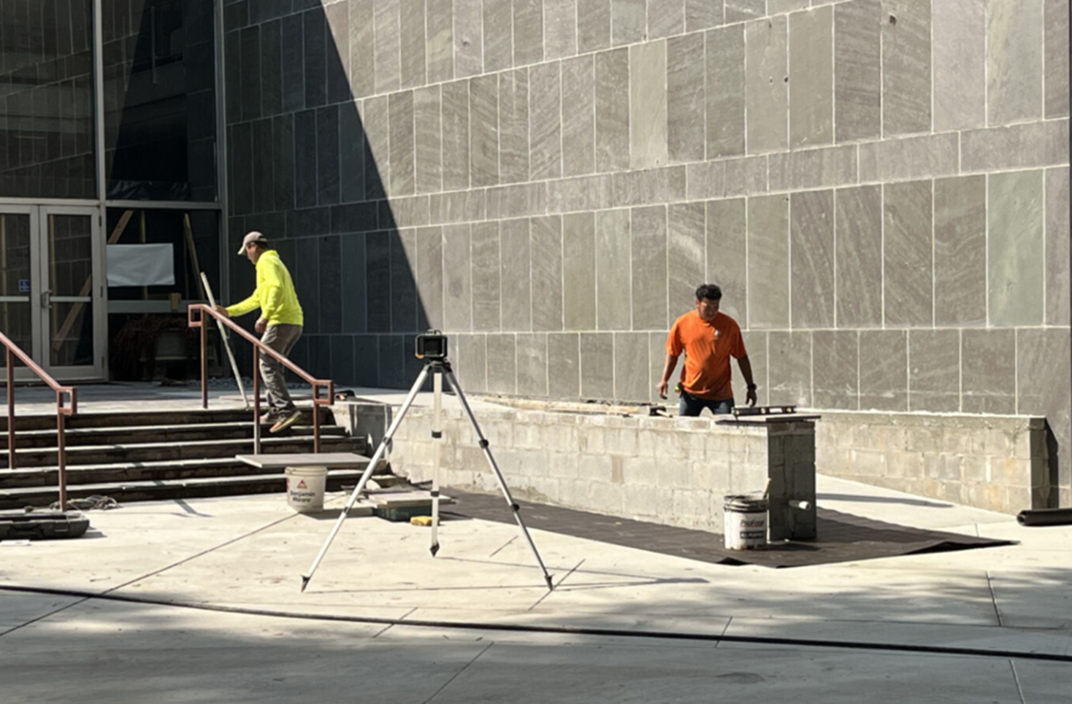
Ramps
A ramp is a walking surface that has a running slope steeper than one unit vertical to 20 units horizontal. (5 percent slope). If the slope is less, it is considered a walking surface and not a ramp. Cross slopes still cannot exceed 2 percent. To be used as accessible routes, they cannot exceed a 1:12 slope

Slide 29
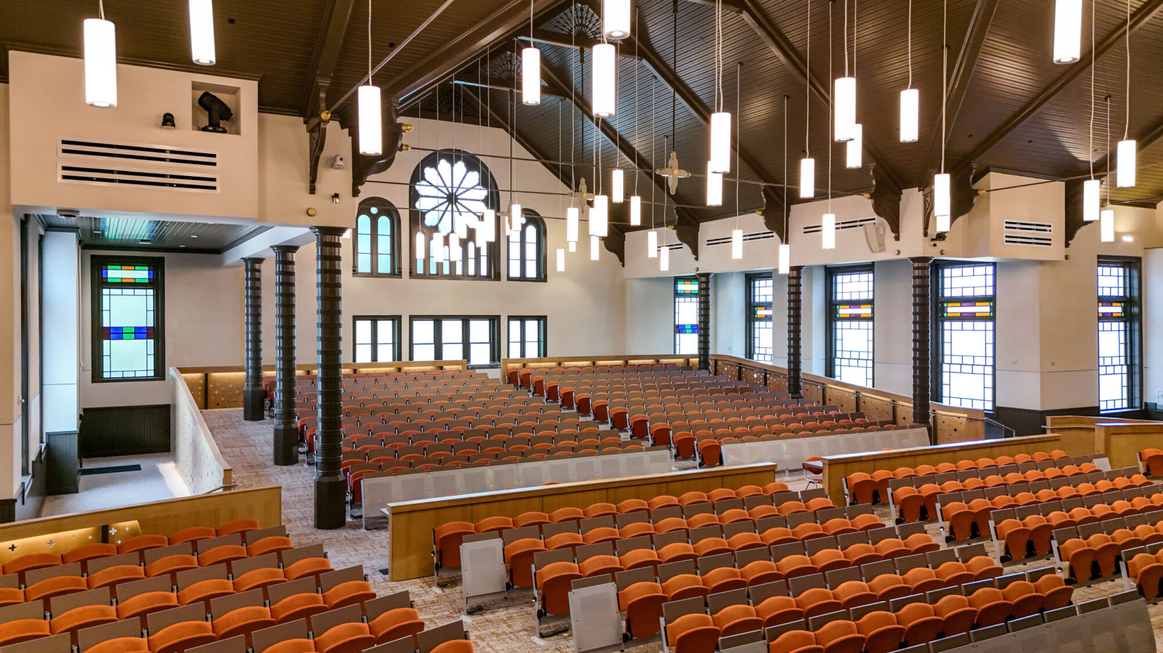

Slide 30
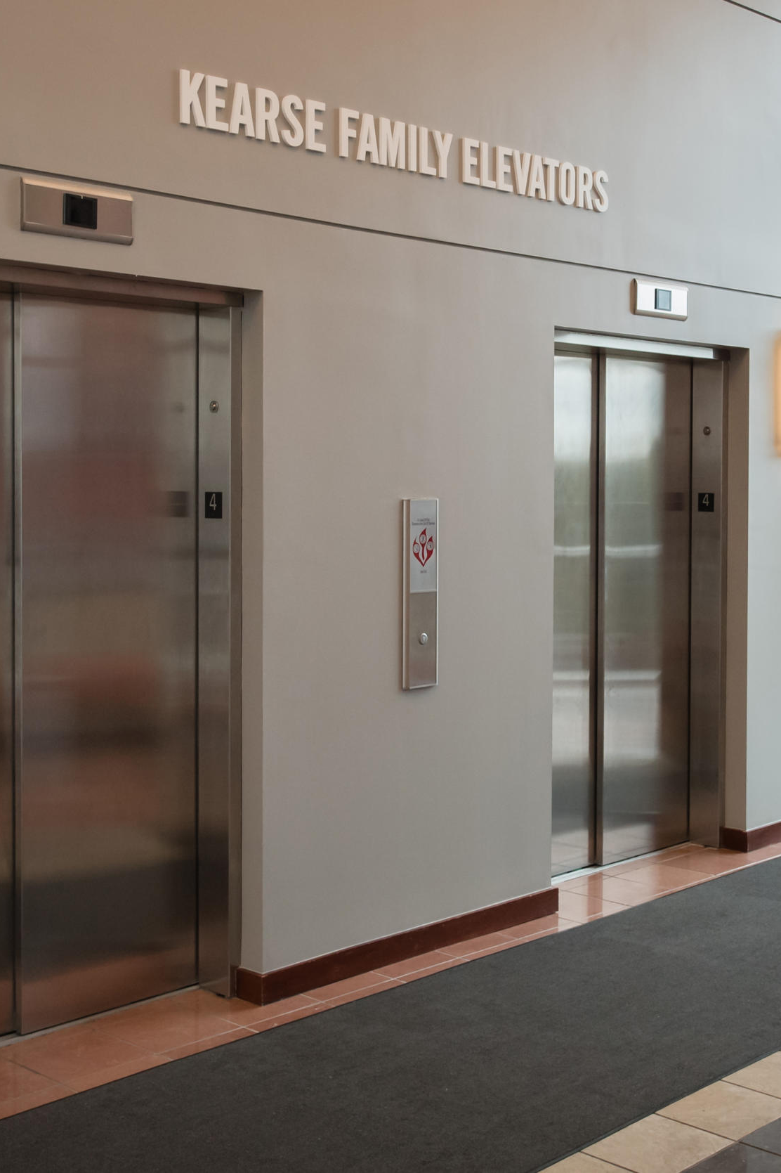
Elevators
In multistory buildings, elevators are the most common and most efficient way to provide an accessible route to upper or lower floors. Elevator cars must be large enough to get a person in a wheelchair and one additional person in the elevator. The controls must be placed so that a person in a wheelchair can reach them to operate the elevator. The controls are also required to have raised characters and braille for the visually impaired.
In certain conditions, a platform or wheelchair lift can be used as part of accessible route in a multi-story building.

Slide 31
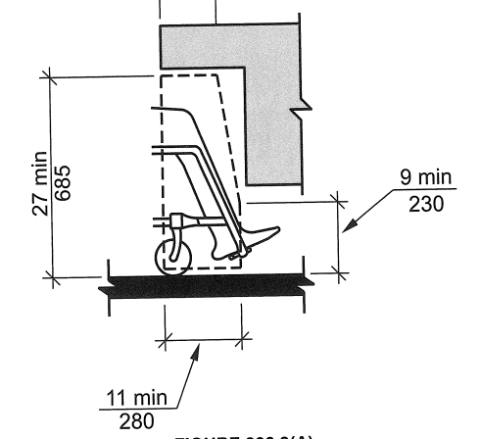
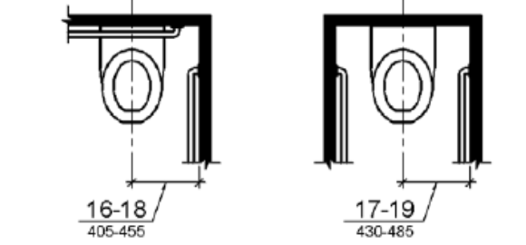
Restrooms
At least one of each type of fixture, element, control and dispenser in each restroom must be accessible. Single gender/single user/ fully accessible (Inclusive) restrooms are encouraged and must be within 500 feet of separate-sex facilities to count towards the required overall number. Turning space, knee and toe clearance, grab bars, and privacy locks are essential requirements of accessible restrooms.

Slide 32
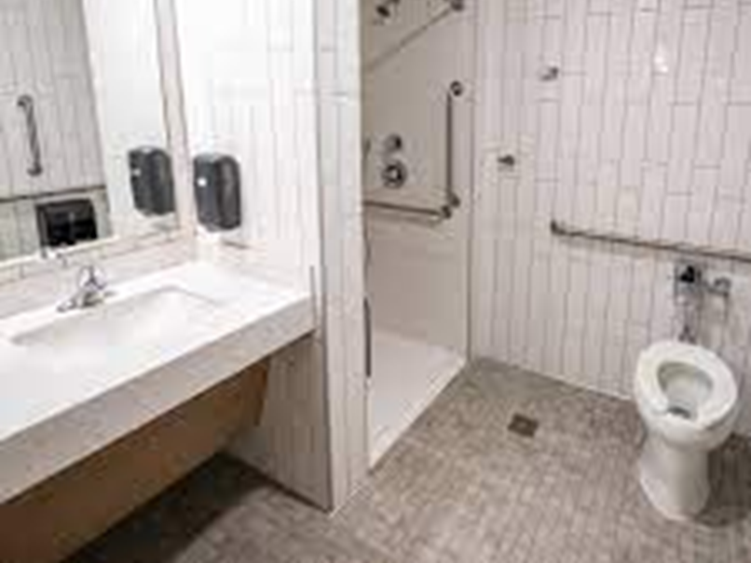

Slide 33
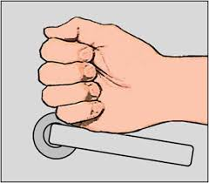
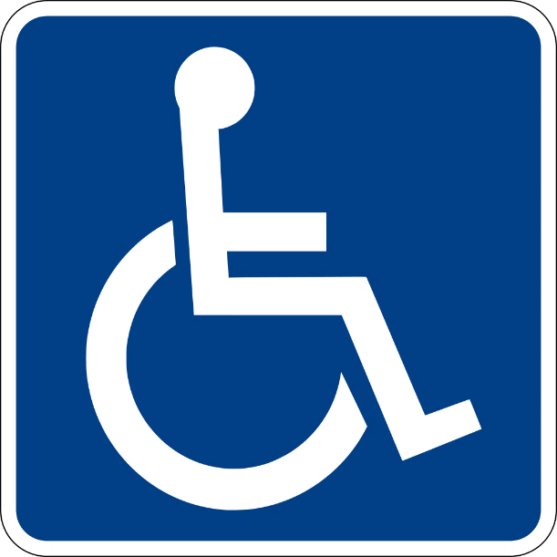

Hardware and Communication:
Guards, handrails, faucets, doors, keyboards, washers, dryers, ovens and other hardware and operable equipment must be graspable.
Directional signs, permanent room numbers, egress signs, area of refuge, bathroom signs, and fire alarms must meet provisions.
Please use Universal Symbol.

Slide 34
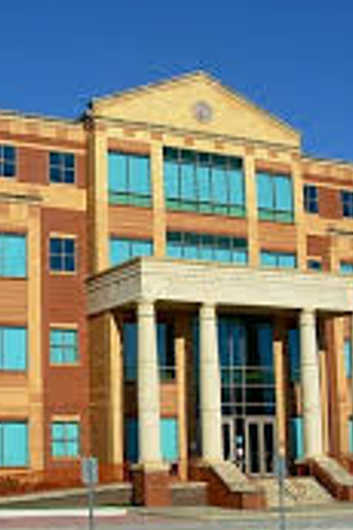
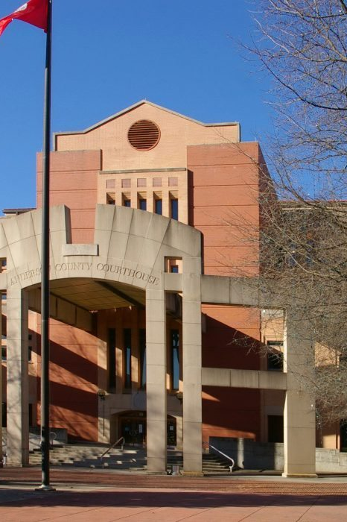
Notes:
Anderson and Oconee County Courthouses

Slide 35
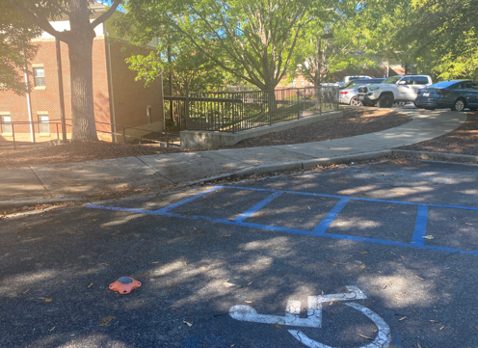

Slide 36
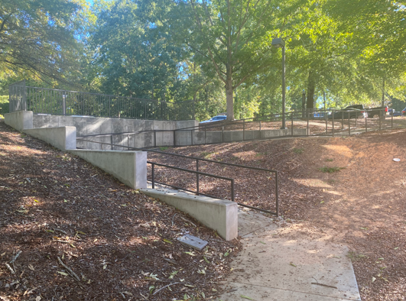

Slide 37
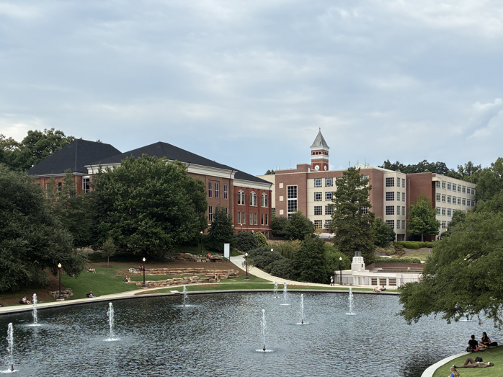

Slide 38
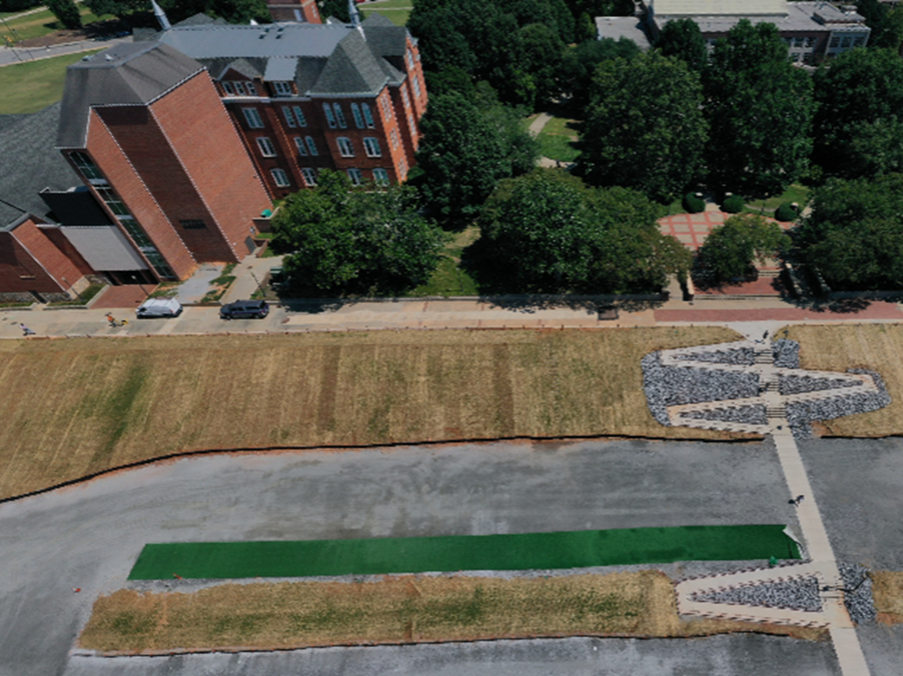

Slide 39
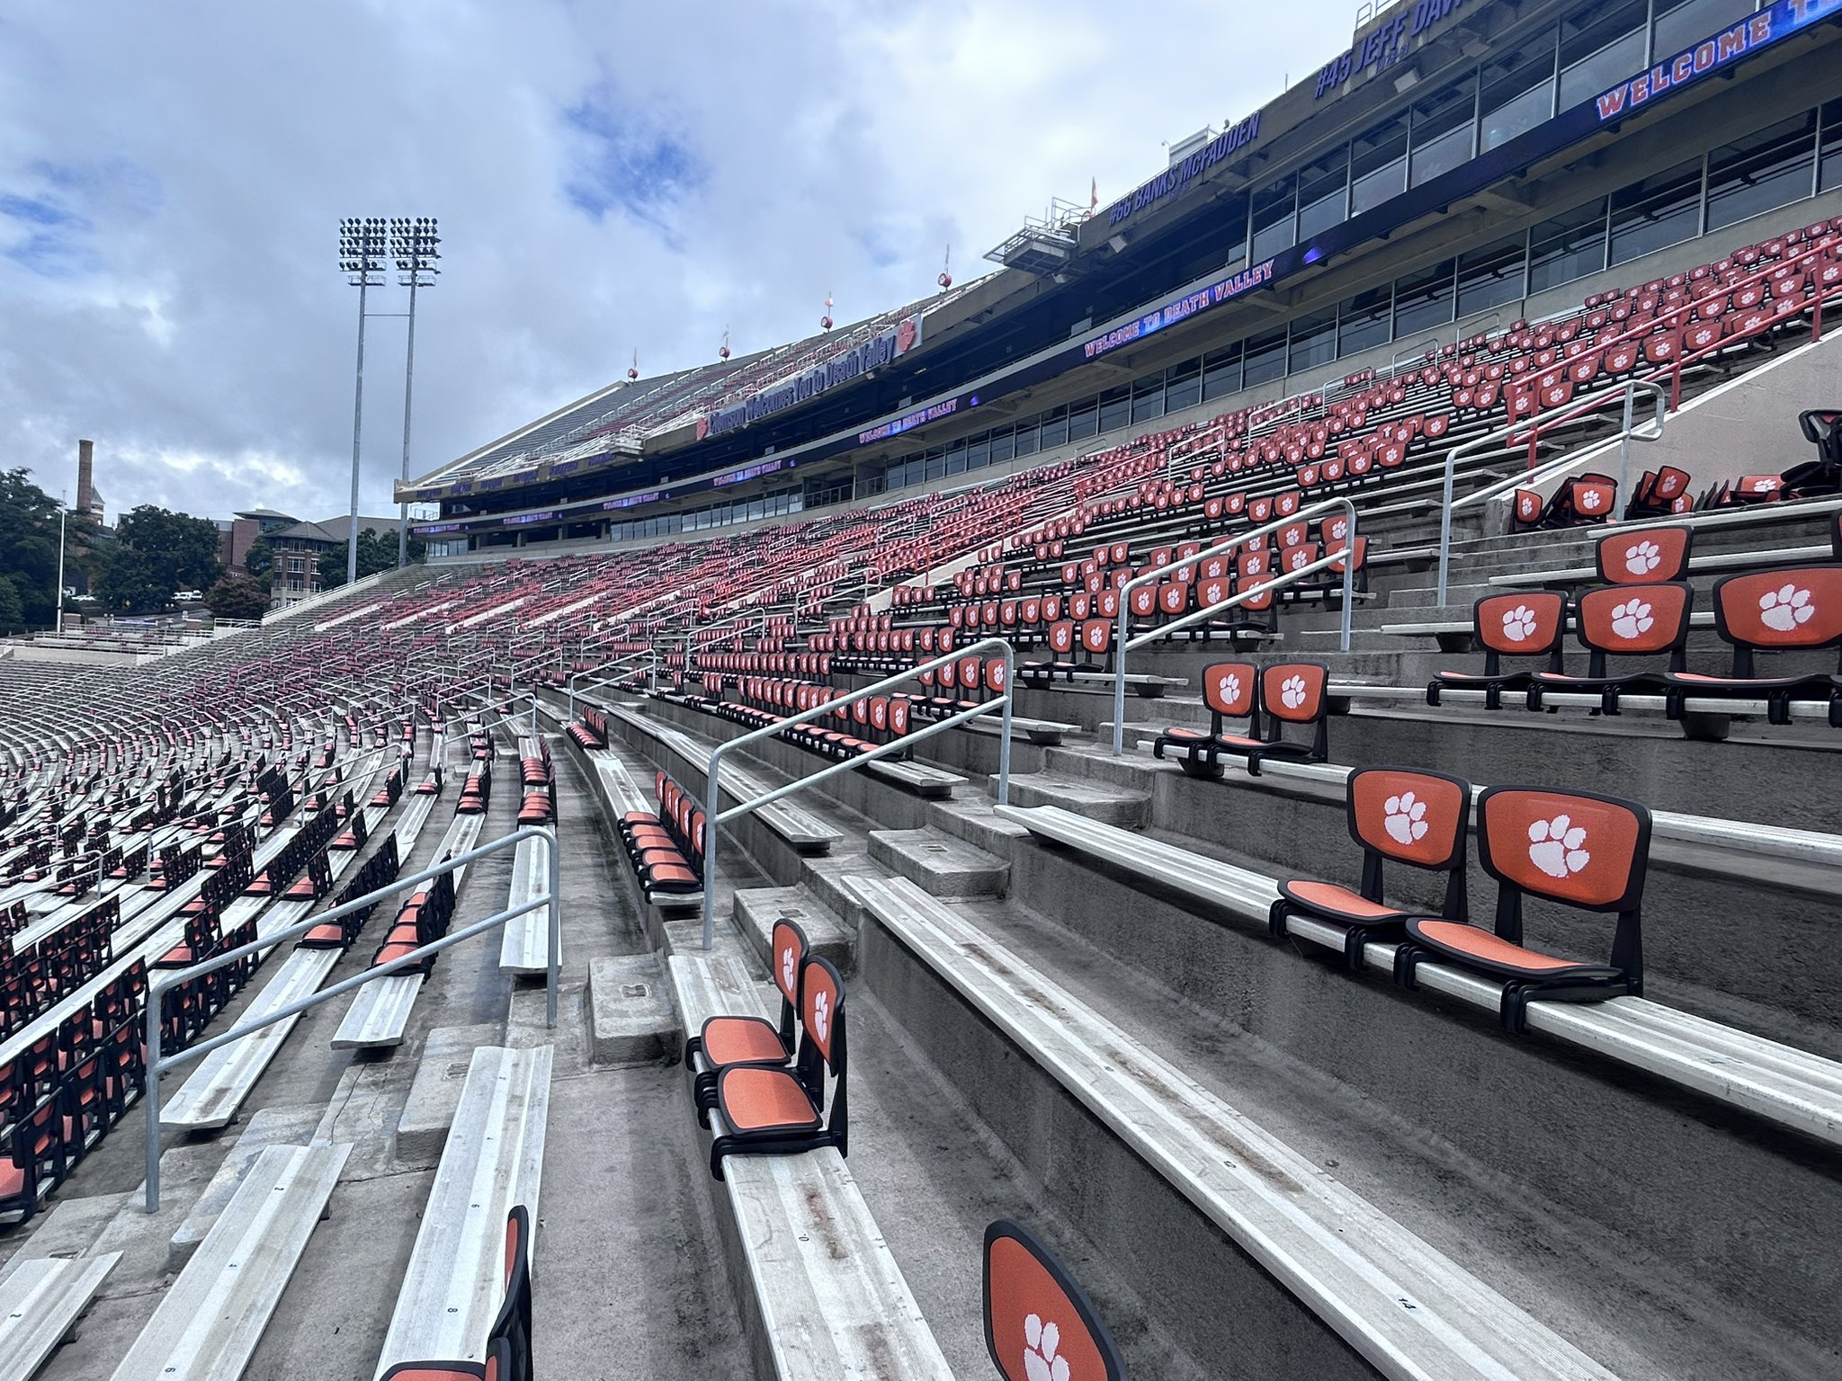

Slide 40
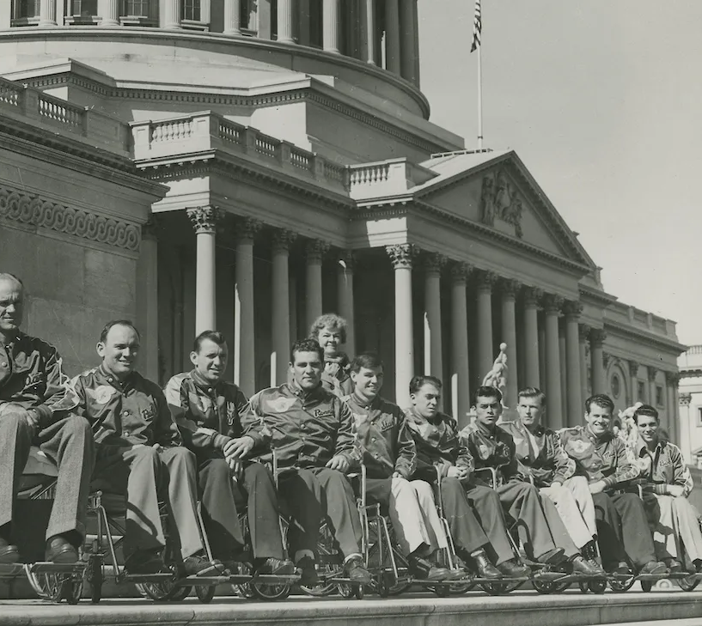
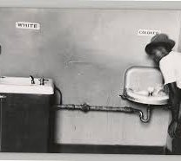
This is Civil Rights!
According to CDC statistics, around 26% of the US population have a disability.
Not all disabilities can be seen (like neurological and other internal processing disabilities).
Most of us will experience some kind of temporary or permanent disability in our lifetime, whether due to an accident, injury, or conditions as we age.

Slide 41

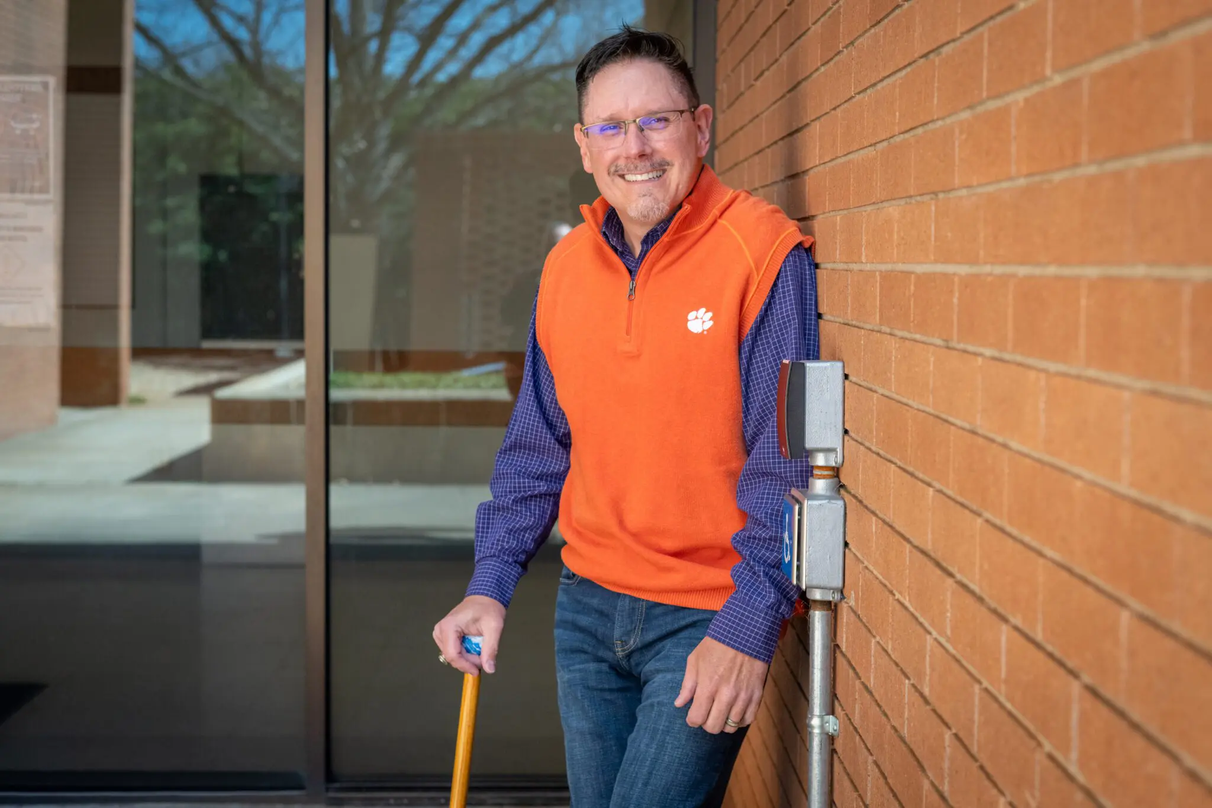
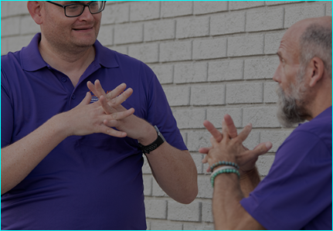

Notes:
Best is the Standard!
Everyone is involved.

