Slide 1

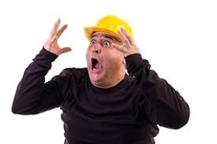
Building Inspections & Testing
Another 5 years
What’s new?

Slide 2
Start Date………
Existing contracts will end on December 15, 2019
December 16, 2019

Slide 3
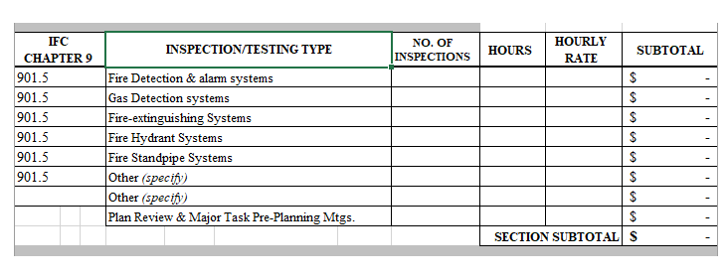
What’s new?
Inspections for fire suppression systems and alarms

Slide 4
Reminders…

Slide 5
When do you need inspections?
Assume ALL projects need inspections.
OSE PM can assist in final determination.

Slide 6
Who performs inspections?
Building Inspections & Testing
Statewide Term Contract

Slide 7
Exception!!!
Re-roofing projects
Design Professional

Slide 8
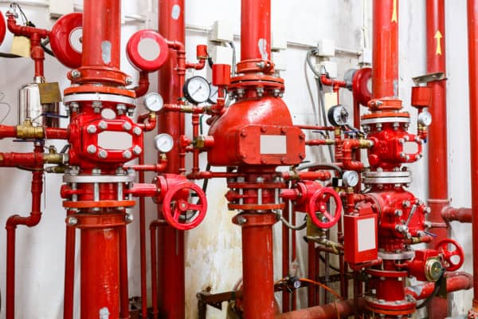
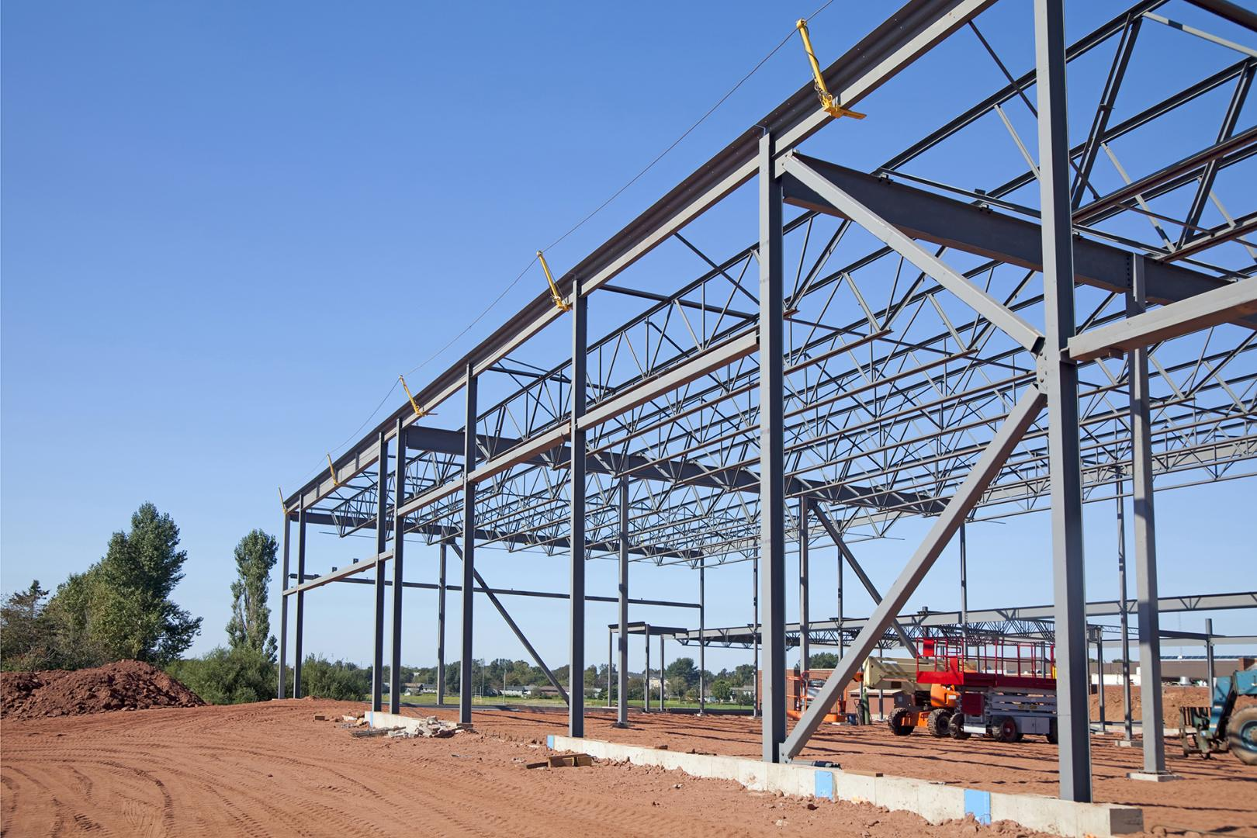
What is to be inspected and tested?
Two Words….
Fire
Structural

Slide 9
Odds & Ends….
Contract is not for Professional Services
All fees and charges are fixed for five years. Fees and charges are listed on the website
Inspection Quotes – Are inspection companies quoting the same number of inspections?
Inspector is to present ID to the Contractor, sign in & note what is to be inspected

Slide 10
Odds & Ends….
Inspectors cannot direct, modify, or make recommendations to the Contractor. Pass or Fail
Re-inspections and re-testing fees are NOT a change order. Fees are withheld from the Contractor’s pay application
Contractor to provide inspector two business days lead time for inspection

Slide 11
Odds & Ends….
Inspection reports are to be delivered within two business days to Agency, Contractor, A/E, and OSE Project Manager
Discrepancy report 24 hours after site visit and noted on the Report in the Site Trailer
Read all the reports

Slide 12
Odds & Ends….
If you’re having problems with a Firm or Inspector, call the OSE Project Manager

Slide 13
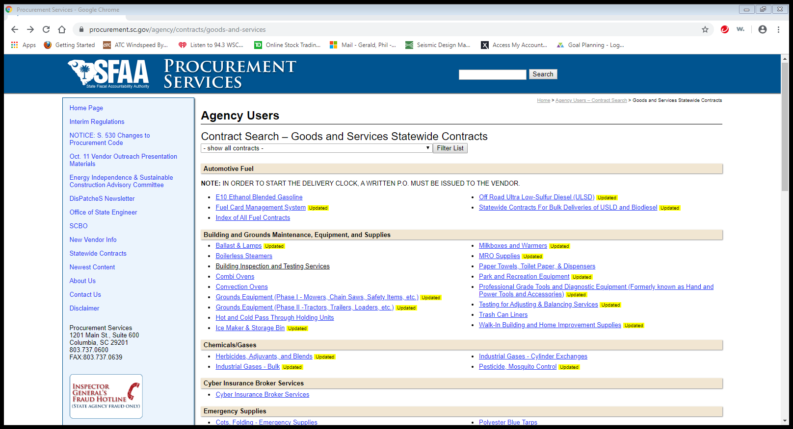

Slide 14
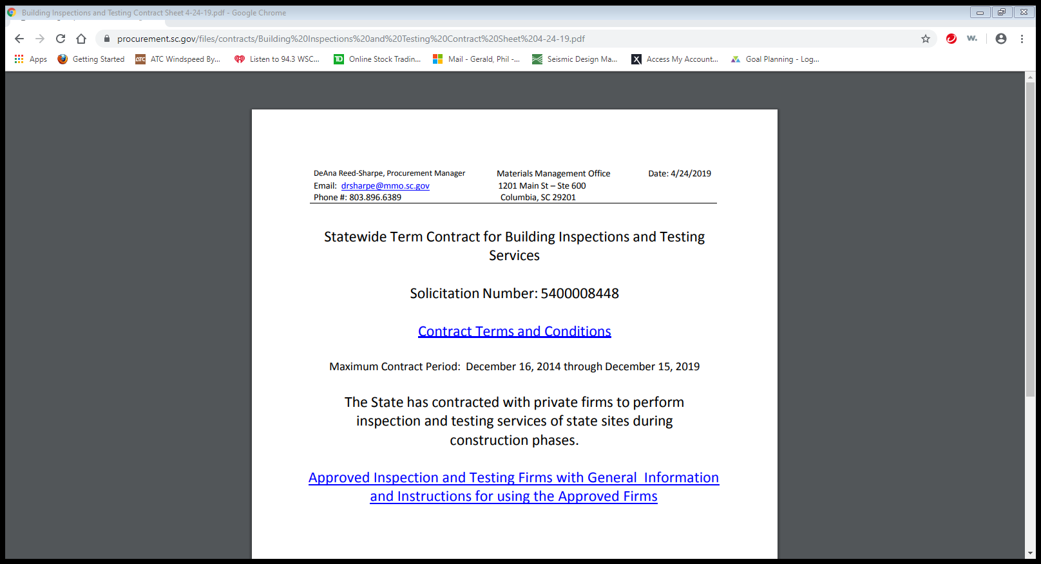

Slide 15
Inspection Firms
Bunnell-Lammons Eng., Inc
ESP Associates, PA
GS2 Engineering & Environmental
Dennis Corporation
Froehling & Robertson
Soil Consultants, Inc.
S&ME, Inc.
Mead & Hunt
Safebuilt, Inc.
Terracon Consultants
RCI of SC, Inc.
CC&I Services
F&ME Consultants
Summit Engineering Lab. & Testing, Inc.

Slide 16

Questions?

