Slide 1

Performance Bonds, Payment Bonds (and liquidated damages)
Manton Grier, Jr.
Notes:
*Introduction
*Work for John White; handle protests and appeals
*”Exciting” topic

Slide 2

Basic terms
Performance Bond:
  Covers the risk that the contractor will inexcusably fail to complete the contract according to its terms.
  In general terms, if the bond is triggered, the surety (the bond company) steps in to ensure (a) the contractor finishes the project or (b) that the project is completed some other way.
Payment Bond:
  Covers the risk that the contractor, even if completing the project, will fail to pay claims for unpaid labor and material.
  In general terms, if the subcontractors or companies supplying equipment or materials have not been paid by the general contractor, they can seek payment from the surety.
Notes:
*These are risk allocation devices – they give the agency another layer of protection if the contractor goes bellyup.
*Essentially, the surety stands in the shoes of the contractor

Slide 3
Comparison between insurance and bonds
While both are meant to give protection to the agency, there are differences.
Insurance
  Insurance company is simply responsible for paying out money if conditions are triggered
  Two-party relationship between insurance company and insured (contractor)
Bonds
  Rather than simply paying out money, the surety is obligated to ensure the project is completed (performance bond) and that labor and materials have been paid (payment bond).
  Three-party relationship between the surety, contractor, and the agency.
Notes:
*Again, both insurance and bonds are risk-allocation devices – shifting much of the risk from agency to these companies
*Insurance company liable for payments; surety liable for performance
*Unlike insurance agreements, the surety company actually signs the forms that reference the contract and project

Slide 4
Bond requirements
Required for all construction contracts exceeding $50,000: Contractors must have both a performance bond and payment bond for 100% of the contract price “that does not include the cost of operation maintain, and finance.” S.C. Code § 11-35-3030(2).
  (for construction manager at-risk contracts, required for construction phases but not for pre-construction or design phases)
Surety qualifications:
  Licensed in South Carolina
  An “A” rating in latest “Best Key Rating Guide, Property Liability.”
  A financial strength of at least 5 times the contract price related to construction. R. 19-445.2145C(2)
May not require contractor to use a certain surety company, agent, or broker. S.C. Code § 11-35-3030(5).

Slide 5
Bond requirements (continued)
What must be submitted:
  Form SE-355 Performance Bond and executed Power of Attorney
  Form SE-357 Labor & Material Bond and executed Power of Attorney
    The Power of Attorney must authorize contractor to bind the surety. R.19-445.2145C
When submitted?
  Within three days after contractor submits the signed contract. (OSE Manual 6.20.2)
Agency duties upon receipt
  Upon receiving them, agency should review to determine if authentic and if they comply with the Procurement Code, regulations, and the contract. (OSE Manual 6.21)
  Agency is responsible for assuring they are in place before signing contract—failure to do so could make the agency liable for the contractor’s failure to pay for labor and supplies.
Notes:
*In addition to the risk of having to make payments, failure to have in place places additional risk on the agency if the contractor does not perform.

Slide 6
Performance bonds

Slide 7
The surety has no obligations if . . .
The contractor performs the contract
  Except to participate in conferences if necessary to get contractor on track (SE-355, ¶ 2).
The agency terminates for convenience
  The surety’s obligations are generally triggered by contractor default
  Be wary of this when considering whether to terminate for default or for convenience
Notes:
*Sometimes we just want to move on from a contractor without the headache of termination for default, but keep in mind that if you do this, the surety is OUT.

Slide 8
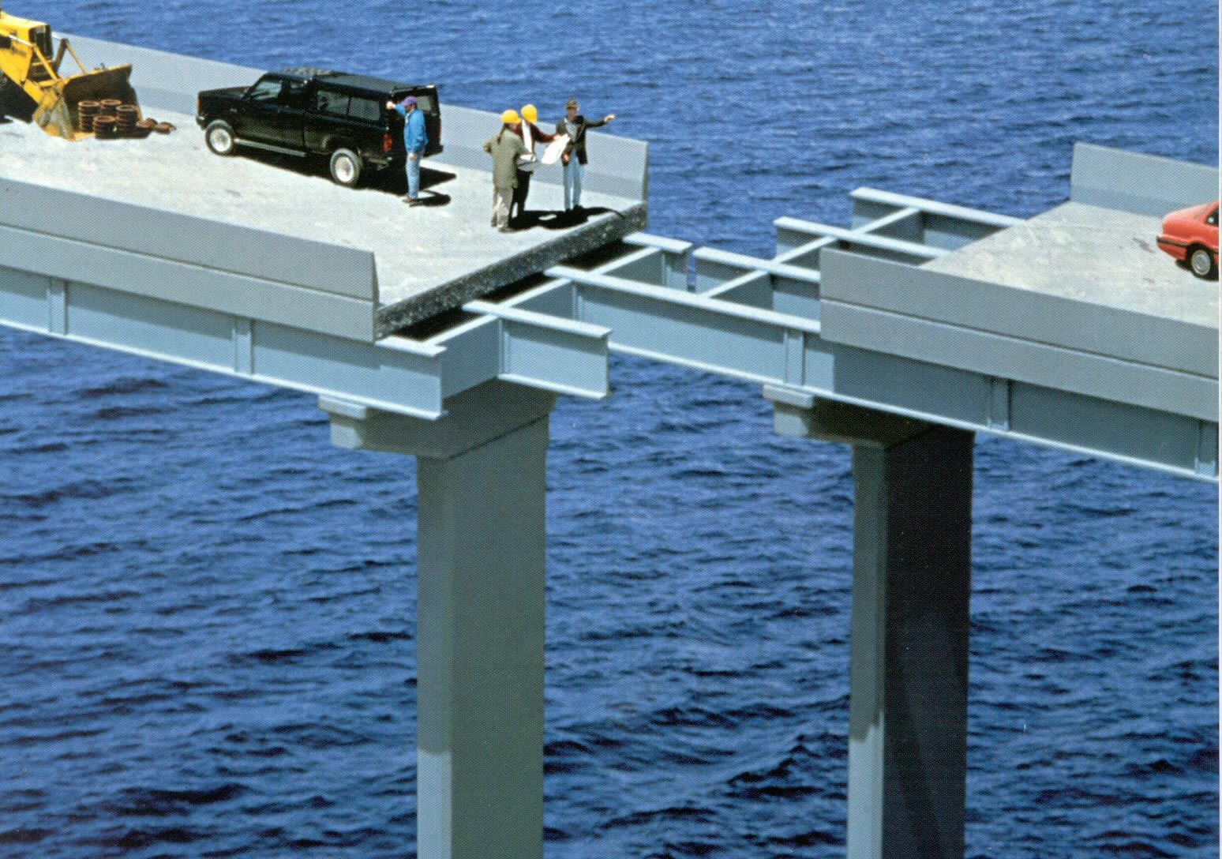
When things go wrong . . .
Notes:
*We hope that once the bonds are executed and in place, we can simply forget about them.
But what happens if the project is failing or delayed and the contractor is in default?

Slide 9
When is the performance bond triggered?
Surety’s obligations are triggered under two scenarios (Form SE-355).
First, when agency is considering declaring a contractor default.
  Must give proper notice to both contractor and surety
  Must request and attempt to arrange a conference with contractor and surety to discuss performance, to be held within 15 days of their receipt of notice.
  If agreement reached with all parties—agency, contractor, and surety—contractor is allowed a reasonable time to perform, and agency does not waive right to declare default.
Second, when agency has properly given cure notice and then terminated contract for default
  Within 15 days of receiving notice, surety must act.

Slide 10
The importance of proper notice
ALWAYS consult your agency’s lawyer before (a) giving notice of default or (b) terminating a contract.
This is crucial because . . .
Notes:
*This topic is about as exciting as Gamecock football this year (and I’m a fan)
*But if there is one thing to remember, it’s the importance of proper notice.

Slide 11
The importance of proper notice
“Termination of a contract for default without giving the required ‘cure notice’ is a material breach of the contract, which overrides the contractor’s uncured breaches for which no cure notice was provided.”
  5 Bruner & O’Connor on Construction Law, § 12.42 (5th ed. 2024).

Slide 12
The importance of proper notice
Prior to termination, seven days notice to both contractor and surety required:
  A201 § 14.2.2
The notice cannot be vague.
  Telling the contractor and surety simply that a breach exists is not enough; must give specifics.
Appeal by Hass Const. Co., Panel Case No. 1997-16(II)
  Architect certified: “To the best of my judgment, given the history and performance of this Project there appears to [sic] a systematic and material breach of the contract on part of the Contractor.”
  Surety was not given notice until after the termination.
  Held: Not only was the architect’s notice vague, but it was not given to the surety until after termination.
“When a party asserts a particular provision of a contract as grounds for acting, that provision must be complied with by the asserting party. Therefore, the Panel declines to affirm SCSU’s declaration of Hass as being in default of its obligations under 14.2.2 and 2.4.1”
Notes:
*You have to tell the contractor WHY they are in breach;
That they have delayed by a certain number of days
That they did not install something correctly
You can’t just say “you breached the contract”
*You might call this a technicality, but the courts take this serious. If you fail to give the proper notice before termination, you have breached the contract and the contractor is off the hook.

Slide 13
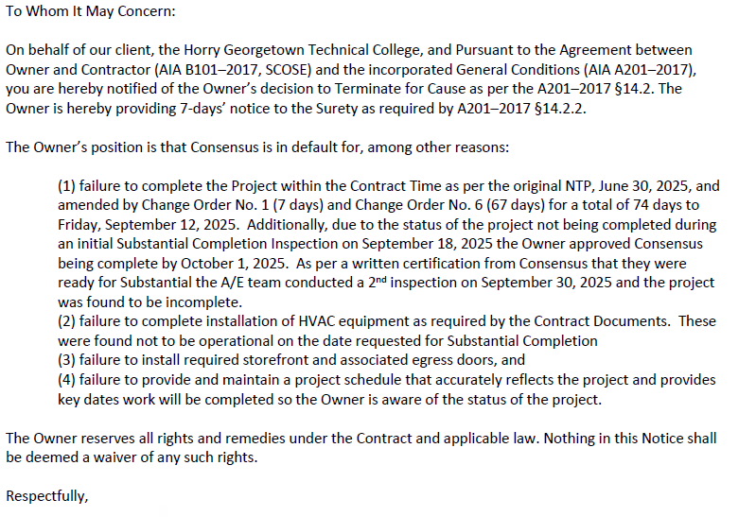
Example of a letter from architect to surety
Notes:
*Take a minute to read this.
*Notice

Slide 14
Final reminder
ALWAYS consult your agency’s lawyer before (a) giving notice of default or (b) terminating a contract.

Slide 15
The surety’s options upon termination
If the surety’s obligations on a performance bond are triggered, it must take one of these four options “with reasonable promptness”: (From SE-355)
Arrange for the contractor, with the agency’s consent, to finish the contract;
Perform the contract itself through agents and subcontractors;
Solicit bids or proposals from qualified contractors and with agency’s consent enter contract—secured by performance and payment bonds—and pay the agency the difference for having to hire new contractors to finish the project.
Waive the right to perform and either (a) pay damages or (b) deny liability.
Notes:
*We hope they don’t take the 4th option, because then they either act like an insurance company or you might be facing litigation.

Slide 16
What happens next?
If the surety elects to proceed, it stands in the same legal position as the contractor did.
  It is responsible for correcting defective work and finishing the contract.
  It is responsible for its own delays.
  It must pay damages awarded in a contract controversy
  It must pay liquidated damages for delays caused by the contractor
Just as surety stands in contractor’s shoes to perform the contract, the payments that would have gone to the contractor now go to the surety.
From Form SE-355
Notes:
*So if the surety is now the de facto contractor – legally they are responsible for getting this project done.
*Again, shows the importance of having a performance bond in place.

Slide 17
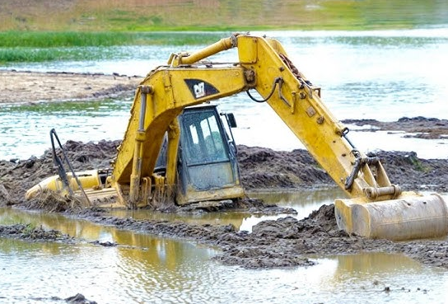
What if the surety does not proceed?
Then you have a mess on your hands.
  If the surety fails to proceed “with reasonable promptness” after its obligations are triggered, you must provide written notice.
  If it still has not acted after 15 days notice, the surety is in default.
If litigation is necessary, a contract controversy is filed just as the agency would against a contractor.
Notes:
*This is a place we do not want to be.
*If the contractor fails, AND the surety fails, then we truly have a mess on our hands.
*The contract controversy would probably be against BOTH the contractor and the surety company

Slide 18
Payment bonds

Slide 19
When the surety has no obligations
With respect to the agency
  If the contractor promptly makes payments to all claimants; and
  If the contractor defends and indemnifies the agency from all claims by all who furnished labor, materials, or equipment.
With respect to claimants (suppliers of labor, materials, or equipment)
  If the contractor promptly makes payments to all claimants.
Notes:
*Again, this is where we hope to be – where the surety is “out of sight, out of mind.”

Slide 20


When is the payment bond triggered?
Surety’s obligations are triggered when:
  The person who supplied labor, materials, or equipment has not been paid in full,
  90 days have passed since the labor was last done, or material or equipment last delivered, and
  The claimant sues on the bond.
Unlike performance bond disputes, which are handled by the CPO in a contract controversy, payment-bond disputes are handled by a court.
Notes:
*Surety has no obligations until these three steps are met.
*Again, importance of payment bond, we don’t have to deal with any messy litigation – the surety is on the hook for that.

Slide 21
Liquidated damages
Notes:
*Not really related to bonds, except when the bond company has to pay damages.

Slide 22
Basic terms
Definition: Liquidated damages are “damages the amount of which has been made certain and fixed either by the act and agreement of the parties or by operation of law to a sum which cannot be changed by the proof.” Beckman Concrete v. United Fire & Cas. Co., 360 S.C. 127 (Ct. App. 2004).
In other words: An amount stipulated by contract to be a reasonable estimation of the damages one would suffer in the event of a breach.
Typical application? For delay damages – for example, damages of $500 per day the project is delayed without a valid excuse.
Notes:
(first definition is a bit of legal mumbo jumbo

Slide 23
They cannot be a penalty
Liquidated damages must be a “reasonable estimation” of the damages caused by delay.
  If they are considered a penalty, it does not matter what the contract says; they are unenforceable.
When are they a penalty?
  “When the sum stipulated is plainly disproportionate to any probable damage result from breach of contract, the stipulation is an unenforceable penalty.” DD Dannar, LLC v. SC LAUNCH!, 431 S.C. 9 (Ct. App. 2020).

Slide 24
How to calculate the amount?
No magic formula
Determining the “correct” amount of liquidated damages is a balancing of two interests.
  On one hand, if the amount is too high, it will be unenforceable as a penalty.
  On the other hand, if the amount is too low, it will dis-incentivize the contractor to finish on time.
Try to find the “sweet spot”
Take time to do a reasonable estimate of what damages the agency would suffer each day the project is delayed.
Keep a record of the calculations and a detailed justifications.
Notes:
*Ask JOHN for thoughts on reasonable estimates.

Slide 25
Questions?

