Slide 1
Small Purchases
2021 Office of State Engineer Facility Directors Conference
October 20-22, 2021
Hickory Knob State Park

Slide 2
Limited to an amount of $100,000 or less

Slide 3
Protest Rights do not apply to contracts under $50,000

Slide 4
Purchases under $10,000
Agency may make purchases under $10,000 without competitive quotes
Agency should distribute these purchases equitably among qualified contractors
Agency should make the purchase on a purchase requisition form provided by the agency
Agency Procurement Officer or their designee must annotate the purchase requisition with the words “Price is fair and reasonable” and sign it.

Slide 5
Purchases over $10,000 but under $100,000
Agency receive at least (3) bona fide responsive and responsible quotes from qualified contractors
Agency may advertise in SCBO under “Minor Construction”
OR

Slide 6
Purchases Exceeding Agency’s Basic Authorization of $50,000 – Before Bidding
Agency to submit SE-311 Invitation for Minor Construction Quotes along with bid documents to the OSE Project Manager for review and approval
OSE Manager will send an approved SE-311 back to agency if quotes are solicitated from at least (3) qualified contractors OR…
OSE Manager will forward the SE-311 to SCBO for advertisement

Slide 7
Purchases Exceeding Agency’s Basic Authorization of $50,000 – After Bidding
Quotes can be opened at any time after the quote due date and time.
A public opening is not required
Agency should create a quote tabulation
After the agency determines the lowest responsive and responsible bidder, agency to send SE-375 Notice of Award to the OSE Project Manager along with the quote tab for approval.

Slide 8
Purchases within Agency’s Certification
Agency to directly solicit quotes from at least (3) qualified contractors using the SE-311 form OR…
Advertise in SCBO using https://scbo.sc.gov/advertise and provide a link to a completed SE-311 form
After the agency determines the lowest responsive and responsible source, agency posts the SE-375.
These contracts are immediately effective upon posting and the agency may direct the contractor to start work even though the time to protest the award has not passed.

Slide 9
Key Notes
ALL projects require a SE-580 (Building Permit) & SE-585 (Certificate of Occupation/Use)
Don’t forget Special Inspections and Testing (SE-955 & SE-962)
All construction contracts valued in excess of $50,000 must be provided with both performance and a labor and material payment bond in the full amount of the contract.
Requiring a bid bond for construction contracts under $100,000 is optional.

Slide 10
Key Notes
Quotes can be opened at any time after the Quote due date and time
A public opening is not required
Agency should make a quote tabulation

Slide 11
Poll….
Text
PERRYDERRICK376 to 22333

Slide 12
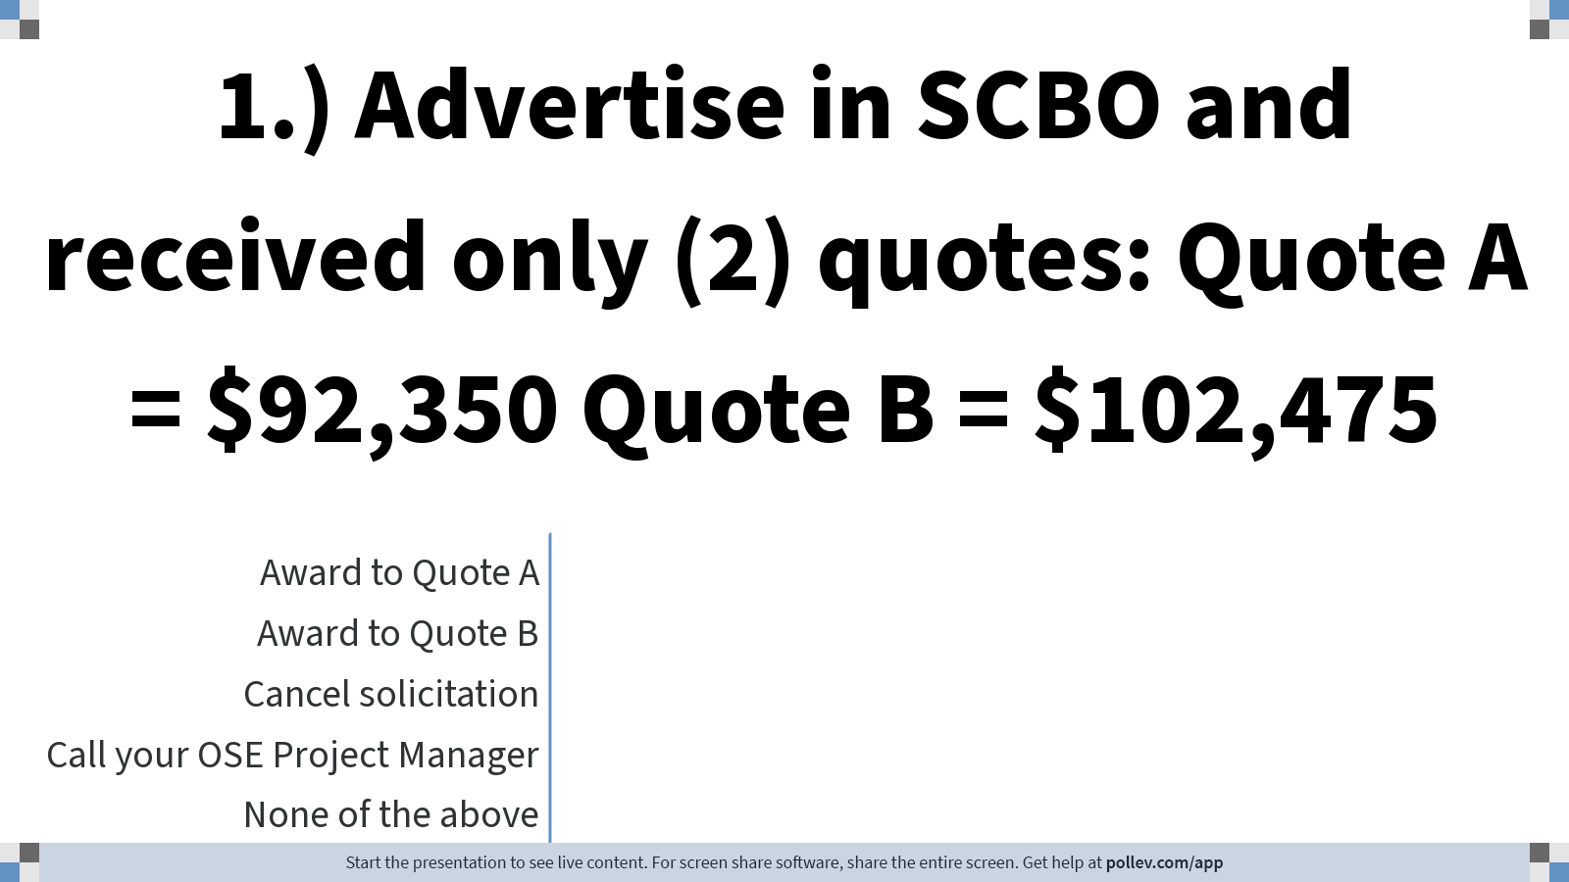
Notes:
Poll Title: Do not modify the notes in this section to avoid tampering with the Poll Everywhere activity.
More info at polleverywhere.com/support
1.) Advertise in SCBO and received only (2) quotes Bid A = $92,350 Bid B = $102,475
https://www.polleverywhere.com/multiple_choice_polls/n9Pu0ClDh4wq19nX7LBCH

Slide 13
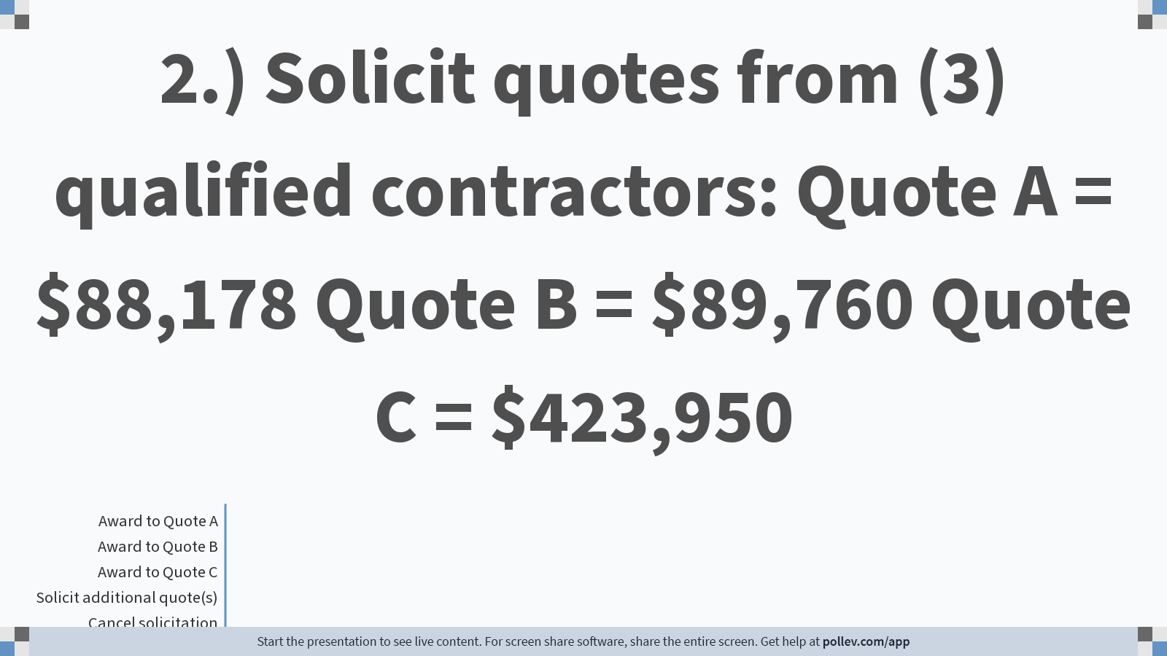
Notes:
Poll Title: Do not modify the notes in this section to avoid tampering with the Poll Everywhere activity.
More info at polleverywhere.com/support
2.) Solicit quotes from (3) qualified contractors Quote A = $88,178 Quote B = $89,760 Quote C = $423,950
https://www.polleverywhere.com/multiple_choice_polls/1FfCTOouLAU1odxqC8MSX

Slide 14
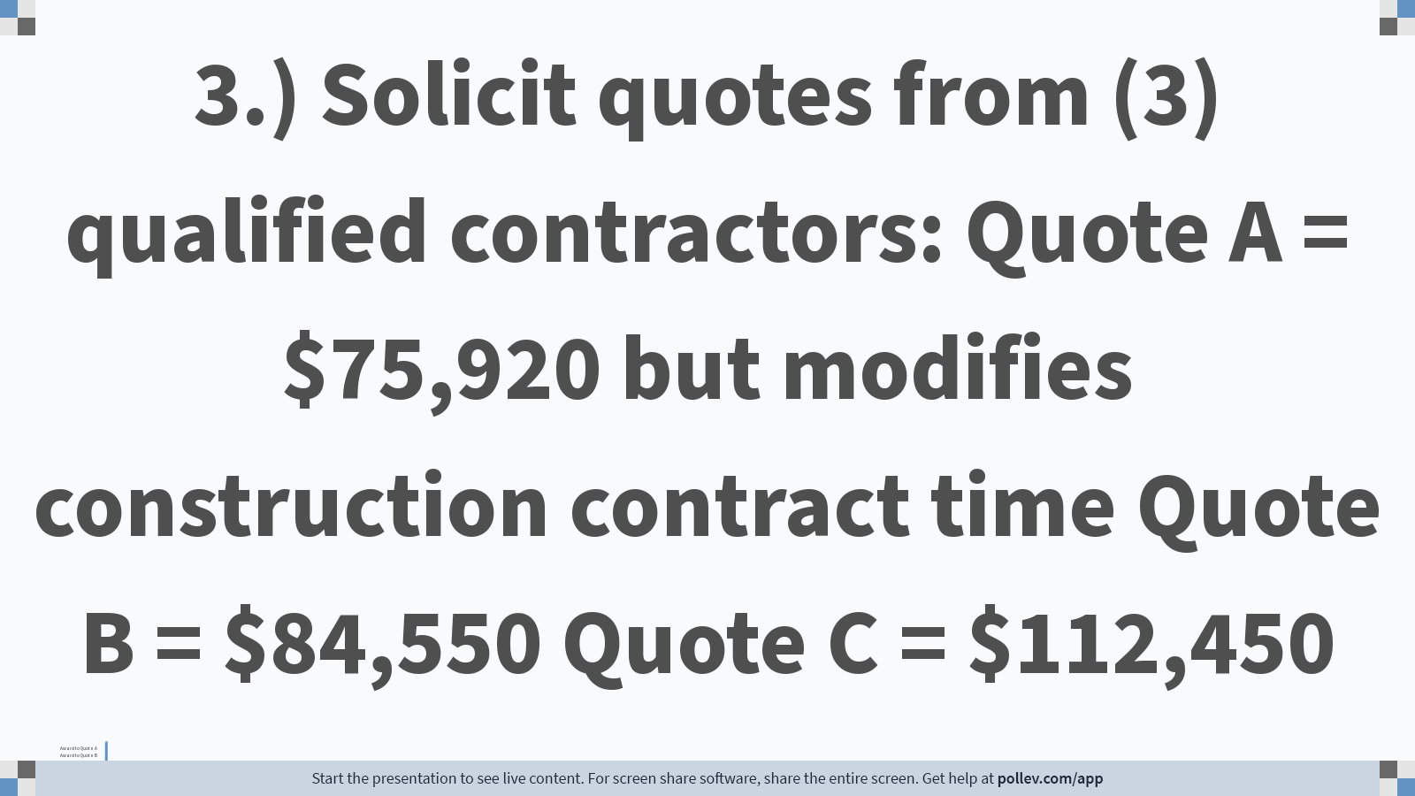
Notes:
Poll Title: Do not modify the notes in this section to avoid tampering with the Poll Everywhere activity.
More info at polleverywhere.com/support
3.) Solicit quotes from (3) qualified contractors Quote A = $75,920 but modifies construction contract time Quote B = $103,550 Quote C = $112,450
https://www.polleverywhere.com/multiple_choice_polls/wAXaUIlaqMTG7mZVvQy2n

Slide 15
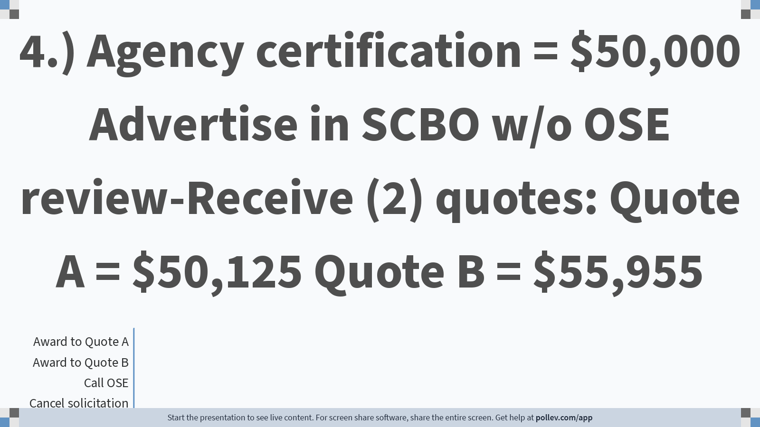
Notes:
Poll Title: Do not modify the notes in this section to avoid tampering with the Poll Everywhere activity.
More info at polleverywhere.com/support
4.) Agency certification = $50,000 Advertise in SCBO-Receive (2) quotes Quote A = $50,125 Quote B = $55,955
https://www.polleverywhere.com/multiple_choice_polls/4DSa4ThRhikqbdR2wb37k

Slide 16
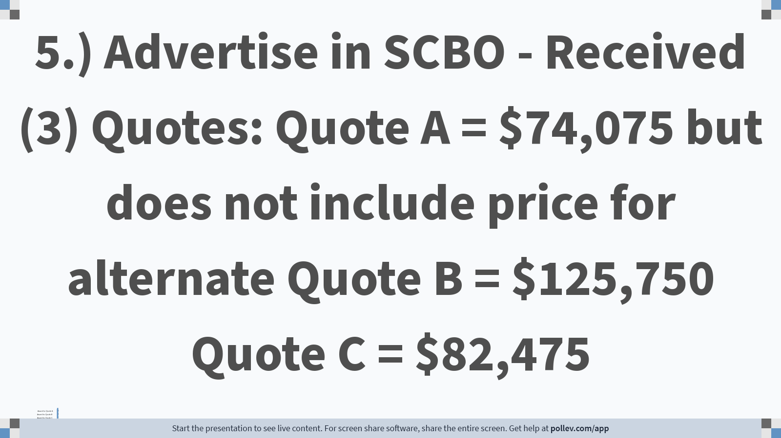
Notes:
Poll Title: Do not modify the notes in this section to avoid tampering with the Poll Everywhere activity.
More info at polleverywhere.com/support
5.) Advertise in SCBO - Received (3) Quotes - Quote A = $74,075 but does not include price for alternate Quote B = $125,750 Quote C = $82,475
https://www.polleverywhere.com/multiple_choice_polls/fzQfe5Ef3zlMlBpIzTkw3

