Slide 1

Job Ordering Contract (JOC)
Proviso 117.151

Slide 2
Proviso 117.51
The License Areas:
General Contractor (BD3)
Roofing (RF3)
Electrical (EL5)
Plumbing (PB5)
HVAC (HT5/AC5)
Up to 4 Contractors will be awarded for each license classification per each Agency.
Contractors' contract is for valid for 2 years
Job orders may not exceed $750,000 individually
Sum of all individual jobs may not exceed $6 Million per contract.

Slide 3
How does JOC Work:
JOC Administrator has been awarded by competitive bidding of an RFP.
Tier 1- Job Order when the Agency Performs Job Order Development Services, JOC System License Fee
Tier 2 – Job Order where the Agency Performs Job Order Development Services and includes the JOC Administrator to perform a compliance review of the Price proposal and the JOC System License Fee
Tier 3 – Job Order where the JOC Administrator performs the Job Order Developments Services and JOC System License Fee
Notes:
Tier 1 – Agency performs the Job Order Development Services
Tier 2 – Agency performs the Job Order Development Services and includes the JOC Administrator to perform a compliance review of the price proposal.
Tier 3 - JOC Administrator performs the Job Order Development Services

Slide 4

JOC Administrator has been awarded to Gordian effective 10/1/2025
4400037960

Slide 5
Request for Qualifications
Request for Qualifications has been solicited for the following disciple areas:
  General Contractor (Minimum BD3 license)
  Roofing (Minimum RF3 License)
  Plumbing (Minimum PB5 License)
  HVAC (Minimum HT5/AC5 License)
  Electrical (EL5)

Slide 6
Step 1. Receive Request for Qualifications
2. Score the qualifications.
3. An invitation will be sent to each qualifying Contractor to participate in the IFB.
4. Qualified Contractors will bid their coefficient.
5. Up to 4 lowest bidders will be awarded per license per UGU/Region.

Slide 7
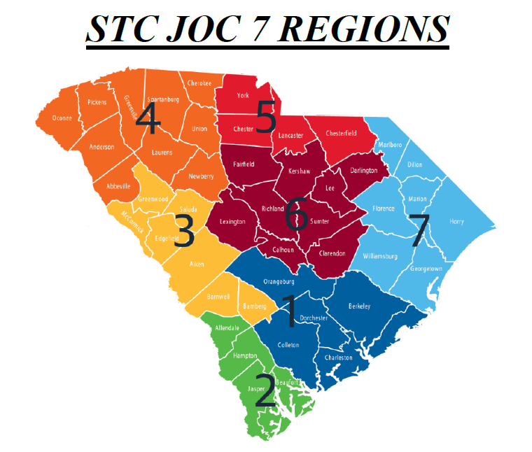
OSE Regions
Region 1 - Charleston, Colleton, Dorchester, Berkeley, & Orangeburg
Region 2 - Beaufort, Jasper, Hampton, & Allendale
Region 3 - Bamberg, Barnwell, Aiken, Edgefield, Saluda, McCormick, & Greenwood
Region 4 - Newberry, Union, Cherokee, Spartanburg, Laurens, Greenville, Abbeville, Anderson, Pickens, & Oconee
Region 5 - York, Chester, Lancaster, & Chesterfield
Region 6- Fairfield, Kershaw, Lee, Darlington, Richland, Sumter, Clarendon, Calhoun, & Lexington
Region 7 - Marlboro, Dillon, Marion, Horry, Florence, Williamsburg, & Georgetown

Slide 8
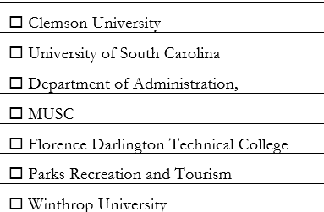
State Agencies

Slide 9
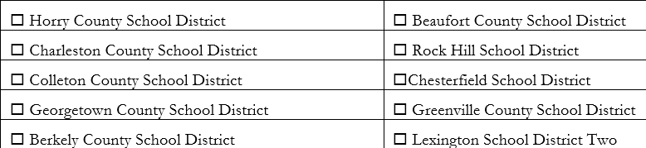
School Districts

Slide 10

Political Subdivisions

Slide 11
Unit Price Book
Cost Transparency and Controls - Unit Price Book (UPB) updated two times a year.
  Reflects current local cost for labor and materials
    Estimating Repair
    Renovation
    Maintenance Projects

Slide 12
Competitive Process
Faster Project Delivery – Competitive Bidding Process is already completed upfront.
Budget is more accurate
Transparency
Fairness
Notes:
The Competitive Process....
An RFP was completed for the JOC Administrator awarded to Gordian
Request for Qualifications was solicitated and currently being evaluated
Top 6 qualified vendors will receive the invite to participate in the Invitation for Bid
IFB will only award the 4 lowest coefficient

Slide 13
Example from Clemson
Coastal REC submitted minor project
Budget: $250,000
JOC Contractor
Quote: $423,023.87
Multiplier: 1.26
University Formal Solicitation
One Offer: $530,991.34
Over JOC Quote by $107,967.47

Slide 14
Why Use JOC?
Saves Time
Saves Money
Quality Contractors
Options to Choose From

Slide 15
Why Use JOC?
Saves Time
Saves Money
Quality Contractors
Options

Slide 16

Any Questions?

