Slide 1
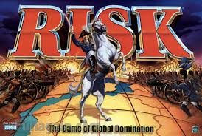
Risk

Slide 2
What is risk?
What’s the worst thing that can happen?

Slide 3
What is risk?
Risk = Exposure
Probability of Loss or Damage

Slide 4
Ways to Manage Risk
Accept it: Performance Obligations
Avoid it: Unacceptable or Catastrophic Risks
Abate it: Learn/Improve/Plan; QC/QM
Allocate it: Contract responsibilities
Finance it: Buy (or require) Insurance

Slide 5
Identify Risks
Assess Risks
Control Risks
Accept Risk
Administration
Communicate
Risk Finance
Purchased Insurance
What can happen, when, how, and why?
Identify existing controls
Determine level of risk
Avoid Risk
Transfer Risk
Reduce Risk
Implement
Monitor
Retained Risk/Deductible
Contractual Transfer
QC/QM

Slide 6
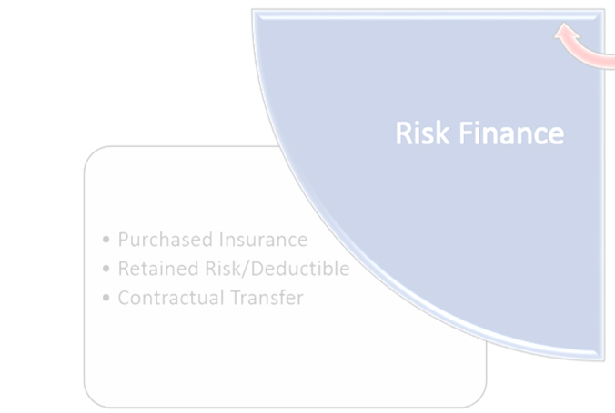
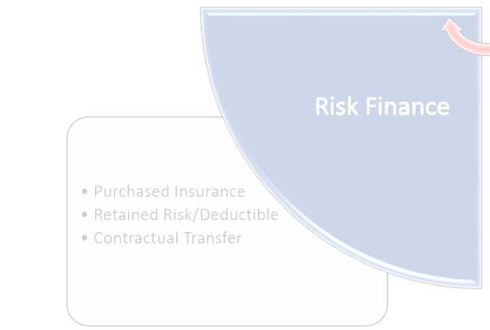
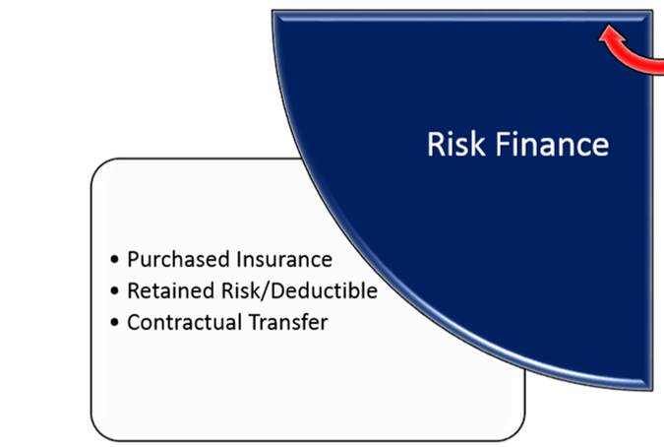
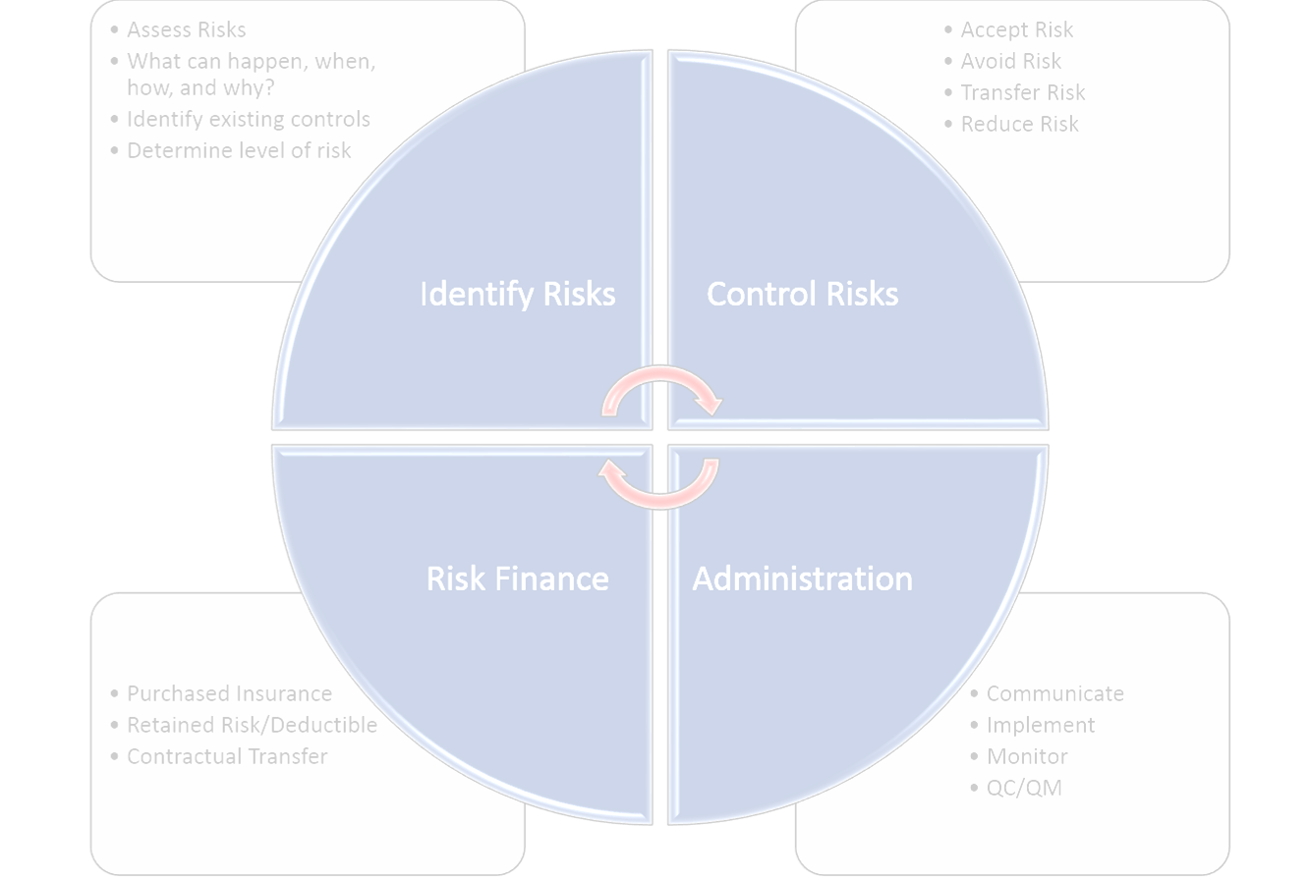
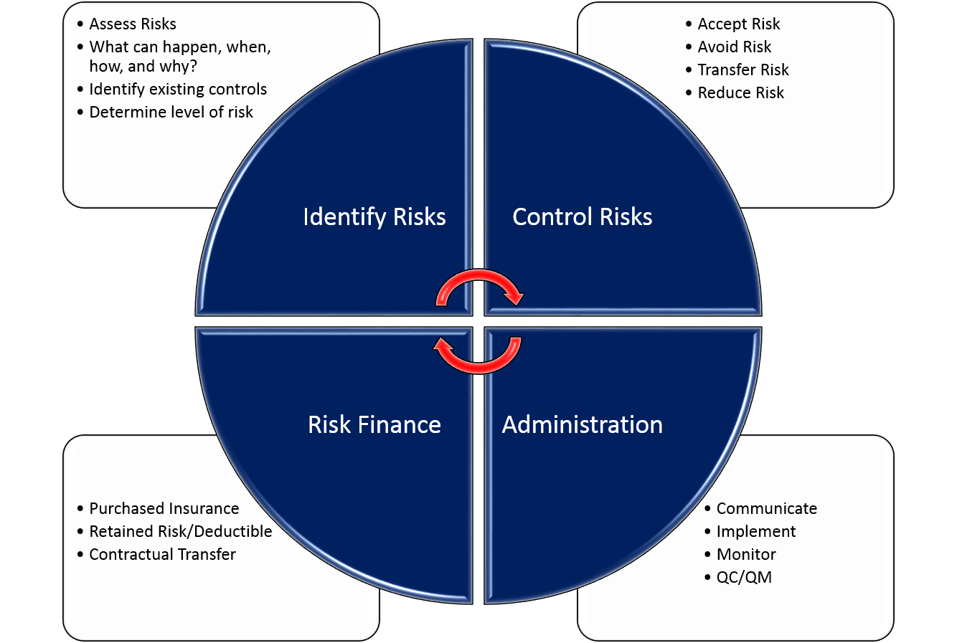


Slide 7
Insurance Types
Property
General Liability
Professional Liability
Workers Compensation and Employers Liability
Automobile

Slide 8
Property Insurance
Owner’s Property (Fire)
Builders Risk
Inland Marine
Installation Floaters

Slide 9
Builders Risk – The Good
Builder’s Risk
Construction contracts are indivisible
  Progress payments don’t excuse performance
  Obligation is to deliver completed building
Covers all parties’ interest in project: Owner, GC, subs
GC must purchase
  IRF can’t insure non-government interests
  Beware: only policy owner may be entitled to cancellation notice
Subrogation and claim waivers

Slide 10
Builders Risk – the Not-So-Good
Replacement cost only
No consequential damages
  See Owner’s Loss of Use Insurance
GC administers policy and claims
Accidental damage to boilers and equipment excluded
  See Boiler and Machinery Insurance
Coverage Terminates at Substantial Completion
  Must be replaced with Owner’s property insurance
  Value of completed building and FF&E exceeds contract price

Slide 11
Builders Risk – Do You Even Need It?
Site work
Renovation/Upfit work
  Damage to existing structure covered under Owner’s property insurance
Your policy doesn’t protect GC/subcontractor interest
In appropriate circumstances, Installation Floater may be enough

Slide 12
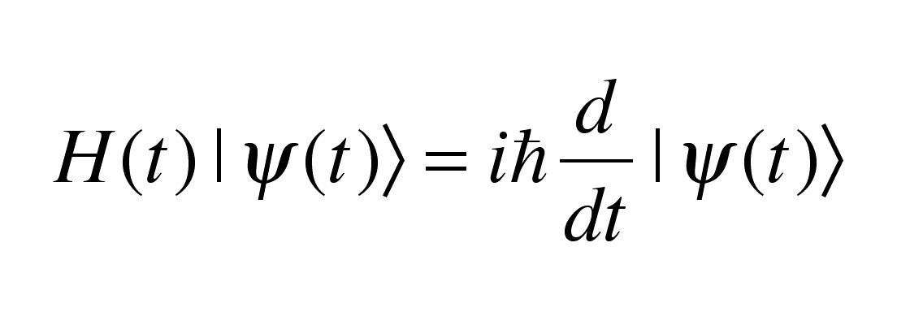
Builders Risk Limits

Slide 13
Liability Insurance – Policy Basis
Claims Made and Reported
Occurrence
Latent claims covered in later policy years
A/E may be gone-dead, retired, moved to Alaska
Can’t monitor if coverage maintained
Tail or extended reporting period
Different “triggers”
Multiple policies (and limits) may be triggered
Certificate “plus” will verify coverage
Rick, we’ll always have Paris

Slide 14
Commercial General Liability Insurance
Architects and contractors
  GC should require subcontractor policies
  Architects GL coverage not as broad
Almost always written on an occurrence basis
Contractual Liability: coverage for indemnity obligations
Exclusions-watch out!
Completed Operations: the gift that keeps on giving

Slide 15
CGL: What’s covered?
Bodily injury, sickness or death
Property Damage:
  Physical damage
  To Tangible Property
  Including loss of use
  AND loss of use of property not physically damaged
Exclusion: “your own work”
Except for completed operations

Slide 16
CGL: What triggers?
Accident
Property Damage: “continuous exposure to same generally harmful conditions”
Property Damage: “Manifestation?”
Completed operations

Slide 17
CGL: How much?
Sovereign Immunity
  $300,000 per claimant
  $600,000 per occurrence, regardless how many governmental units involved
Immunity doesn’t apply to GC, subs or A/E
Effectively caps their indemnity exposure

Slide 18
CGL: How much more?
What’s the worst that can happen?
  Sitework, isolated location
  Demolition/implosion downtown
Agency activities
  Research facility with limited access
  Active campus with curious students
Construction is almost always a “high risk” activity
You may be immune; doesn’t mean you won’t be sued

Slide 19
CGL: How much more (more)?
Defective construction
  Repair cost
  Diminished value
Bodily injury, sickness or death
Damage to other property
Difficult to value

Slide 20
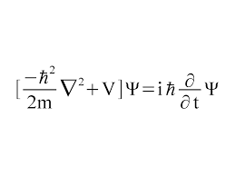
General Liability Limits

Slide 21
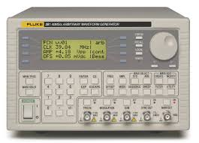
Limits Computer

