Slide 1
    OSE Facilities Directors Conference
    Santee
    October 15-17, 2025
    Deferred Maintenance & Alterations using the IEBC
    OSE Deputy to the State Engineer
    Clint Burdett

Slide 2

This is how I have always done it.

Slide 3
You have an existing building that needs alterations or additions or even a change of occupancy what do you do first.
IEBC
International Existing Building Code

Slide 4
The IEBC states multiple times don’t make your project any less compliant than it is today.
When ever you do a renovation take baby steps to make your project better to meet todays codes

Slide 5
IEBC
    OSE made a code table, Table 3E, What is your project?
      Alteration
      Addition
      Change of Occupancy

Slide 6
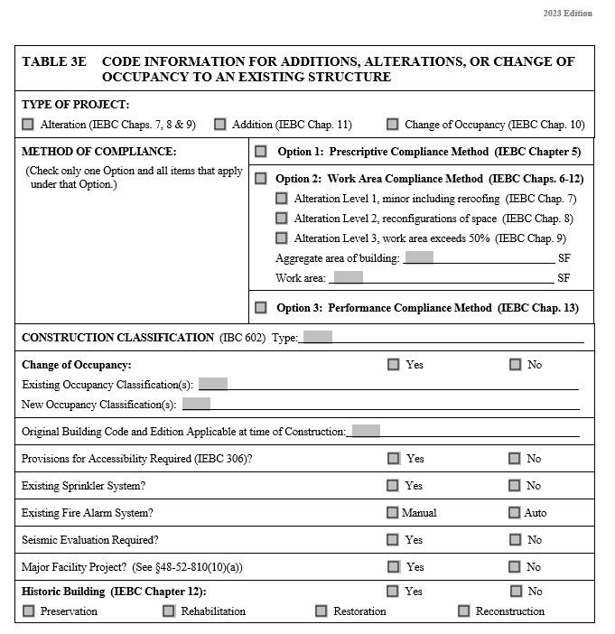
OSE Table 3E

Slide 7
Alteration
    Any CONSTRUCTION or RENOVATION TO AN EXISTING STRUCTURE
Addition
    An EXTENSION or INCREASE in floor area, number of stories, or height of a building.
Change of Occupancy
    A change in the USE of a building or portion of a building that results in any of the following.
      Change of Occupancy Classification
      Change from one group to another within an occupancy classification

Slide 8
After choosing which project type you then choose which Compliance Method:
  Prescriptive
  Work area
  Performance
  You can not mix and match methods, you must pick a method and follow the code requirements of that method

Slide 9
Option 1: Prescriptive Compliance Method Chapter 5 IEBC
    This method requires that alterations shall comply with the requirements of the IBC for new construction.
    The alteration shall not make the building less complying than the building was prior to the alteration.

Slide 10
Option 1: Prescriptive Compliance Method Chapter 5 IEBC
    Fire Resistance Ratings. Where applicable, this method allows for the reduction in fire resistance ratings of building elements with the addition of a fire sprinkler system.
    Exceptions
      Stairways and handrail extensions in stairways.

Slide 11
Proposed corridor extension

Slide 12
Option 2: Work Area Compliance Method Chapters 6-12 IEBC
    This method is based on a proportional approach to compliance where upgrades are triggered by the type and extent of the work. There are three levels of work.
      Alteration level 1
      Alteration level 2
      Alteration level 3

Slide 13
Option 2 work area compliance method
Alteration level 2 chpt 7 & 8
Alteration level 3 chpt 7-9
Alteration level 1 chpt 7

Slide 14
Alteration level 1
  Level 1 Alterations include the REMOVAL and REPLACEMENT or covering of existing materials, elements, equipment, or fixtures using new materials for the same purpose.
    Level 1 alterations shall comply with chapter 7 of the IEBC.
    In level 1 alterations an existing building shall not be altered such that the building becomes less safe than its existing condition.

Slide 15
Option 2 work area compliance method
Alteration level 2 chpt 7 & 8
Alteration level 3 chpt 7-9
Alteration level 1 chpt 7

Slide 16
Alteration level 2
  Level 2 Alterations include the RECONFIGURATION of space, the addition or elimination of any door or window, the reconfiguration or EXTENSION of any system or the installation of any ADDITIONAL equipment.
    Level 2 alterations shall comply with chapter 7 & 8 of the IEBC.

Slide 17
Option 2 work area compliance method
Alteration level 2 chpt 7 & 8
Alteration level 3 chpt 7-9
Alteration level 1 chpt 7

Slide 18
Alteration level 3
  Level 3 Alterations include the RECONFIGURATION of space where the work area exceeds 50% of the building area.
  Level 3 alterations shall comply with chapter 7, 8 & 9 of the IEBC.
  Work areas can be tricky, most of the time A/E’s define them incorrectly. If only a wall and a door in a room are being altered, only 3’ on both sides is considered the work area not the entire room.

Slide 19
Option 3: Performance Compliance Method Chapter 13 IEBC
    This section is based on an evaluation process that includes a numerical scoring system involving various safety issues and the degree of code compliance for each issue.
    A performance code requires that the building as a whole performs to a certain standard.
    This option is very difficult to apply. I have not seen this option used.

Slide 20
Additions Chapters 11 IEBC
    An addition is an extension or increase in the floor area, number of stories, or height of a building.
    An addition to a building shall comply with the IBC for new construction.
    The main question is the attached wall.

Slide 21
Change of Occupancy Chapters 10 IEBC
    A change in the use of a building. A change of occupancy shall include a change of occupancy classification or a change from one group to another within the same classification.
    An alteration that includes a Change of Occupancy must be brought up to meet the code requirements of the IBC for the new occupancy.

Slide 22
Historic Buildings Chapters 12 IEBC
    They must go thru a process with the State Historic Preservation Office (SHPO).
    The agency and A/E should prepare a plan of action for the treatment of historic properties using one of the following:
      Preservation
      Rehabilitation
      Restoration
      Reconstruction

Slide 23
Accessibility for Existing Buildings section 305.
    A facility that is altered shall comply with the IBC unless technically infeasible.

Slide 24
Alterations on a Primary Function
    Accessibility is required if alterations are on a primary function.
    Exceptions
      Alterations not on a primary function
      Not exceed 20% of the costs.
      Windows, hardware, controls, electrical, mechanical, fire protection alterations only do not require accessibility requirements.
      Entrances not on a primary function

Slide 25
Toilet Rooms
    Toilet rooms on a primary function shall be accessible unless technically infeasible.
      If technically infeasible then an accessible family or assisted use toilet is permitted in accordance with IBC.

Slide 26
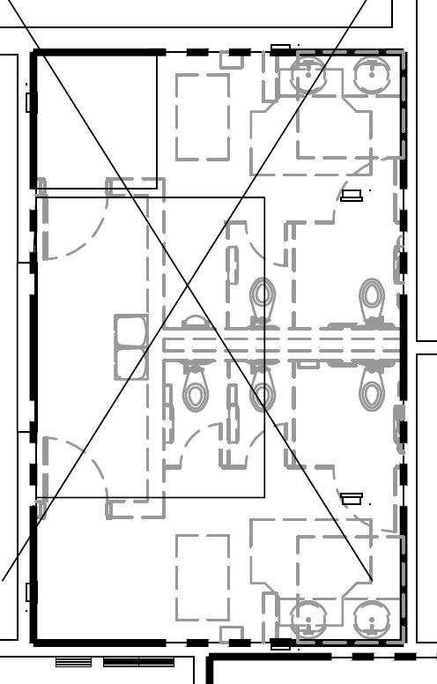
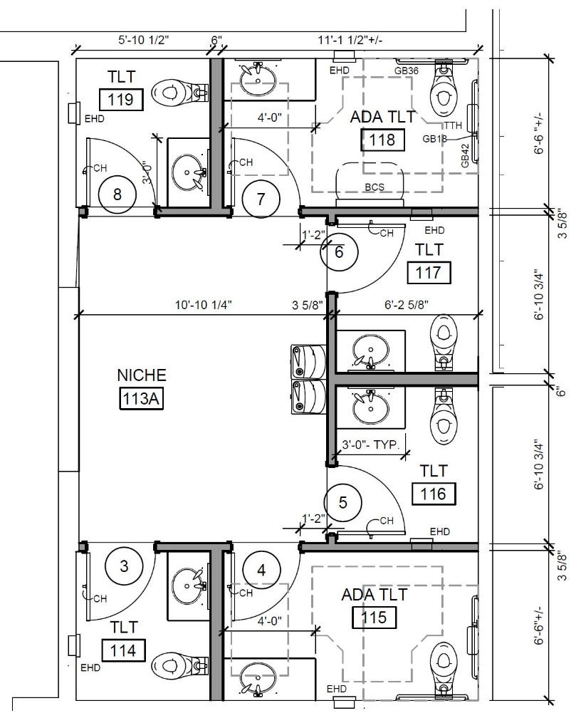
Before
After

Slide 28
What is wrong with this picture?

Slide 29
What is wrong with this picture?

Slide 30
What is wrong with this picture?

Slide 31
What is wrong with this picture?

Slide 32
What is wrong with this picture?

Slide 33
Interesting urinal

Slide 34
Interesting signage

