Slide 1
PROCUREMENT CODE UPDATES
2019 Act 41
John St. C. White, PE
Materials Management Officer

Slide 2
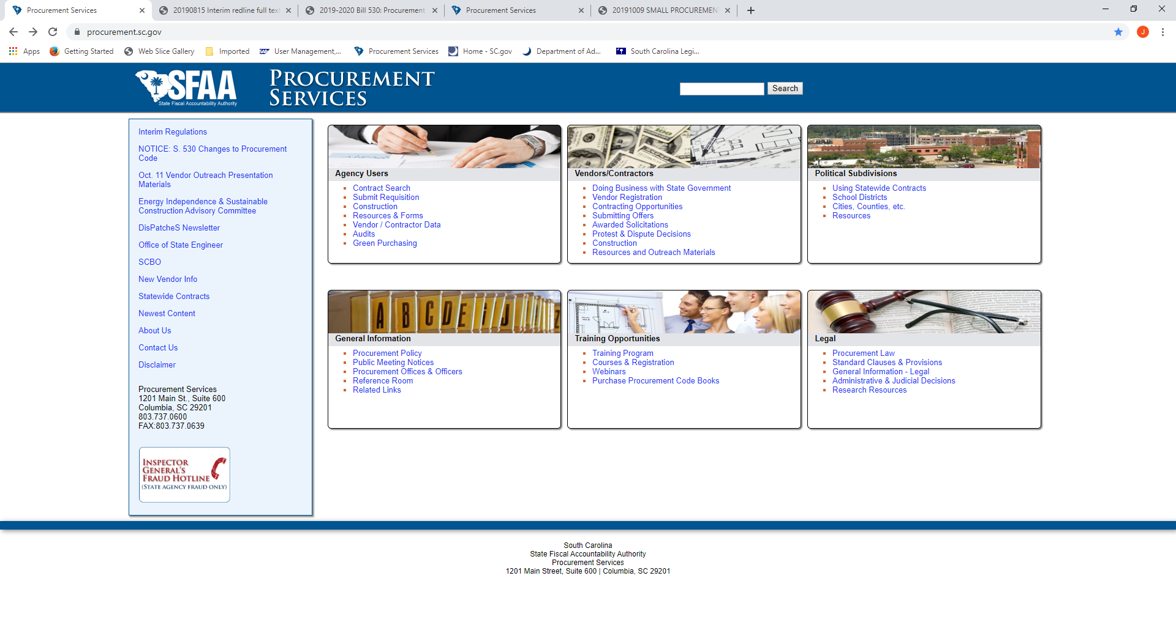

Slide 3
Definitions
§11-35-310
Business Day
Day
Public Funds
Notes:
‘Public funds’ means any money or property owned by the 14 State or a political subdivision thereof, regardless of form and 15 whether in specie or otherwise

Slide 4
Public Access to Public Information
§11-35-410
No Award – Reg. 19-445.2045(C)
Confidential Information in a Solicitation – Reg. 19-445.2010(I)
5 Days to respond to FOIA received
  During Protest Period
  From someone with right to protest award
Notes:
How to handle open and unopened bids/proposals – Dispose of unopened bids

Slide 5
Exemptions
§11-35-710
Acquisition of Construction by Eleemosynary Corporation with Conditions
  See §11-35-40(4)

Slide 6
Procurement Authority/Certification
§11-35-1210
Base Authority
Division Director Authority to Certify – Reg. 19-445.2020(B)

Slide 7
Competitive Negotiations
§11-35-1535
Reg 19-445.2099

Slide 8
Sole Source Procurement
§11-35-1560
Advertising
Notes:
Justification for Brand Name Specification – MMO#139

Slide 9
Emergency Procurement
§11-35-1570
Advertising

Slide 10
New §11-35-2050
Contract term requiring state to indemnify is void ab-initio
All contracts must be governed by SC law
Exclusive venue for any dispute is in SC
Contract with terms and conditions contrary to forgoing is enforceable as if it did not contain such terms and conditions

Slide 11
Competitive Sealed Bidding – Construction
§11-35-3020
Subcontractor Listing

Slide 12
Bid Security
§11-35-3030

Slide 13
Right to Protest Award
§11-35-4210

